Slide 1
WELCOME

Slide 2
Teacher introduce
Shibani Rani
Assistant teacher
Dhadash Government Primary school
Puthia, Rajshahi

Slide 3
Lesson introduce
Subject: English
Class:1
Lesson:Alphabet (unit6)

Slide 4
Lesson title
Alphabet
Lessons 4-6

Slide 5
Learning Outcomes:
Students will be able to……..
Listening:
1.1.1 become fimilar with English sounds by listening to common English works.
Speaking:
1.1.1 repeat after the teacher simple words and phrases
Reading:
1.2.1 recognize and read the alphabet both small and capital.
( non- cursive)
Writing:
1.1.1 to practice letter shapes/ simple writing patterns, etc.

Slide 6
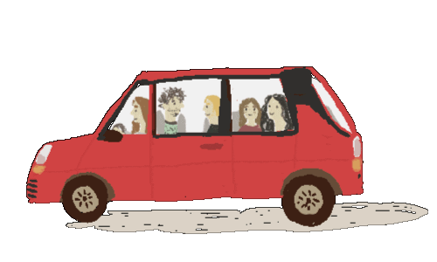
Lets see vedio
E e

Slide 7
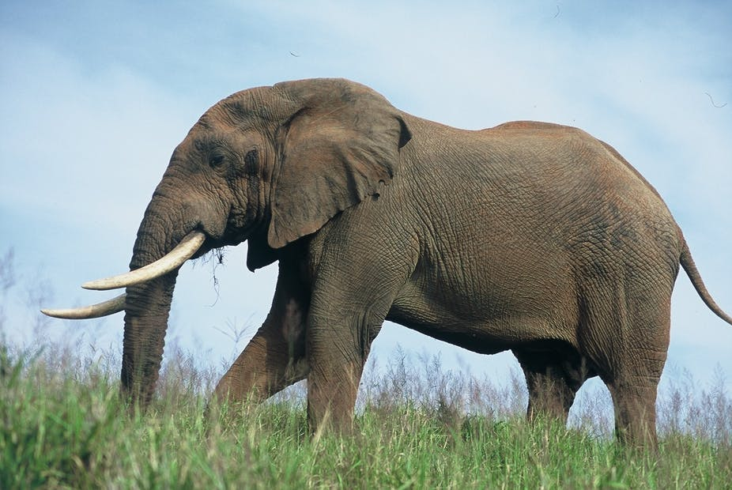
Alphabet
Look and say
E
Elephant

Slide 8
Alphabet
Look and say
elephant
e

Slide 9
Alphabet
Look and say
E
Egg

Slide 10
Alphabet
Look and say
e
egg

Slide 11
Alphabet
Look and say
Elephant
elephant

Slide 12
Alphabet
Look and say
Egg
egg

Slide 13
E
Capital letter
Small letter
e

Slide 14
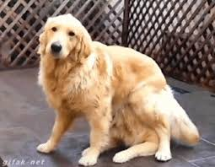
Say and mtach the pictures with first letters.
Pair work
Elephant
dog

Slide 15
WCW
Students say and read. Trace and air.

Slide 16
Students say and read. Trace and Write.
I W
E
E
E
E
E
e
e
e
e
e

Slide 17
Evaluation
e
e
e
e
a
e
e
a
e
e

Slide 18
Good Bye

