Slide 2
Todays Lesson
Voice

Slide 3
Voice
Voice is the way of expressing verbs which describes whether the subject does the work or it has been done by the subject.
Types of Voice:
1. Active voice
2. Passive voice

Slide 4
Active voice:
The sentence in which the subject does the work by himself actively in that sentence the verb has an active voice.
Sentence Structure:
Subject + Verb + Object
Example:
I write articles.

Slide 5
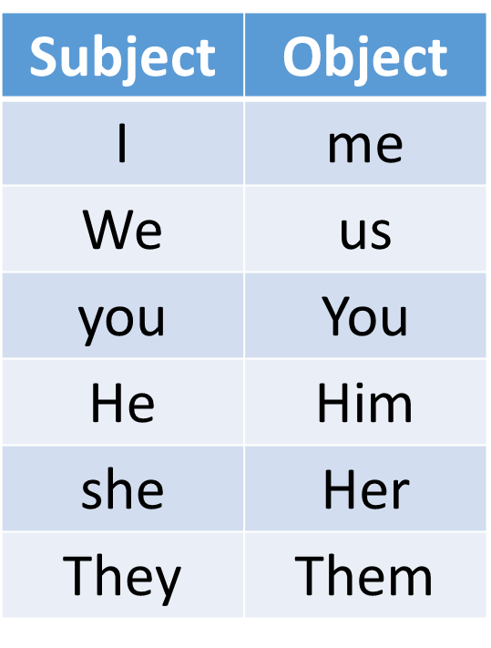
Passive voice:
The sentence in which the subject does not do the work by himself actively rather the object’s work is done by the subject in that sentence the verb has passive voice.
Sentence Structure:
Object + be verb+ verb’s past participle + by+ subject
Example:
Articles are written by me.

Slide 6
Rules of Voice from active to passive :
Rule 1:
Active voice’s subject is changed to passive voice’s object.
b. Active voice’s object is changed to passive voice’s subject.
c. Main verb’s past participle is used, and auxiliary verb/ be verb is chosen according to subject and tense.
Example:
I write poems. (Active)
Poems are written by me. (Passive)

Slide 7
Ruule 2:
⇒Structure of Indefinite tense-
a. Present- Object’s subject+ am/is/are+ Verb’s past participle+ by+ subject’s object
Example:
She praises me. (Active)
I am praised by her. (Passive)
I praise her. (Active)
She is praised by me. (Passive)
b. Past- Object’s subject+ was/were+ Verb’s past participle+ by+ subject’s object
Example:
She praised me. (Active)
I was praised by her. (Passive)
She praised them. (Active)
They were praised by her. (Passive)

Slide 8
c. Future- Object’s subject+ shall be/will be+ Verb’s past participle+ by+ subject’s object
Example:
She will praise me. (Active)
I shall be praised by her. (Passive)
She will praise him. (Active)
He will be praised by her. (Passive)
Active | Passive
Present Indefinite | Am/is/are
Past Indefinite | Was/were
Future Indefinite | Shall be/will be

Slide 9
⇒Structure of continuous tense-
a. Present- Object’s subject+ am being/is being/are being+ Verb’s past participle+ by+ subject’s object
Example:
She is praising me. (Active)
I am being praised by her. (Passive)
She is praising him. (Active)
He is being praised by her. (Passive)
She is praising them. (Active)
They are being praised by her. (Passive)
b. Past- Object’s subject+ was being/ were being+ Verb’s past participle+ by+ subject’s object
Example:
She was praising me. (Active)
I was being praised by her.
She was praising them. (Active)
They were being praised by her.

Slide 10
c. Future- Object’s subject+ shall be being/will be being+ Verb’s past participle+ by+ subject’s object
Example:
She will be praising me. (Active)
I shall be being praised by her. (Passive)
She will be praising them. (Active)
They will be being praised by her. (Passive)
Active | Passive
Present continuous | Am being/is being/are being
Past continuous | Was being/were being
Future continuous | Shall be being/will be being

Slide 11
⇒Structure of perfect tense-
a. Present- Object’s subject+ has been/ have been+ Verb’s past participle+ by+ subject’s object
Example:
She has praised him. (Active)
He has been praised by her. (Passive)
She has praised me. (Active)
I have been praised by her. (Passive)
b. Past- Object’s subject+ had been+ Verb’s past participle+ by+ subject’s object
Example:
She had praised me. (Active)
I had been praised by her. (Passive)
c. Future- Object’s subject+ shall have been/ will have been+ Verb’s past participle+ by+ subject’s object
Example:
She will have praised me. (Active)
I shall have been praised by her. (Passive)
She will have praised him. (Active)
He will have been praised by her. (Passive)

Slide 12
c. Future- Object’s subject+ shall have been/ will have been+ Verb’s past participle+ by+ subject’s object
Example:
She will have praised me. (Active)
I shall have been praised by her. (Passive)
She will have praised him. (Active)
He will have been praised by her. (Passive)
Active | Passive
Present perfect | Have been/has been
Past perfect | Had been
Future perfect | Shall have been/will have been

Slide 13
Active | Passive
Present perfect continuous | Have been being/has been being
Past perfect continuous | Had been being
Future perfect continuous | Shall have been being/will have been

Slide 14
Rule 3:
Object’s subject+ may/might/can/could/ must/ought to/going to+ be+ Verb’s past participle+ by+ subject’s object
Example:
You must write the poem. (Active)
The poem must be written by you. (Passive)
She may help you. (Active)
You may be helped by her. (Passive)
We ought to obey our parents. (Active)
Our parents ought to be obeyed by us. (Passive)
We are going to organize a party. (Active)
A party is going to be organized by us. (Passive)
Active | Passive
must | must be
may | May be
Ought to | Ought to be
can | Can be
could | Could be
might | Might be
should | Should be
Going to | Going to be

Slide 15
Rule 4:
For Imperative sentence :
a. If the sentence begins with Main verb:
Let+ Object’s subject + be+ verb’s past participle+(by you)
Example:
Write the article. (Active)
Let the article be written. (Passive)
Prepare the assignment. (Active)
Let the assignment be prepared. (Passive)
b. If the sentence begins with “Do not”
Let not + Object’s subject + be+ verb’s past participle
Example:
Do not write the article. (Active)
Let not the article be written. (Passive)
Do not prepare the assignment. (Active)
Let not the assignment be prepared. (Passive)

Slide 16
c. If the sentence begins with “Let”
Let+ Object’s subject + be + verb’s past participle+ personal object
Example:
Let me write the article. (Active)
Let the article be written by me. (Passive)
Let him write the letter. (Active)
Let the letter be written by him. (Passive)
d. If the sentence begins with “Never”
Let not + Object’s subject + ever be + verb’s past participle
Example:
Never deceive anyone. (Active)
Let not anyone ever be deceived. (Passive)
Never go there. (Active)
Let not there ever be gone. (Passive)

Slide 17
If the sentence begins with “main verb + object”
Let+ direct object + be+ verb’s past participle + for + personal object
Example:
Give me a pencil. (Active)
Let a pencil be given for me. (Passive)
Give me an eraser. (Active)
Let an eraser be given for me. (Passive)
Give me a pencil.
Personal object.
Direct object.

Slide 18
Thanks to all

