Slide 1
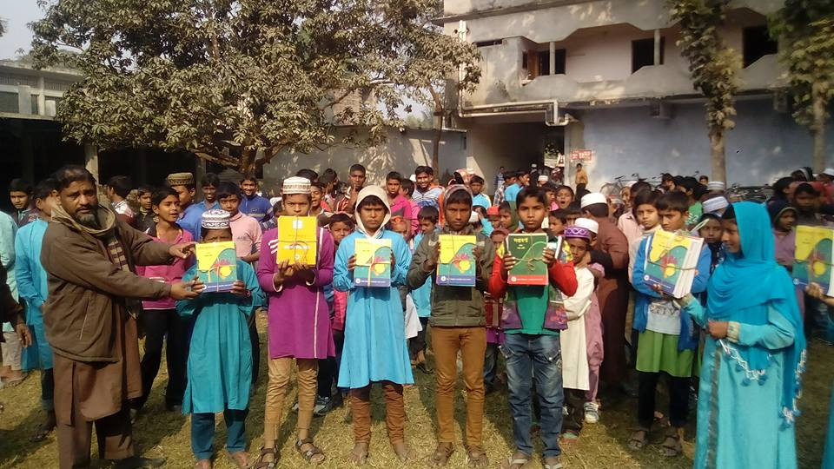
Welcome to
Zoom Online Class
Abul Kalam Azad(Assistant Teacher)
Satrajitpur Fazil Madrasah
Shibganj, Chapainawabganj

Slide 2
Question Tag Practice
Contracted form of Negative Tags
Am not | Aren’t
Is not | Isn't
Are not | Aren’t
Was not | Wasn’t
were not | Weren’t
Have not | Haven’t
Has not | Hasn’t
Had not | Hadn’t
Shall not | Shan’t
Will not | Won’t
Can not | Can’t
Could not | Couldn’t
should not | Shouldn’t
Must not | Mustn’t
might not | Mightn’t
do not | Don’t
does not | Doesn't
did not | Didn't

Slide 3
Question Tag Practice
We may fail at first.
We must take care of our health.
Bangladesh is a democratic country.
‘I’ is a vowel.
The rich are not always happy.
Raya told me the matter.
Most of you know French.
If you come, I will go.
He said that he would do the work.
Let him do the work.

Slide 4
Question Tag Practice
We may fail at first, mayn’t we?
We must take care of our health, mustn’t we?
Bangladesh is a democratic country, isn’t she?
‘I’ is a vowel, isn’t it?
The rich are not always happy, are they?
Raya told me the matter, didn’t she?
Most of you know French, don’t you?
If you come, I will go, won’t I?
He said that he would do the work, didn’t he?
Let him do the work, will you?

Slide 5
Question Tag Practice
They used to play football.
He as well as his friends has done the work.
Jack is short but his brother is tall.
The earth is round.
One should do one’s duty.
It has hardly rained at this summer.
Don’t boil rice.
Kindly, do me a favor.
Nobody phoned.
No, I don’t believe this. You know he is very honest.

Slide 6
Question Tag Practice
They used to play football, didn’t they?
He as well as his friends has done the work, hasn’t he?
Jack is short but his brother is tall, isn’t he?
The earth is round, isn’t she?
One should do one’s duty, shouldn’t he?
It has hardly rained at this summer, has it?
Don’t boil rice, will you?
Kindly, do me a favor, would you?
Nobody phoned, did they?
No, I don’t believe this. You know he is very honest, isn’t he?

Slide 7
Question Tag Practice
Neither of them went.
Cricket is a very exciting game.
People of all ages enjoy the game.
At present cricket is the most popular game in our country.
People of all classes enjoy playing it.
Bangladesh is a test playing country but its standard is not high.
Patriotism inspires a man to shed last drop of blood to defend the freedom of his country.
A true patriot is honored by all.
Unfair means in the examination is an offence.
It degrades the standard of education.

Slide 8
Question Tag Practice
Neither of them went, did they?
Cricket is a very exciting game, isn’t it?
People of all ages enjoy the game, don’t they?
At present cricket is the most popular game in our country, isn’t it?
People of all classes enjoy playing it, don’t they?
Bangladesh is a test playing country but its standard is not high, isn’t it?
Patriotism inspires a man to shed last drop of blood to defend the freedom of his country, doesn’t it?
A true patriot is honored by all, isn’t he?
Unfair means in the examination is an offence, isn’t it?
It degrades the standard of education, doesn’t it?

Slide 9
Question Tag Practice
An educated man cannot support unfair means in the examination at all.
Bangladesh is a land of rivers.
They’d gone to Chottogram.
I’d meet you.
Sabina was sleeping.
How sweetly the bird sings.
Don’t forget me.
Let’s do the work.
Let them do their work.
They will not go to school.

Slide 10
Question Tag Practice
An educated man cannot support unfair means in the examination at all, can he?
Bangladesh is a land of rivers, isn’t she?
They’d gone to Chottogram, hadn’t they?
I’d meet you, wouldn’t I?
Sabina was sleeping, wasn’t she?
How sweetly the bird sings, doesn’t it?
Don’t forget me, will you?
Let’s do the work, shall we?
Let them do their work, will you?
They will not go to school, will they?

Slide 11
Question Tag Practice
He has not done the work.
The boy does not play.
I don’t need any help from you.
The girl does not need any tutor.
You needed a blanket.
All of us attended the meeting.
There were many problem.
Some of you can speak well.
She had a pen.
You should obey your teachers.

Slide 12
Question Tag Practice
He has not done the work, has he?
The boy does not play, does he?
I don’t need any help from you, do I?
The girl does not need any tutor, does she?
You needed a blanket, didn’t you?
All of us attended the meeting, didn’t we?
There were many problem, weren’t there?
Some of you can speak well, can’t you?
She had a pen, didn’t she?
You should obey your teachers, shouldn’t you?

Slide 13
Thank you

