Slide 1
WELCOME TO MY ENGLISH CLASS

Slide 2
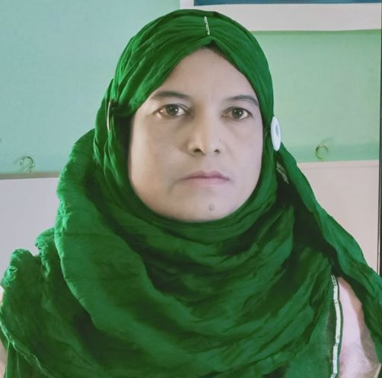
Presented by
Mst. Hosneara Parvin
Head Teacher
Sholotaka Gps.
Gangni, Meherpur.

Slide 3
Lesson Identity:
Class: Two
Subject: English
Time: 45 minute

Slide 4
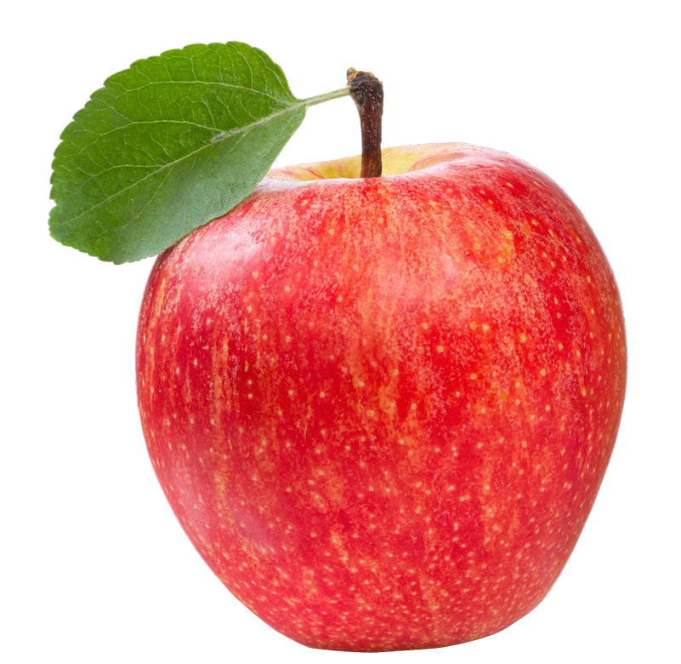
What are these?
These are apples

Slide 5
What is this?
This is a tray.

Slide 6
What can you see in the picture?
How many apples are there?
There are 4 apples.

Slide 7
Today’s Lesson
How many………?
Unit-8

Slide 8
Learning Outcomes: Students will be able to
Listening:
3.1.2 Understanding simple questions and statements about familiar objects.
Speaking:
3.1.2 ask and questions about familiar objects.

Slide 9
How many apples are there?
There are 4 apples.
There are 3 apples.

Slide 10
How many apples?
There are 5 apples

Slide 11
How many apples?
There are 6 apples.

Slide 12
Look and say.
Individual work.
How many apples?
There are 6 apples.

Slide 13
Open your book at page no. 17

Slide 14
Count and say.
How many dolls?
There are 6 dolls.

Slide 15
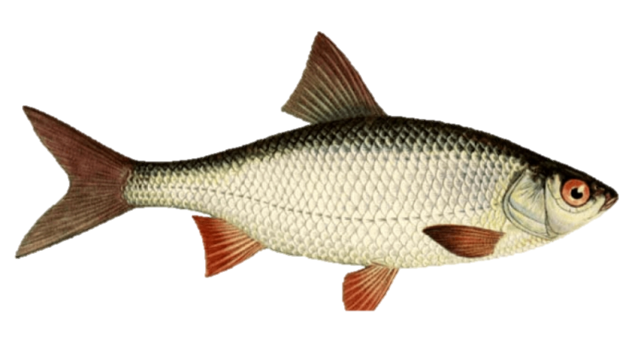
Count and say.
How many fishes?
There are 7 fishes.

Slide 16
Count and say.
How many bats?
There are 8 bats.

Slide 17
Count and say.
Pairwork
How many dolls?
How many bats?
There are 8 bats.
There are 6 dolls.

Slide 18
Count and say.
Pairwork
There are 7 fishes.
There are 6 fishes.
How many fishes?
How many fishes?

Slide 19
Count and say.
Evaluation.
How many mangoes?
There are 7 mangoes.
There are 9 mangoes.
There are 5 mangoes.

Slide 20
HOMEWORK
Look at everything in your house. Ask and answer with “ How many…………?

Slide 21
Bye Bye !

