Slide 1
Welcome everybody to my class
Good Morning

Slide 2
Introduction
Md. Jahangir Alam
Assistant Head Teacher
Durgapur High School
Aditmari, Lalmonirhat.

Slide 3
English First Paper
Class: 8
Time:50 minutes

Slide 4
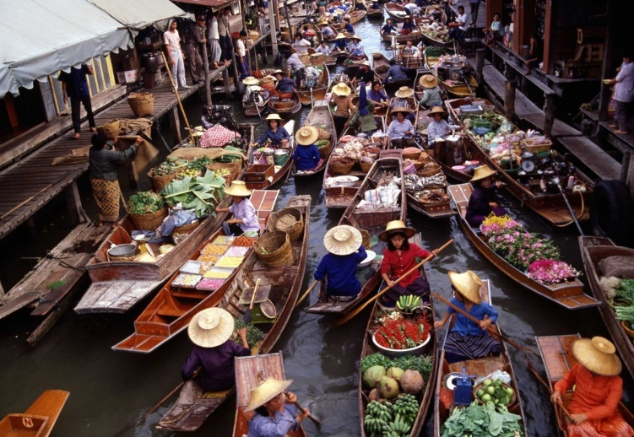
Let’s see the pictures…
Picture 1

Slide 5
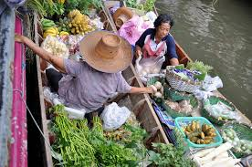
What is this picture about?
Picture 2

Slide 6
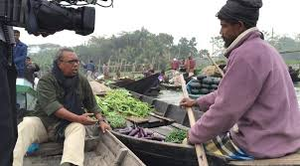
Our today’s lesson is
The The Kha Floating Market Unit: 6
Lesson : 9 Period: 1st

Slide 7
Outcomes of the lesson
Students will be able to --
1. read and comprehend the text
2. talk about the floating market
3. Summarize the information in the text 4. ask and answer questions on floating market

Slide 8
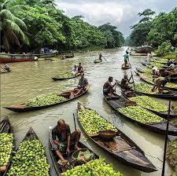
New Word: Laden (Adj.) heavily loaded The boats were laden with fruits and vegetables.

Slide 9
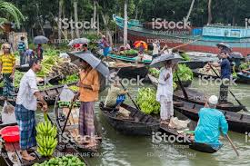
New Word: Chit-chat (Noun) Talk about trivial matters They were having a chit chat.

Slide 10
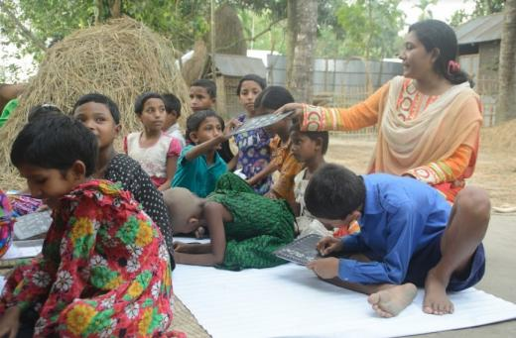
New Word: Native (Adj.) belonging to a particular place by birth. We are the native speakers of Bangla.

Slide 11
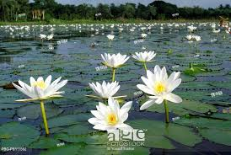
New Word: Lotus (Noun) One kind of watery flower Lotus is our national flower.

Slide 12
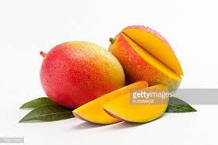
New Word: Delicious (Adj.) pleasing, especially to the taste Mango is a delicious fruit.

Slide 13
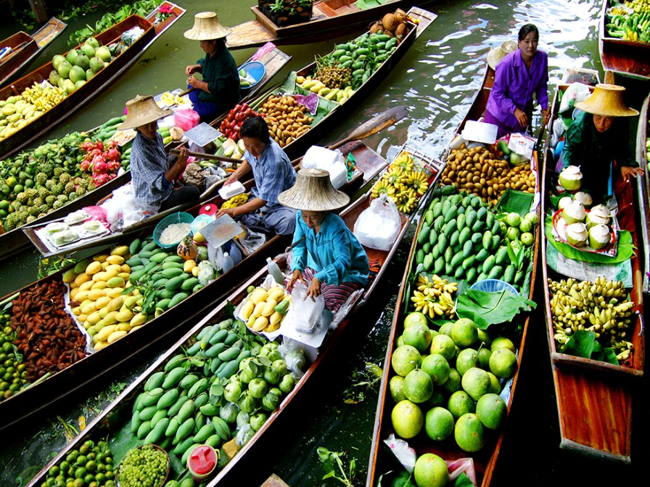
What kind of market was it?
Why did the boatman row slowly?
Who were selling goods? How were they selling their goods?
Group Work

Slide 14
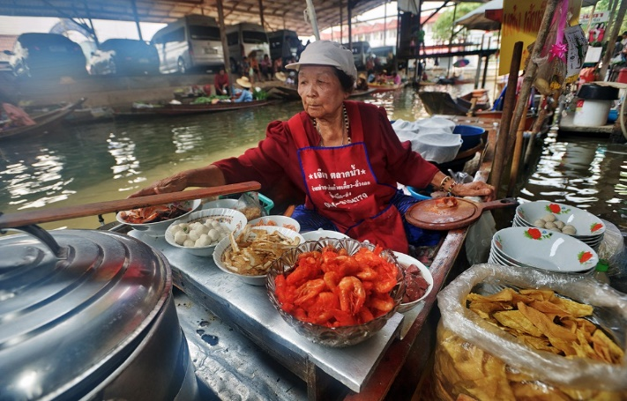
It was a floating market
The boatman rowed slowly so that they could enjoy the buying and selling activities in the market.
The elderly Thai women were mainly selling goods. They displayed their goods on the boats and the buyers chose their pick. They were also having a little chit-chat as buying and selling was going on.
Answers

Slide 15
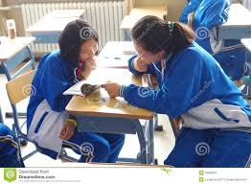
What was the atmosphere at the market?
What were they selling?
Answers:
They were selling lotus flowers, farm-fresh coconuts, fruits, vegetables, local food, and delicious sweets.
The atmosphere at the market was very nice and enjoyable.
Pair Work

Slide 16
Write a synonym of the following words.
Elderly,
Market
Hire
delicious
Evaluation

Slide 17
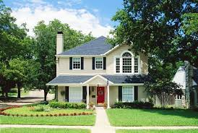
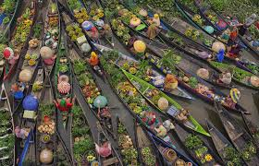
Write a paragraph on ‘The Tha Kha Floating Market’
Homework

Slide 18
Thank You all.

