Slide 1
WELCOME

Slide 2
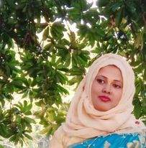
Teacher’s Introduction
Mst.Sharmin Akter
Assistant teacher
Matoin Govt. Primary School Hajigonj, Chandpur.
E-mail: mstsharminakter1985@gmail.com

Slide 3
Lesson Identity
Class : Two
Subject : English
Lesson :4-6 (A)
Unit:11
Time : 40 min
A
s
h

Slide 4
Student’s will be able to-
Listening:1.1.1 become familiar with English sounds by listening to common English words.
Speaking:1.1.2 repeat after the teacher simple words and phrases with proper sounds and stress.
Reading:1.4.1 read words and phrases with the help of visual clues(about 30 new words) and simple sentences.

Slide 5
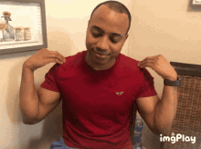
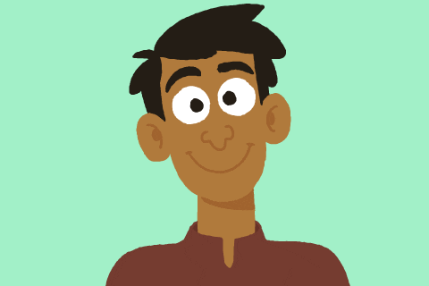
Look at the picture.
what can you see in the picture ?
We can see here two parts of our body.
head
shoulder

Slide 6
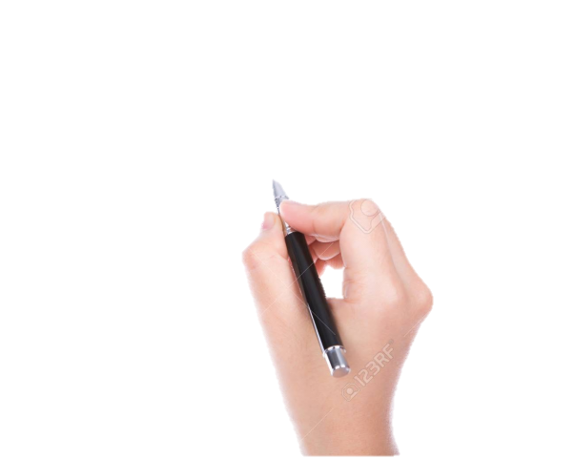
Todays lesson is
Parts of the body

Slide 7
finger
teeth
New word
leg
hand
hair

Slide 8
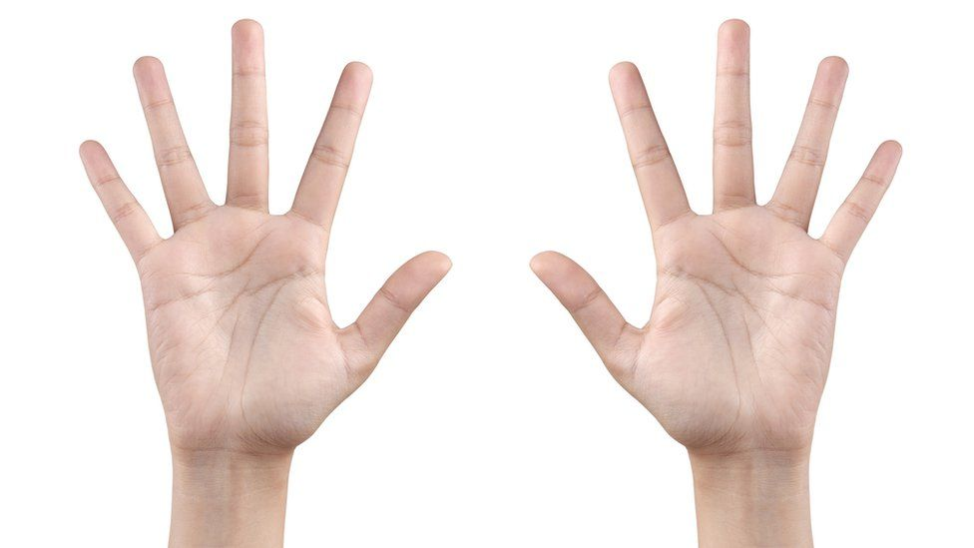
finger
Jointed parts of hand

Slide 9
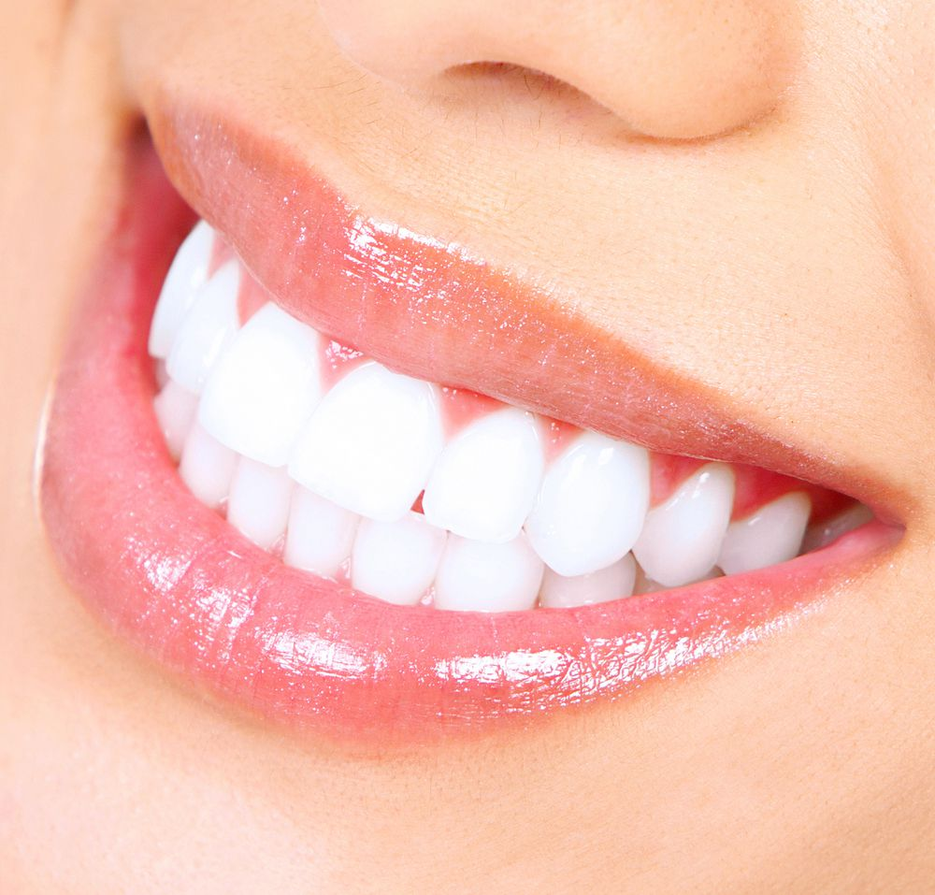
teeth
tooth

Slide 10
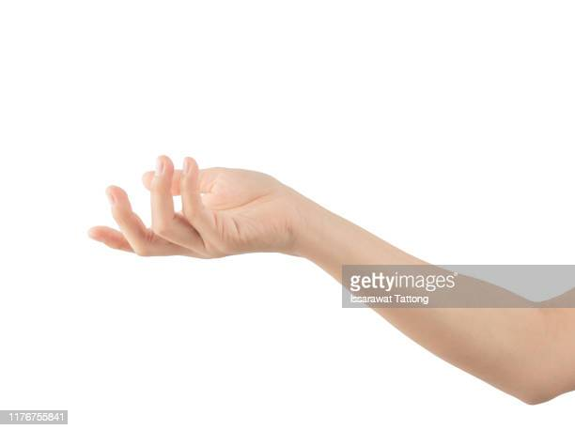
hand
arm

Slide 11
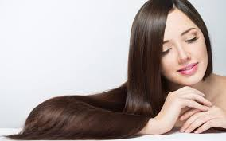
hair collectively those growing on a persons head
hair

Slide 12
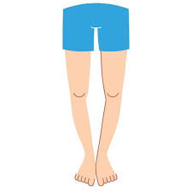
leg
foot

Slide 13
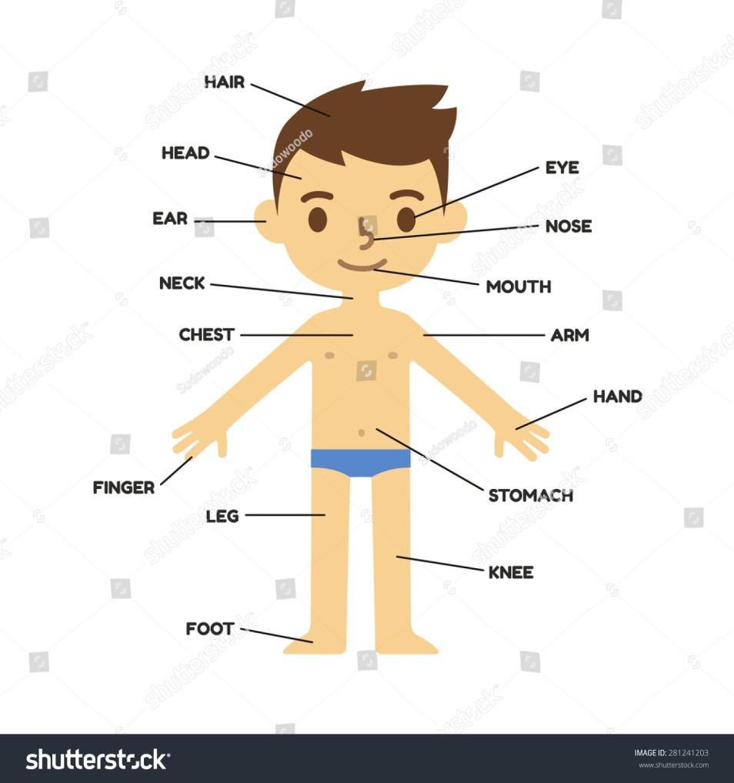
Teacher demonstrate body part in his /her body and students follow

Slide 14
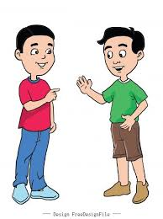
Student do the activities in pair.

Slide 15
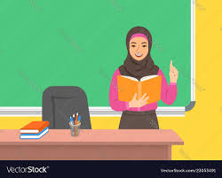
Teacher’s Reading
Open at page 23.

Slide 16
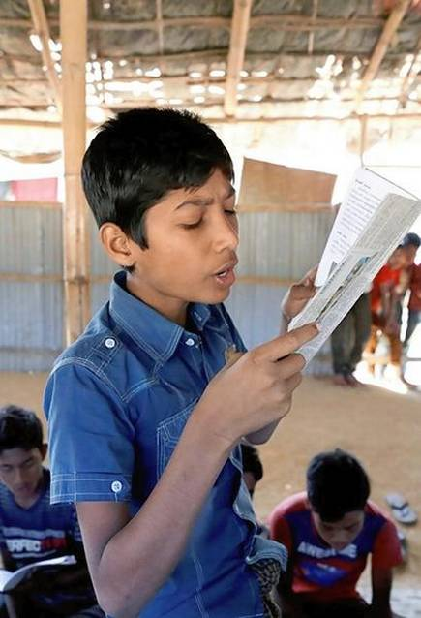
Student’s reading

Slide 17
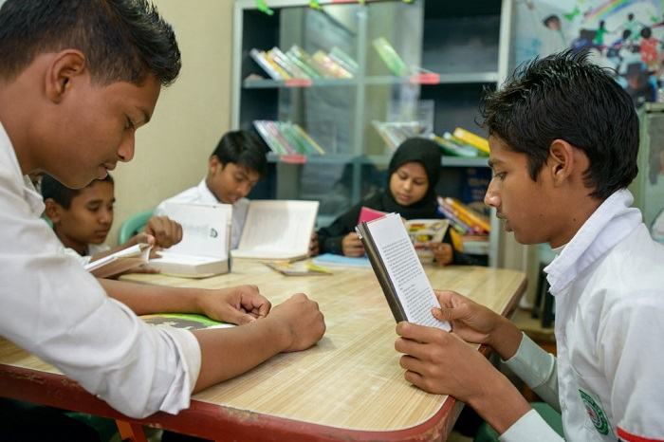
Group reading

Slide 18
Read in pair

Slide 19
