Slide 1
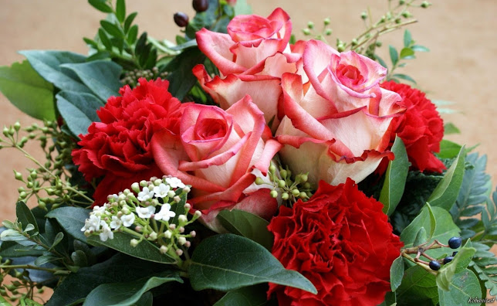
WELCOME

Slide 2
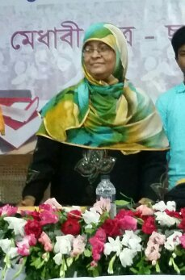
TEACHER’S IDENTITY
Mushfika Ferdausee
Asst.Head Teacher
Patgudam High School,Mymensingh
E-mail-mushfika1972@gmail.com

Slide 3
INTRODUCTION
CLASS: IX
SUBJECT: ENGLISH 1st PAPER
UNIT: 03
LESSON: 06
TIME: 50 MINUTES
DATE:23/02/2021

Slide 4
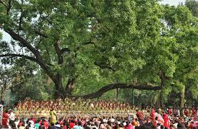
Ask and answer the question
1.Can you name the twelve months of Bangla year?
2.What is the first months of Bangla year?
3.What is the the first day called?
4.What is the picture about?
5.Where do you think the picture was taken?
6.What are the people doing?

Slide 5
Our Todays Lesson

Slide 6
Learning Outcomes
By the end of the lesson learners will be able to: .Talk about festivals.
Read text and know new words.
Ask and answer questions.
Use suitable words in the blanks.
Describe a festival.

Slide 7
Vocabulary
Inspiration
Encouragement,Motivation
Irrespective
Regardless
Procession
Parade,Rally
Renowned
Famous, Great
Significance
Importance,Exclusive
Supplement
Addition, Complement

Slide 8
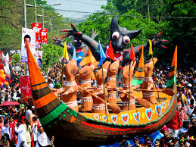
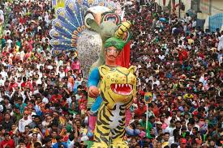
People from all walks of life,irrespective of their ethnic identity or religious beliefs,celebrate the day with traditional festivities.

Slide 9
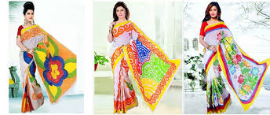
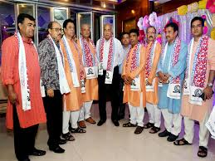
Women wear sharee and men dress themselves in Pajamas and Punjabis.

Slide 10
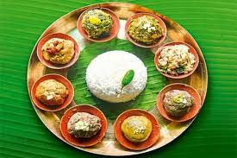
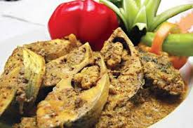
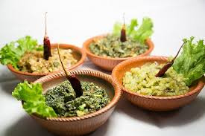
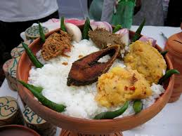
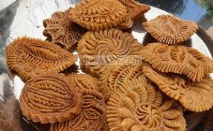
It is a day when people love eating traditional food.

Slide 11
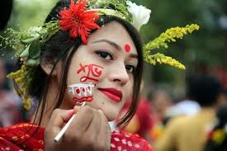
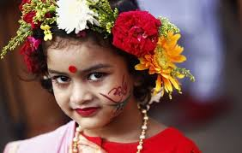
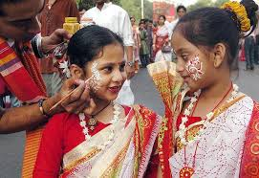
Girl’s adorn themselves with colourful naksha,churis and flowers..

Slide 12
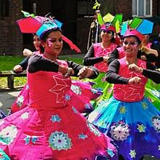
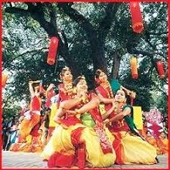
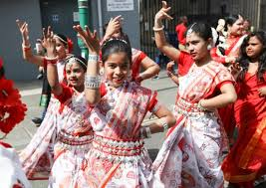
Early in the morning,people in hundreds and thousands pour in from all directions to attend the cultural functions.

Slide 13
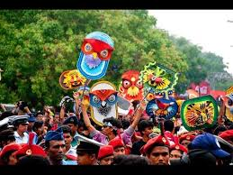
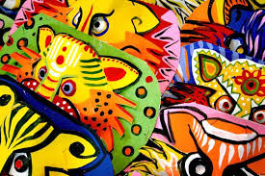
The masks and wreaths worn by the people are so fascinating!

Slide 14
Group Work
Describe your own cultural or religious festival that you celebrate.You can use the following words.You can also use other words relevant to the festival.
colourful | special | traditional | religious | dance
cultural | flowers | food | songs | festive

Slide 15
Fill in the gaps with suitable words
Pahela Boishakh is the day of Bangla year.The day is a public holiday.The traders and shopkeepers open(a) -----.The day is(b)-----------all over the country.The days first programme starts at ©-------------at Ramna Batamul by Chhayanat.Different Bangladeshi Television Channels telecast the(d)---------------programme.The Pahela Boishakh is celebrated with traditional(e)----------------across the country.The students of Fine Arts of Dhaka University bring out a colourful (f)-------------.The participants wear masks and also carry many festoons,(g)-------------- and playcards.Many cultural(h)----------------are organised on the day.The people celebrate the day having(i)------------------food and wearing traditional dresses.National dailies bring out special(j)-----------------on the day.
(a)halkhata
(b)celebrate
(c)dawn
(d) live
(e)festivities
(f)procession
(g) banners
(h)function
(i) traditional
(j) suppliment

Slide 16
HOME WORK
Everyone celebrate Pahela Boishakh in YOUR own way .Now write a letter to your friend on how you celebrated Pahela Boishakh last year.

Slide 17
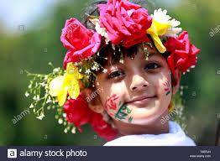
THANK YOU ALL

