Slide 2
GOOD MORNING

Slide 3
Identity
Mahfuja Khatun
Head Teacher
Sujanagor GPS
Pangsha, Rajbari.
Class: One
Subject: English
Unit: 2
Lessons: 1-3
Lesson: Introductions(C)

Slide 4
Learning outcomes
Students will be able to –
Listening :
1.1.1 to become familiar with English sounds by listening to common English words.
3.2.1 understand simple statements.
Speaking :
1.1.1 repeat after the teacher simple words and phrases.
2.1.1 greet each other.
3.1.1 answer questions asked by the teacher about students.

Slide 5
Let’s Listen the audio

Slide 6
TODAY’S LESSON
Introductions

Slide 7
Review of previous lesson
I’m Lana.
What’s your name?

Slide 8
Look and say about the pictures.

Slide 9
What are they doing?
What’s your name?
I’m Lana.
They are getting to know each other.

Slide 10
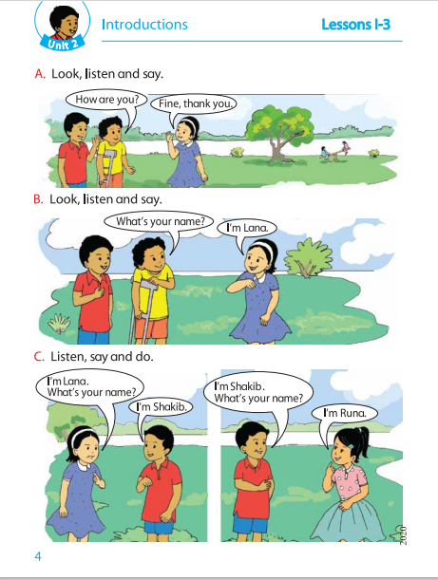
Additions to the textbook.
Open your English for today book at page 4

Slide 11
Teacher’s loud reading

Slide 12
Collaborate to say the students by the teacher

Slide 13
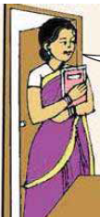
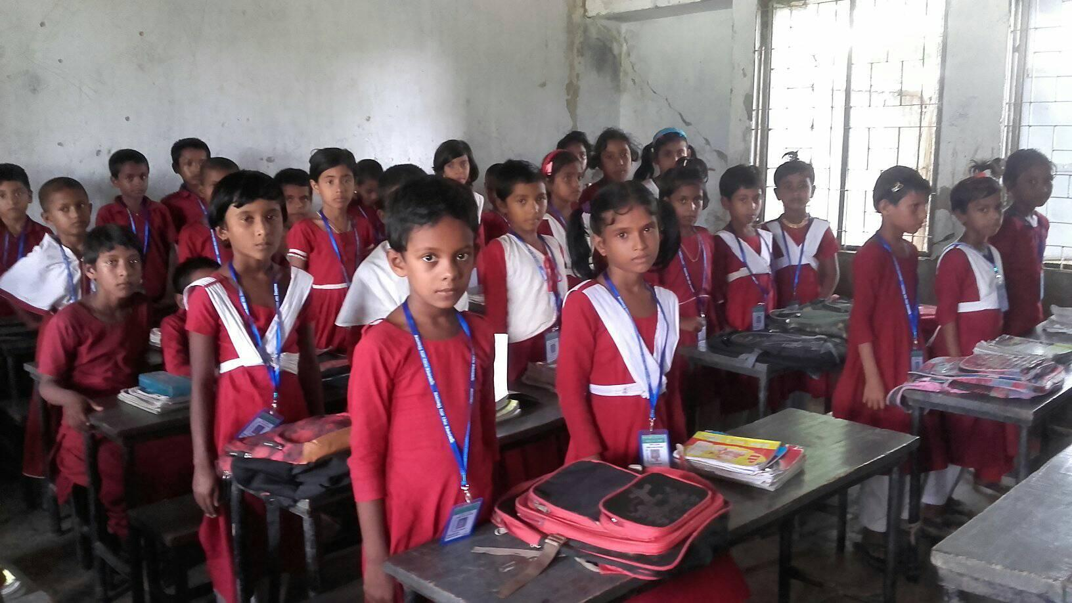
Collaborate to say the students by the teacher
I’m Mahfuja.
What’s your name?
I’m Ruhul.

Slide 14
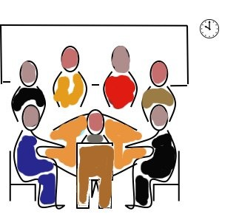
Group work
I’m….. What’s your name?
I’m….. What’s your name?

Slide 15
Present group work
I’m Mamun.
What’s your name?
I am ……..

Slide 16
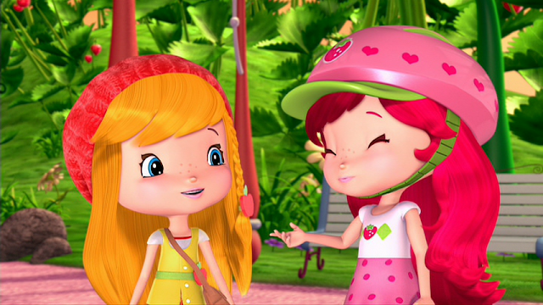
Pair Work
I’m lana.
What’s your name?
I’m Zara.

Slide 17
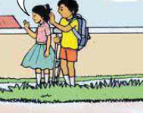
I’m Nishan.
What’s your name?
I am Sabuj
I am Lima
Evaluation

Slide 18
Home Work
Introduce each other.

Slide 19
Thank you

