Slide 1
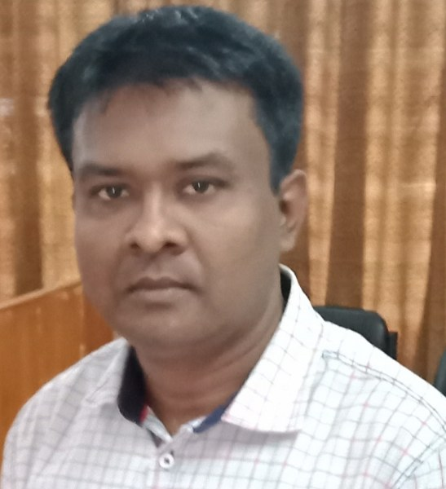
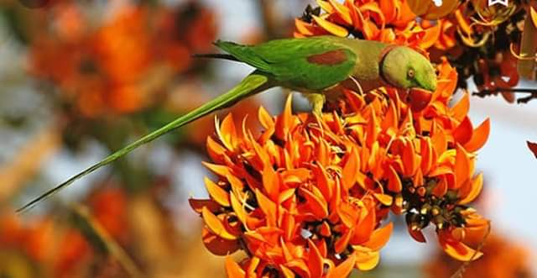
Kapasia Horimonjury Pilot Girls’ High School
to
today’s Presentation

Slide 2
Look , Gauge and Say -----
What do see in the picture ??

Slide 3
YES,
Punctuation & Capitalization

Slide 4
Learning Outcomes
Learners will able to--
recognize punctuation
improve the idea of using punctuation;
Use punctuation and capitalization in the sentences.

Slide 5
Usage of Punctuation and Capitalization
Proper noun (man & woman ) is used capital letter.
Such as –
Messy visited the place.
Runa Laila sang a song.
2. 1st letter of any sentence is used in capital letter.
3. Allah, God & Goddess is used in capital letter.
4. Name of any country , nation , Subject is used in capital letter.
5. Pronoun of Allah, God & Goddess ( He / She ) is used capital letter.

Slide 6
1. Inverted comma is used to close the direct speech.
Rahim said to me, “ my father is going to start a business.”
2. স্মবোধন পদ প্রথমে থাকলে তার পরে কমা হয়, শেষে থাকলে কমা হয় তার আগে এবং মাধ্যে থাকলে কমা হয় দুই পাশে। যেমন –
Sonia , come here.
Come here, Sonia.
Come , Sonia , here.
3. Question mark is used after Interrogative sentence.
What is your name ?
4. Exclamation mark is used after exclamatory sentence.
What a fine bird it is !
5. Full stop is used after assertive, imperative & optative sentence.

Slide 7
Evaluation
Use punctuation and capitalization in the respective sentences.
1. did they see the picture
2. is mina playing doll
3. he said to me what is your name

Slide 8
Home Work
Use punctuation and capitalization in the sentences given below.
1. has he completed the work
2. he and i play ball
3. january is the first month of the year

Slide 9
Thanks a lot

