Slide 2
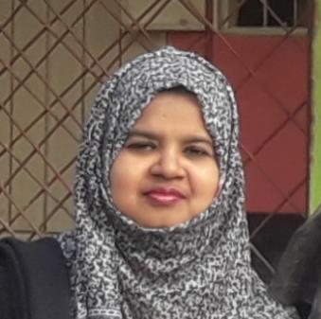
Teacher’s identity
Farjana Amin
Assistant teacher
Dhadash Govt. Pri. School
Puthia, Rajshahi.

Slide 3
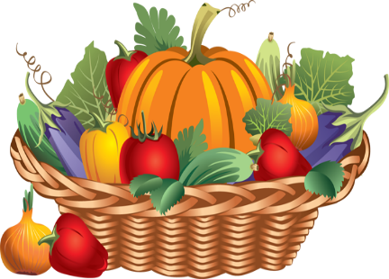
Lesson Identity
Class:5
Sub:English
Today’s Lesson
Unit:7 Be healthy (`Sima: What are……..Ok! thanks.)
Lessons 1-2

Slide 4
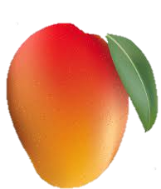
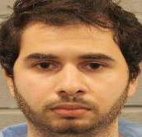
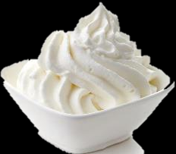
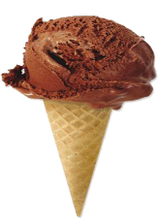
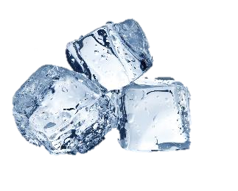
Here are two words . Join together to create a new meaning.
Ready for guessing. Let’s begin…….
Guess the word
Go

Slide 5
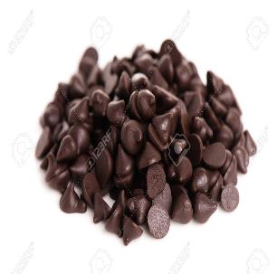
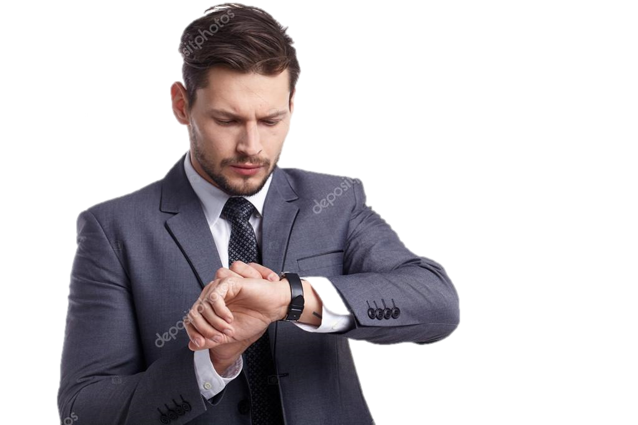
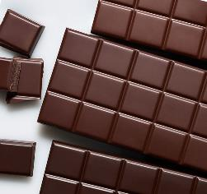
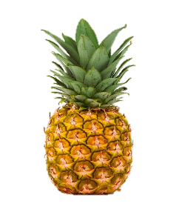
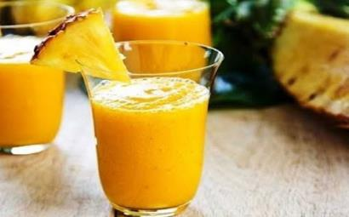
Here are two words . Join together to create a new meaning.
Ready for guessing. Let’s begin…….
Guess the word

Slide 6
Discussion about our previous lesson
Say 6 words from our previous lesson
Eggs
Fruitss
Meat
Healthy food
Milk
Grain
Vegetables

Slide 7
Our today’s topic is
Be healthy

Slide 8
Learning outcomes
Students will be able to-
Listening: 4.2.1 Understand and enjoy simple stories.
Speaking: 6.1.2 Say what others are doing.
Reading: 7.1.1 Recognize punctuation marks and read accordingly.
Writing: 10.1 make sentences using words and phrases given in the text.

Slide 9
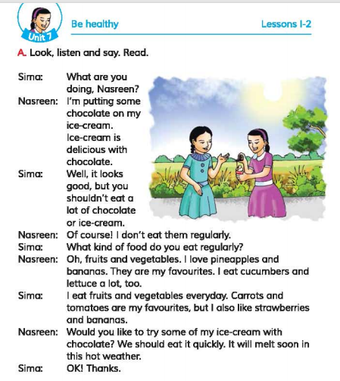
Open at page 26

Slide 10
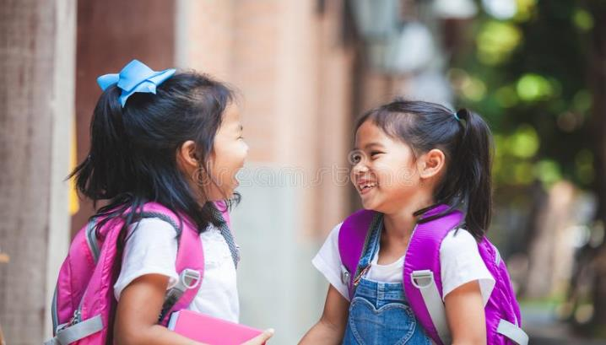
Look at the picture
Can you tell me what are they doing?
There are two girls.
How many girls are there?
They are talking.

Slide 11
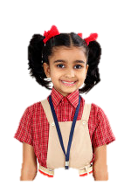
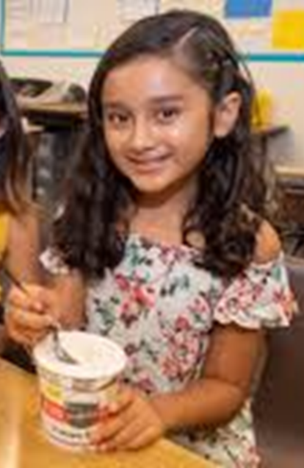
Let’s know the lesson with the pictures
What are you doing Nasreen?
I’m putting some chocolate on my ice-cream. Ice-cream is delicious with chocolate.
Sima
Nasreen

Slide 12
Let’s know the lesson with the pictures
Well, it looks good, but you shouldn’t eat a lot of chocolate or ice-cream.
Of course! I don’t eat them regularly.
Sima
Nasreen

Slide 13
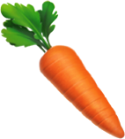
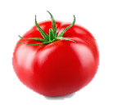
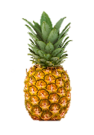
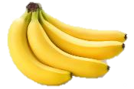
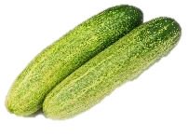
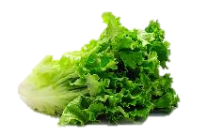
Let’s know the lesson with the pictures
I eat fruits and vegetables everyday. Carrots and tomatoes are my favourites, but I also like strawberries and bananas.
Oh, fruits and vegetables. I love pineapples and bananas. They are my favourites. I eat cucunbers and lettuce a lot,too.
Sima
Nasreen

Slide 14
Let’s know the lesson with the pictures
Would you like to try some of my ice-cream with chocolate? We should eat it quickly. It will melt soon in this hot weather.
Ok! Thanks.
Sima
Nasreen

Slide 15
Teaching Vocabularies
Let’s find out new or difficult words
A kind of food made from milk.
Ice-cream
আইসক্রীম
সুস্বাদু
Having a pleasant taste or smell.
Delicious
Favourite
সবচেয়ে প্রিয়
The most liked.
To become liquefied.
Melt
গলে যাওয়া
A leaf used as a vegetable.
Lettuce
লেটুস পাতা

Slide 16
Make sentences
IW
Delicious
Ice-cream is delicious.
Favourite
My favourite fruit is pineapple.
Kind
Lettuce is a kind of vegetable.
Melt
Ice-cream is quickly melt.
Weather
It is very hot weather.

Slide 17
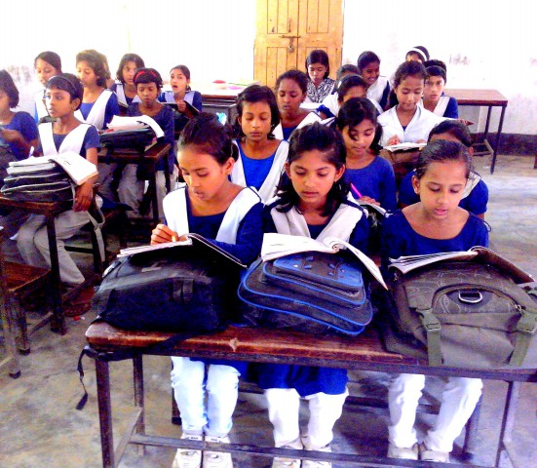
Student’s Silent Reading

Slide 18
Student’s Chain Drilling.
Sima: What are you doing, Nasreen?
Nasreen: I,m putting some chocolate on my ice-cream . Ice-cream is delicious with chocolate.
Sima: Well it looks good, but you shouldn’t eat a lot off chocolate or ice-cream .
Nasreen: Of course! I don’t eat them regularly.
Sima: What kind of food do you eat regularly?
Nasreen: Oh, fruits and vegetables. I love pineapples and bananas.They are my favourites. I eat cucumbers and lettuce a lot, too.
Sima: I eat fruits and vegetables everyday. Carrots and tomatoes are my favourites, but I also like strawberries and bananas.
Sima: Ok! thanks.

Slide 19
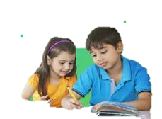
Group work
Group-A
What is Nasreen putting chocolate on?
Group-B
Why does’t Nasreen eat chocolate regularly?
Group-C
What is Sima’s favourite foods?

Slide 20
Pair work
Write True for correct statement and False for incorrect statement
Let’s click on the sentences to know the right answer
a) Ice-cream and chocolate are healthy.
False
b) Sima consumes fruits and vegetables daily.
True
c) Ice-cream should be eaten quickly.
True
d)Pineapple is a vegetable.
False
e) Nasreen dislikes pineapples and bananas.
False

Slide 21
Match the words of column A with the similar meaning of Column B. Two extra meaning are given in column B.
Column A
Column B
a) Delicious
i) a kind of sweet food,made of cream,ice and sugar.
ii) go or come to see something .
b) Favourite
iii) Something liked by somebody.
c) Everyday
iv) tasty .
d) Quickly
v) a member of this organigation .
e) Ice-cream
vi) fast .
vii) daily.

Slide 22
Evaluation
a) What was Nasreen doing ?
b) Why shouldn’t eat a lot of chocolate or ice-cream ?
c) What kind of food does Nasreen like?
d) Who offers Sima ice-cream?
e)Write the name of some dairy products .

Slide 23
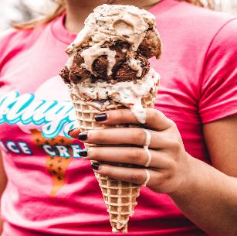
One day one word
Melt
গলে যাওয়া
Ice-cream melts in hot weather.

Slide 24
Home work
Which food do you like most ? Write it in 5 sentences.

Slide 25
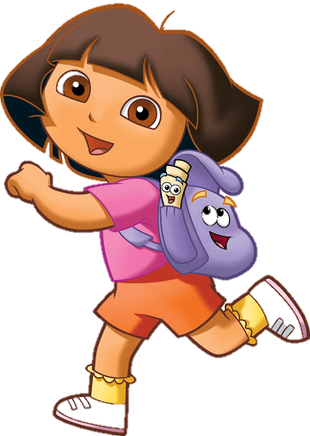
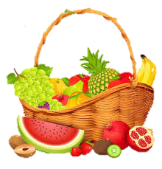
Good bye

