Slide 1
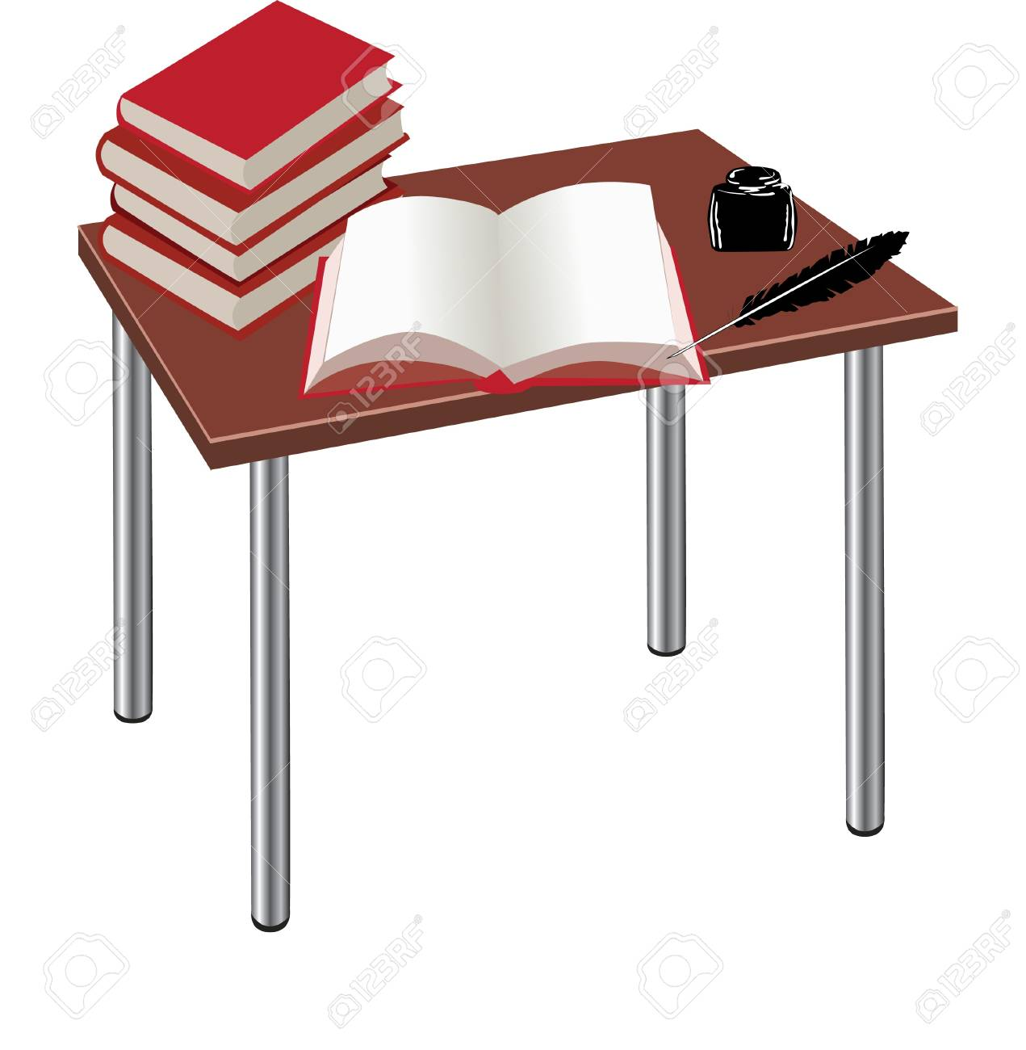
Today this session
Greetings to all

Slide 2
Identification
Md. Motiur Rahaman Manik
8no. Gopalpur govt. Primary School.
Kaligonj, Jhenaidah
Email: motiur.gps@gmail.com
Class: Four
Subject:English
Unit: 18
Lesson: 3-4
Time: 40 minuites

Slide 3
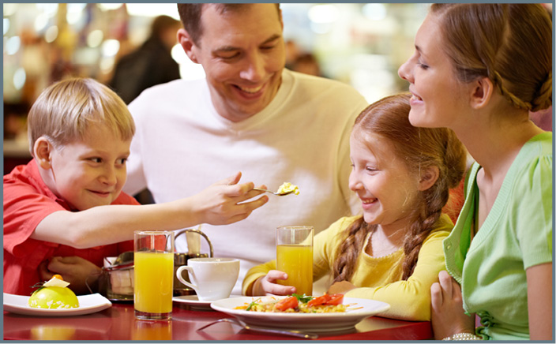
Family Members

Slide 4
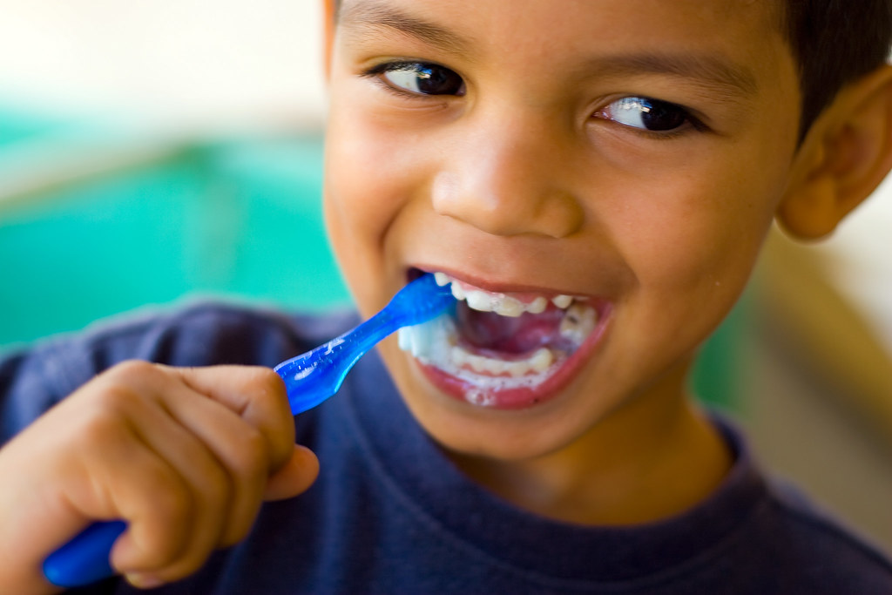
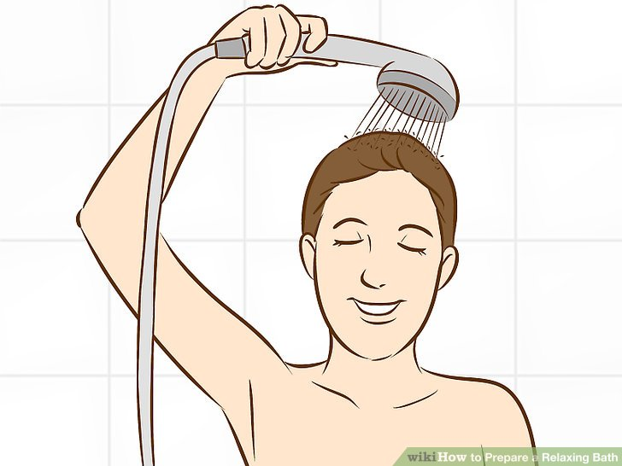
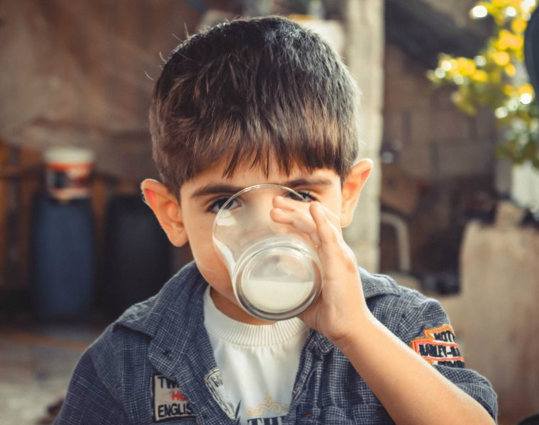
This Photo by Unknown Author is licensed under CC BY-SA

Slide 5
LEARNING OUTCOMES
Notes:
Page--18

Slide 6
Open your book at page-37
Clap and rhyme after me
Everyday
drink

Slide 7
New word learning
Everyday- I go to school everyday.
Drink- I drink milk every morning.

Slide 8
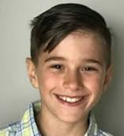
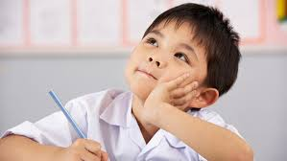
Pair Work
Who is in your family?
Father, Mother, Sister, Aunt, Grant paa

Slide 9
Group Work
Boy
Girl
Q: What do you do everyday?

Slide 10
Home Task
Write the rhyme in your khata as hand writing.

Slide 11
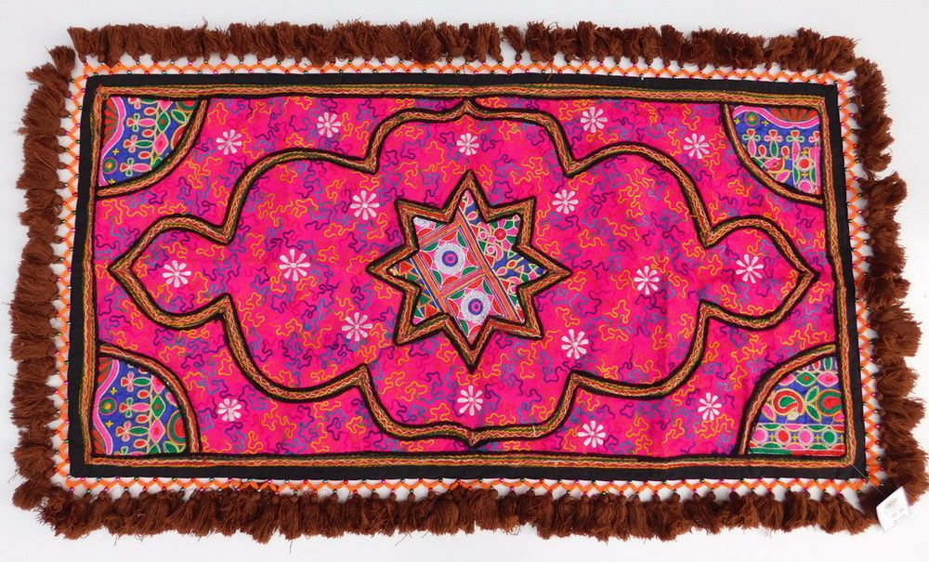
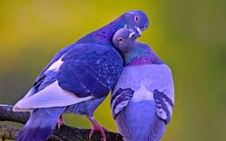
See you again Bye

