Slide 1
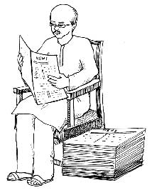
GOOD MORNING

Slide 2
Identity
Md shafiqul islam
Assistant Teacher
Sonatan Darussannat Dakhil Madrasha
Kawnia, Rangpur.
Mail:shafiqulislam42347@gmail.com
Mobile:01735535715
English 1st Paper
Class: Eight
Lesson: One
Date:02/02/2021

Slide 3
LOOK AT THE PICTURE

Slide 4
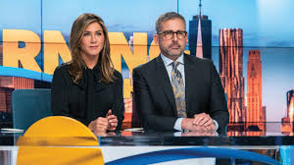
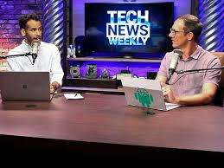
LOOK AT MORE PICTURE

Slide 5
OUR TODAYS LESSON
News! News! News!
Unit-8, Lesson-1
What is news?

Slide 6
Learning outcome
After we have studied this lesson, we will be able to-
Ask and answer question.
Read and understand text materials.
Word meaning
Write answers to questions.
Choose the correct answer from the alternative.
Fill in each gaps with suitable words from the text.

Slide 7
Word Meaning
Bunk off ------------------ গোপনে পলায়ন
Mass people------------ সাধারণ মানুষ
Objective ---------------- উদ্দেশ্য
Broad cast---------------- সম্প্রচার
Editorial ----------------- সমপাদকীয়
Informative ------------- তথ্যবহুল
Educative --------------- শিক্ষণীয়
Occasion ---------------- উৎসব
Opinion ----------------- মত
Self-explained--------- আত্ন-ব্যাখ্যামূলক

Slide 8
Describing lesson-
I eat rice everyday.

Slide 9
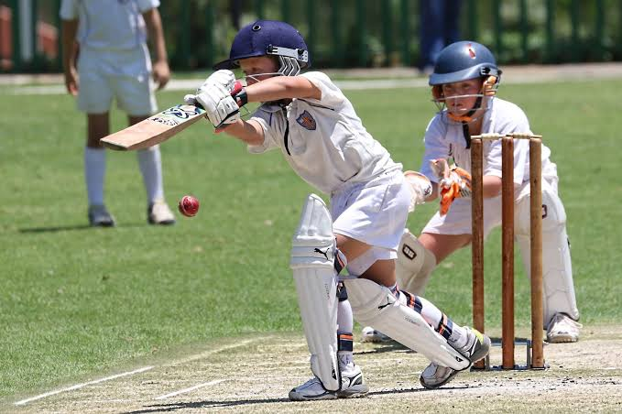
we play cricket.

Slide 10
They happen every day or on some occasions.

Slide 11
Describing lesson-
Are these events news? Should they be published in newspapers? The answer is a big ‘NO’. Then what is news anyway ? What do we want to know from the media?

Slide 12
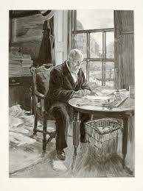

Slide 13
The first thing is that news should be a piece of information. Secondly ,the information should be recent or new, hence it is ‘news’. Thirdly, mass people should take interest in it. Fourthly ,it should be self–explained.

Slide 14
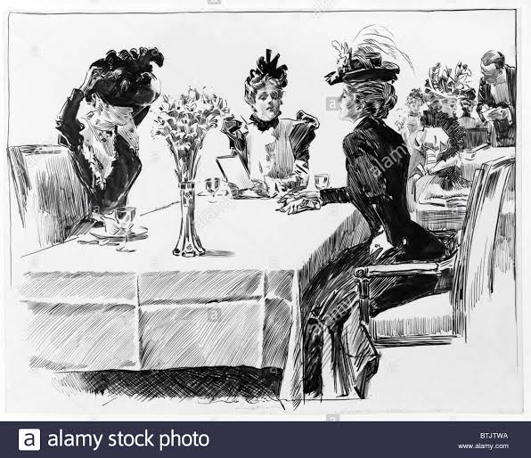
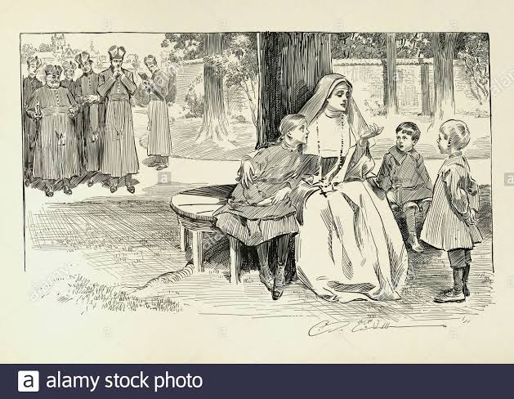
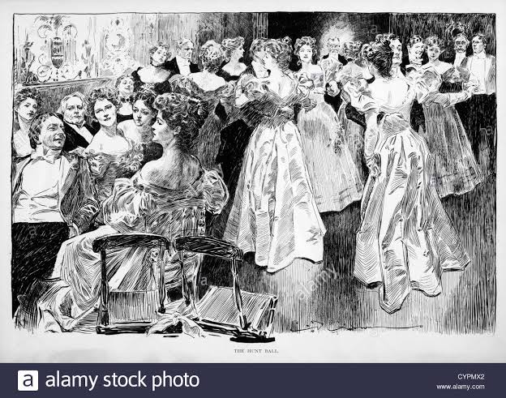
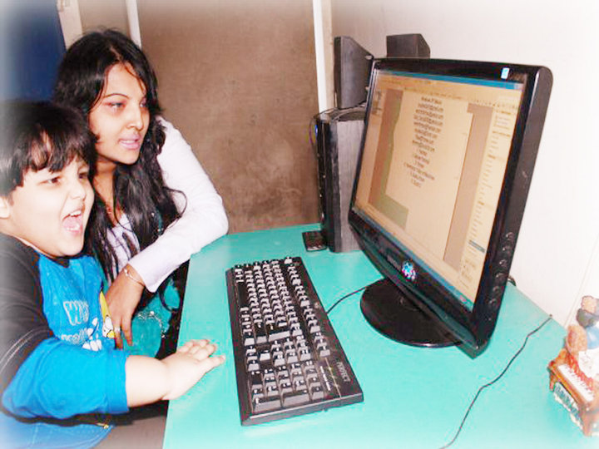
That is , it should answer all the questions with who, which , what, where, when , why , and how Finally, it should be objective. Recently ,another aspect has been added; news is either printed or broadcast or on the internet.

Slide 15
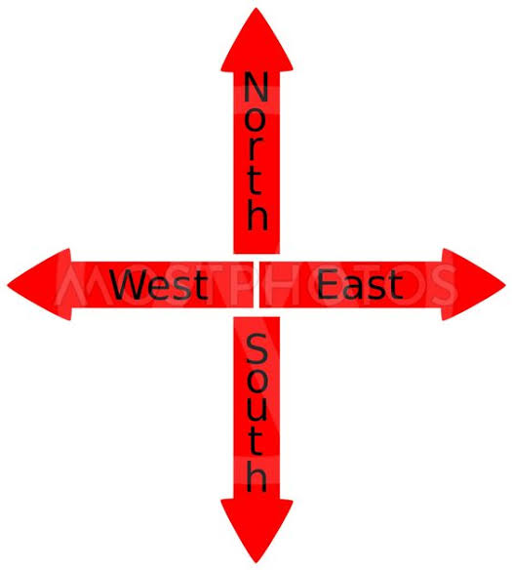
There are opinions that the term ‘news ‘ comes from ‘new’ . Others say it is news because it comes from all directions: North , East , West , South.

Slide 16
Silent Reading

Slide 17
Individual Work
What is news ?
What is an information ?

Slide 18
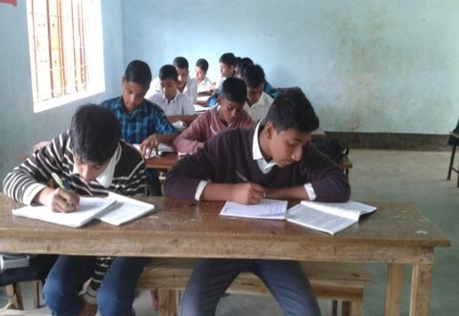
Group Work
Choose the correct answer from the alternative:
News is---------------------------------.
(a ) a common event (b ) a regular event (c ) an event happening on occasions (d) a new information
Newspapers --------news.
(a) happen (b) create (c ) publish (d) advertise
We get news from--------------.
(a) everybody (b) mass people (c ) opinions (d) the media
The news comes from------------------------.
(a ) one direction (b) two directions (c) three directions (d ) four directions
We get news from different ---------------------------.
(a) source (b ) events (c ) meditums (d) media

Slide 19
Evaluation
Answer the following questions from reading of the text:
What does Charles Anderson Dana say about news ?
Which events are news ?
What does ‘News ‘ mean ?
What should not be published in newspapers ?
What is the most educative page of a newspaper ?

Slide 20
Home work
Read the following text and fill in the gaps with appropriate words:
The first newspaper printed in India was Hickey’s Bengal Gazette in 1780 under the (a)------------. It was (b)-------------by James Augustus Hickey. In this process, the first Bangla(c )-------------------, the Samachar Darpon, came out in 1818. The missionaries ran this(d)-----------------. The Azad became (e )----------first daily newspaper.

Slide 21
THANK YOU ALL STUDENT

