Slide 1
Welcome
to my class
Notes:
Say welcome to the students.

Slide 2
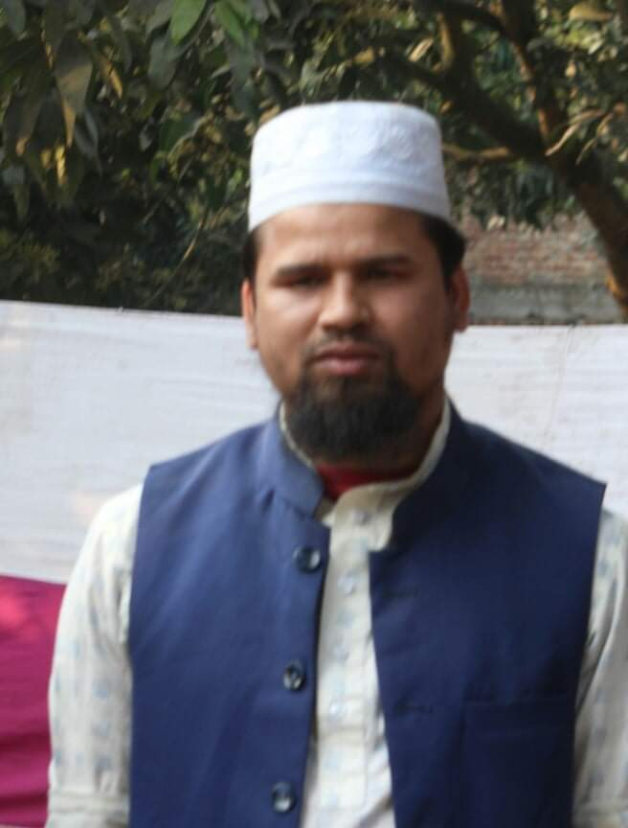
Introduction
Md. Farid Uddin
BA (Hons’), MA in English, B.Ed
Assistant Teacher (English)
Dupchanchia D.S Fazil Madrasah
Subject: English 2nd Paper
Grammar (Time- 45 min)
Notes:
Introduce yourself & the subject of the class to the students.

Slide 3
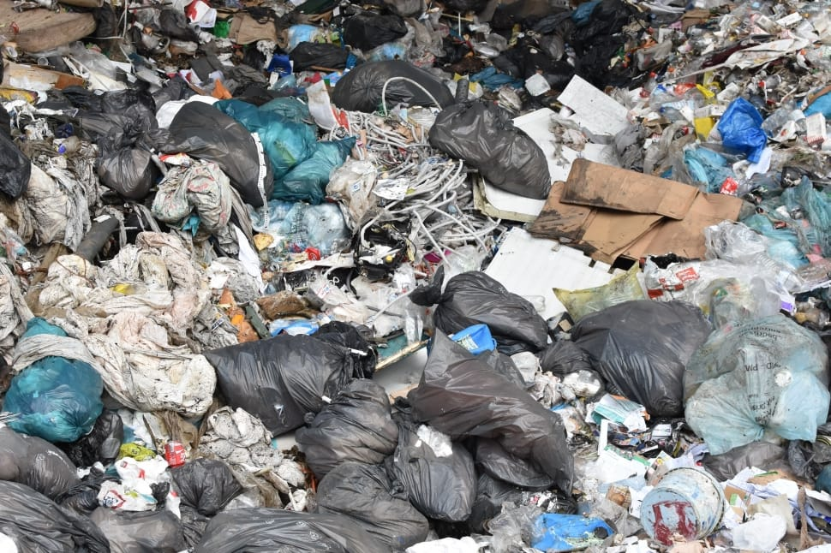
What is the picture
about?
Garbage
People like garbage.
dis
Here the word ‘like’ is not appropriate.
Here the word ‘dislike’ is appropriate.
Notes:
Justify pre-knowledge of students by showing picture and making question.

Slide 4
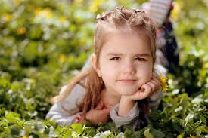
What is the picture
about?
A child / A girl
The child is very .
beautiful
beauty
Here the word ‘beauty’ is not appropriate.
Here the word ‘beautiful’ is appropriate.
Notes:
Justify pre-knowledge of students by showing picture and making question.

Slide 5
dis
+
like
=
dislike
beauty
+
ful
=
beautiful
Today’s lesson is
What might be today’s lesson?
Prefixes & Suffixes
Part-1
Notes:
Ask today’s lesson and declare the lesson.

Slide 6
Learning Outcomes
By the end of the lesson, students will be able
To identify prefixes & suffixes.
To add suffixes to make new words.
To make various nouns using suffixes.
Notes:
Let the students know the learning outcomes of this lesson.

Slide 7
Affix
Prefix
Suffix
dis
+
=
beauty
ful
beautiful
like
dislike
+
=
Prefix is added at the start of a word to make a new word.
Suffix is added at the end of a word to make a new word.
Notes:
Give the definitions of prefix & suffix.

Slide 8
I am (sure) of it.
unsure
We (sure) our participation.
ensure
We (sure) saw him.
surely
We got (sure) from him.
surety
In every sentence,
there is a common word.
Add prefix or suffix to make appropriate.
Why does prefix/suffix vary
in different sentences?
Notes:
Clarify different types of prefixes & suffixes added to the same word and makes different parts of speech.

Slide 9
I am unsure of it.
Be verb
+
Adjective (Noun for complement)
After Be Verb, Adjective is appropriate
( For complement, it will be Noun )
‘sure’ is an Adjective being replaced by another Adjective taking the prefix ‘un’ is appropriate.
Notes:
Describe the use of prefix.

Slide 10
We ensure our participation.
Subject
+
Verb
After Subject, there will be Verb.
‘sure’ is an Adjective being replaced by a Verb taking the prefix ‘en’ is appropriate.
Notes:
Describe the use of prefix.

Slide 11
We surely saw him.
Subject
+
Adverb
+
Verb
Between Subject & Verb, there will be an extra word. So, an Adverb is appropriate.
‘sure’ is an Adjective being replaced by a Adverb taking the prefix ‘ly’ is appropriate.
Notes:
Describe the use of suffix.

Slide 12
We got surety from him.
Subject
+
Verb
+
Noun (Object)
After Subject & Verb, there will be a Noun
if it is an Object.
‘sure’ is an Adjective being replaced by a Noun taking the suffix ‘ty’ is appropriate.
Notes:
Describe the use of suffix.

Slide 13
So, we firstly need to identify
which part of speech is
appropriate in the targeted place.
Let us do some more examples
by using prefix/suffix to make
noun in the targeted place.
Notes:
Take preparation for the next steps.

Slide 14
( Truthful ) is a great virtue.
Truthfulness
Subject
+
Verb
Before main verb, there will be the Subject which demands to be a Noun
‘Truthful’ is a Adjective being replaced by a Noun taking the suffix ‘ness’.
Notes:
Describe the use of noun adding suffix.

Slide 15
We made ( develop ) in study.
development
Verb
+
Object
After main verb, there will be the Object which demands to be a Noun
‘develop’ is a Verb being replaced by a Noun taking the suffix ‘ness’.
Notes:
Describe the use of noun adding suffix.

Slide 16
education
It is ( educate ) which is necessary.
Subject
Noun (Complement)
If a Subject/Object indicates the same thing or person, it is a complement.
‘develop’ is a Verb being replaced by a Noun taking the suffix ‘ness’.
Notes:
Describe the use of noun adding suffix.

Slide 17
assistance.
He was asked for ( assist ).
Preposition
+
Noun
After preposition, there will be a Noun.
‘assist’ is a Verb being replaced by a Noun taking the suffix ‘ance’.
Notes:
Describe the use of noun adding suffix.

Slide 18
Noun Phrase
ability.
He is well-known for his ( able ).
Preposition
+
Noun
After preposition, if there is a Noun Phrase, the last word of the phrase is to be a Noun.
‘able’ is an Adjective being replaced by a Noun taking the suffix ‘ity’ is appropriate.
Notes:
Describe the use of noun adding suffix.

Slide 19
Noun Phrase
permission.
I beg your humble ( permit ).
Adjective
+
Noun
After Adjective to make a Noun Phrase,
the last word of the phrase is to be a Noun.
‘permit’ is an Verb being replaced by a Noun taking the suffix ‘sion’ is appropriate.
Notes:
Describe the use of noun adding suffix.

Slide 20
socialist
electrician.
He is a singer, (act ) , ( social ) and ( electic ).
actor
Noun
,
Noun
,
Noun
and
Noun
Both sides of ‘ ‘and’ ‘or’ ‘but’ ‘comma’ (,) must be the same part of speech.
The words ‘act’ ‘social’ ‘electric’ are replaced by Nouns taking the suffix ‘or’ ‘ist’ ‘ian’ are appropriate.
Notes:
Describe the use of noun adding suffix.

Slide 21
Pair Work
Time- 5 min
Make various Nouns
adding suffixes from below
sion
hood
th
ing
ism
ship
ion
ity
ence
age
ment
ness
operate
admit
+
+
admission
operation
=
=
child
childhood
+
amusement
+
=
amuse
=
true
truth
differ
difference
+
=
+
=
feel
feeling
patriot
+
=
+
patriotism
=
+
possibility
pupil
pupilage
possible
=
+
=
idle
idleness
+
=
citizen
+
citizenship
=
Notes:
Arrange a Pair Work.

Slide 22
Let us see the structures of Noun Phrase.
Noun Phrase
Main word
Suffix
Adjective
Noun
great
expectation
=
expect
+
ation
ing
+
hard
suffering
=
suffer
true
nationalism
+
=
national
ism
heavy
temperature
temperate
ure
=
+
Article
Noun
a
marriage
marry
age
=
+
the
wisdom
wise
dom
=
+
Notes:
Describe the structures of Noun Phrase.

Slide 23
Let us see the structures of Noun Phrase.
Noun Phrase
Main word
Suffix
Possessive
Noun
account
ant
my
accountant
=
+
his
competition
=
compete
+
ition
our
childhood
child
hood
=
+
Demostrative
Noun
this
width
wide
th
=
+
these
friendship
friend
ship
=
+
Notes:
Describe the structures of Noun Phrase.

Slide 24
Evaluation (Flash Back) (The Use of Noun)
( Noun ) Subject
+
Verb
Verb
+
Object ( Noun )
Subject
+
Verb
+
Complement ( Noun )
Preposition
+
Noun
Preposition
+
Noun Phrase (last word is Noun
Noun
,
Noun
and
Noun
or
Noun
but
Noun
Notes:
Evaluate through the Flash Back of the use of Noun in sentences to add suffixes.

Slide 25
Group Work
Time- 8 min
Write down a list of suffixes which are used to Nouns.
ion / tion / ation / ition
hood
ance / ence
age
ty / ity
sion
ing
ure
er / or
ism
ee
cy
ment
ant
ess
th
ness
al
ship
ice
Notes:
Arrange a Group Work.

Slide 26
Write down 3-5 Nouns for each suffix.
Notes:
Give the students Home Work.

Slide 27
for attending my class
Notes:
End the class saying ‘thanks’.

