Slide 1
Assalamu alaikum
Dear students
Welcome

Slide 2
IDENTITY
IDENTITY
SHAH MOHAMMAD LUTFUL HAIDER
ASSISTANT TEACHER
LUTFUNNESA BALIKA BIDDANIKETON
PAGLA, GAFARGAON
SUBJECT: ENGLISH 2ND PAPER
CLASS: SIX
LESSON: PARTS OF SPEECH (noun,pronoun,adjective,verb)
TIME: 50 Minits

Slide 3
Look at the pictures
Some parts of motor cycle

Slide 4
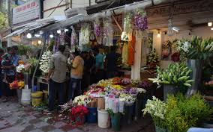
What is the picture about?
They are buying some flowers from shop
Here, what are the names of the words used in sentence individually ?

Slide 5
TODAY’S LESSON
PARTS OF SPEECH

Slide 6
LEARNING OUTCOMES
After completing this lesson the students will be able to-
Speak the definition of parts of speech
Say the kinds of parts of speech
Find out the pointed parts of speech from sentence
Make sentence using pointed parts of speech

Slide 7
Watch the video

Slide 8
we watched on the screen
The performance of Messy
We know he is so good football player
we enjoyed his playing

Slide 9
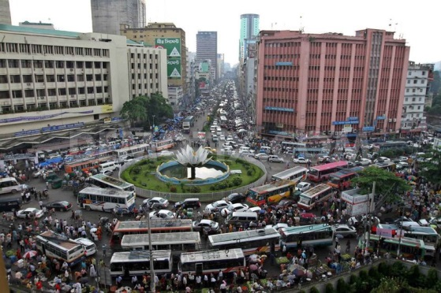
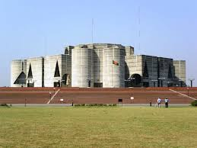
Look, hear MESSY, FOOTBALL PLAYER and PLAYING is a naming word
Definition
Noun is a naming word / The name of anything is called noun
Name of thing
Name of building
Name of place

Slide 10
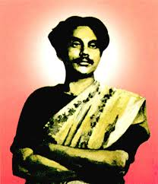
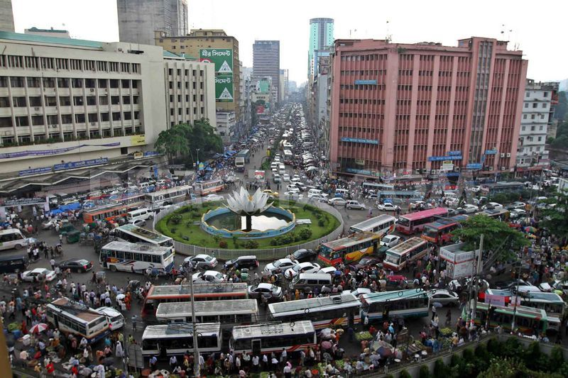
This is Kazi Nazrul Islam
He is a rebel poet
This is Dhaka city
It is very busy city

Slide 11
Here, He is used instead of Kazi Nazrul Islam
and It is used in place of Dhaka
Definition
A word is used in place of noun called pronoun

Slide 12
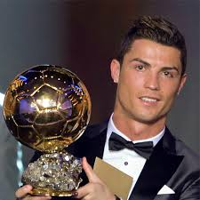
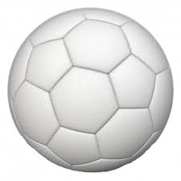
Ronaldo is an excellent football player
This is a white ball

Slide 13
Hear, excellent and white is qualified Ronaldo and Ball
Definition
A word qualifies or describes a noun or a pronoun is called adjective

Slide 14
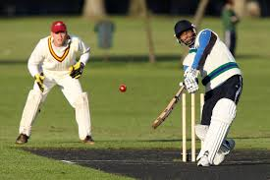
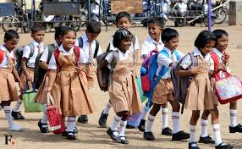
They are playing cricket
They are going to school

Slide 15
Watch
Here, PLAY and GO are action words
SO, we can say verb is an action word

Slide 16
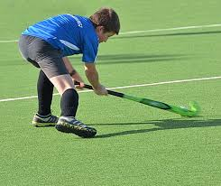
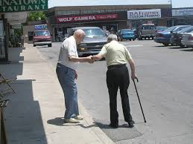
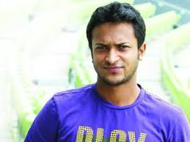
Group works
Look at the pictures
Now , make five sentences using noun , pronoun , verb and adjective

Slide 18
Home task
Find out noun, pronoun , verb and adjective from the text .
Farabi is Flora’s best friend. They live in the same village. They go to different schools. They meet together every week and talk about their lesson.

Slide 19
THANKS ALL

