Slide 1
Welcome to my class

Slide 2
Md. Saifuddin khan
Lecturer in English
Hajee Goyes Uddin Mohila Fajil madrasah
Bhangura,Pabna.
Mobile :01710449379 .
E-mail: skhan84bd@gmail.com.
Alim 1st year
English for today .
Time :40 minutes,

Slide 4
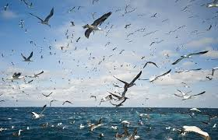
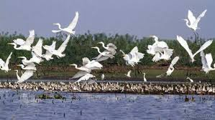
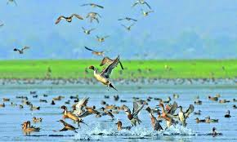
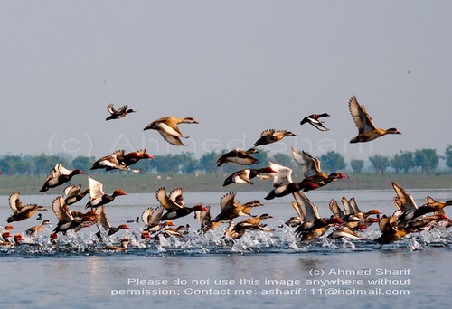

Slide 5
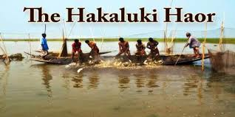
Our todays topic is
Unit: tweleve ,lesson :two

Slide 6
Leaening outcomes
After reading the passage, ss will be able to
1.Tell the area of Hakaluki Haor .
2.Make a list of important interconnected beels and jalmohals in Hakaluki .
3.Write about the economic importance of Hakaluki.
4.Tell the name of fishes available in Hakaluki haor .

Slide 7
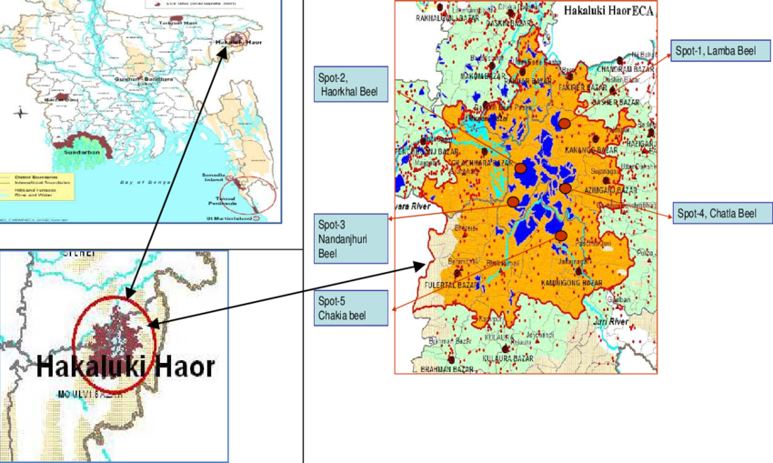
Map of Hakaluki Haor

Slide 8
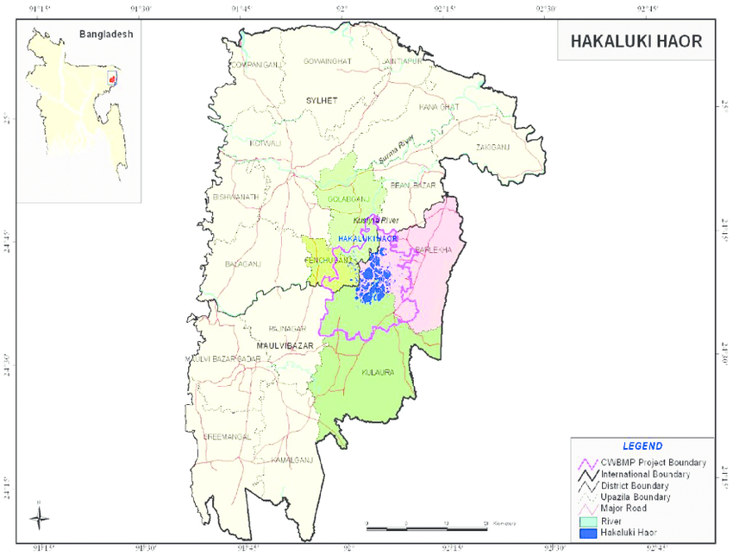
Hakaluki Haor is one of the major wetlands of Bangladesh.
Its area is about 18,386 hectares. This haor is declared an ecologically Critical Area in April 1999 by the Government of Bangladesh.

Slide 9
Single work
1. Hakaluki Haor is bounded by the river …….
(a)Padma (b) Kushiara (c) Meghna (d) Jamuna.
2. Hakaluki Haor contains more than …… interconnecting beels and jalmahals .
(a) 200 (b)300 (c) 400 (d) 238 .

Slide 10
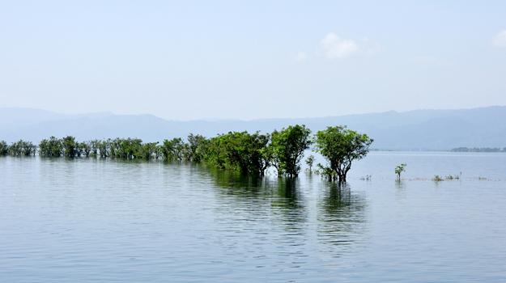
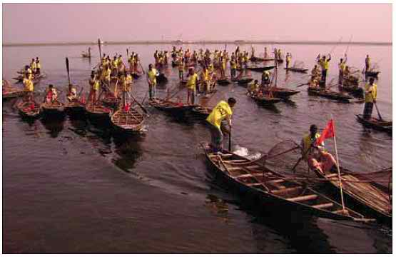
Hakaluki is a complex ecosystem containing more than 238 interconnecting beels and jalmahals.
The most important beels are
Chatla
2. Pinlarkona
3. Dulla
4.Sakuna
5. Barajilla
6.Balijhuri
7. Lamba
8. Tekonia etc.

Slide 11
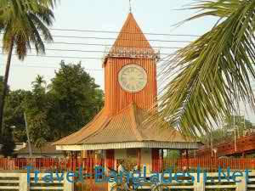
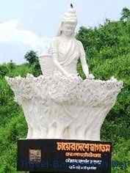
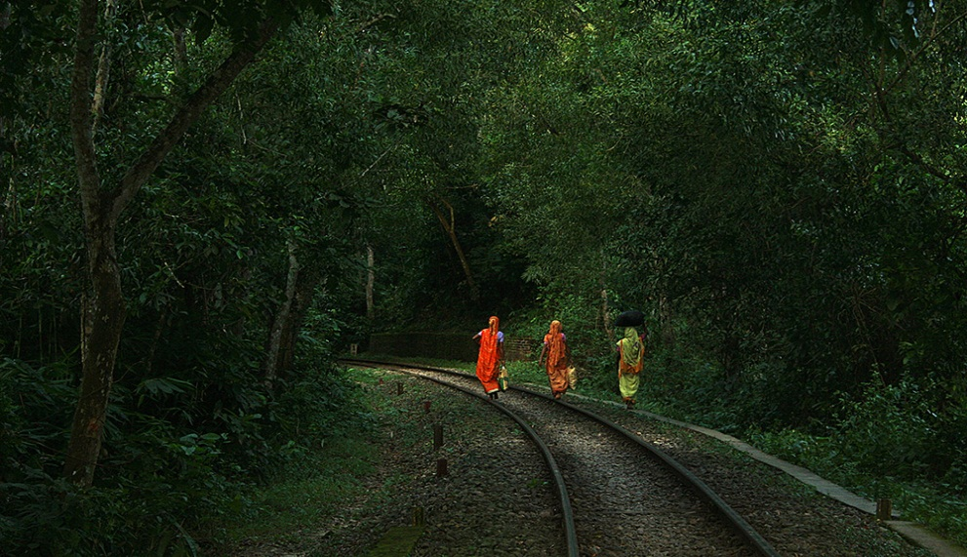
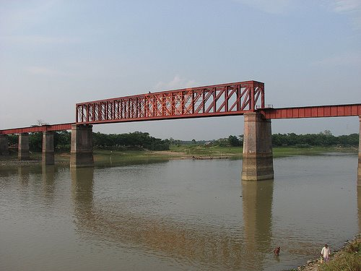
The haor falls under two administrative districts Maulavibazar and Sylhet
Maulavibazar
Sylhet
The haor is bounded by the Kushiara river as well as a part of theSonai-Bardal river to the north.
By the Fenchuganj-kulaura railway to the west and to the south
The Kushiara river

Slide 12
Pair work
Write the name of most important beels in hakaluki Haor.

Slide 13
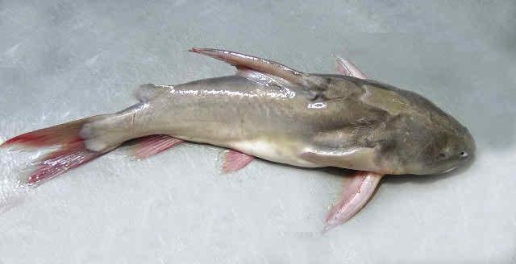
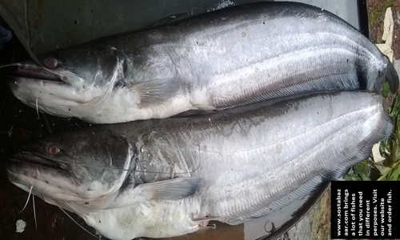
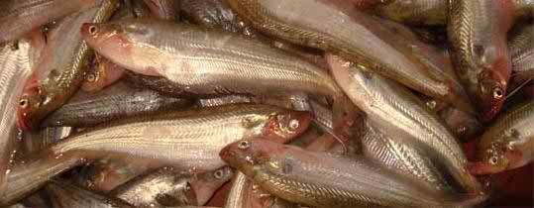
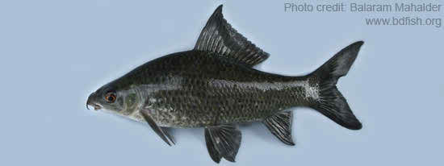
Hakaluki Haor is an important source of fisheries resources for Bangladesh.The main fish species found here are:
Ghagot fish
Boal fish
Pabda fish
Kalibaus fish

Slide 14
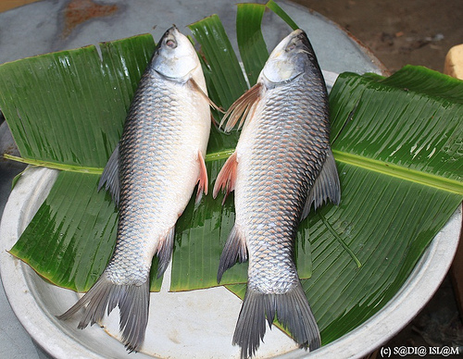
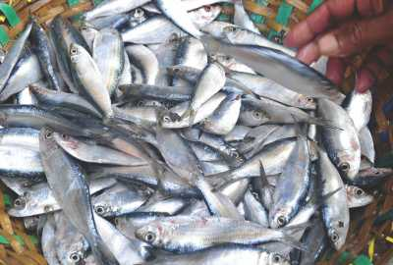
Chapila fish
Rui fish

Slide 15
Group work
Make the flow-chart showing the blessing Hakaluki Haor.
1.Supporting rich biodiversity
2.
3.
4.
5.
6.

Slide 16
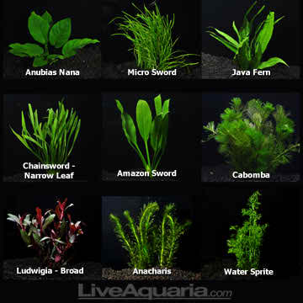
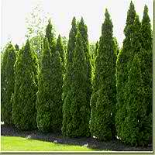
Word meaning
Resources
Wealth
Biological difference
Biodiversity
Community
Anything of common interest
Aquatic
Water based
Evergreen
Always green

Slide 17
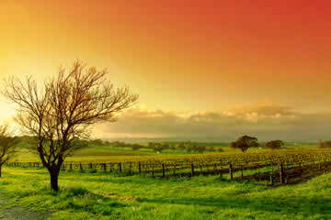
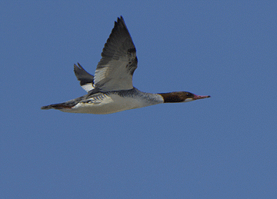
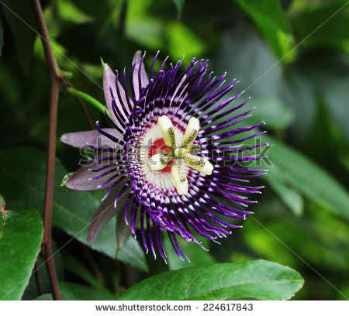
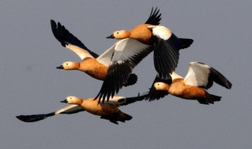
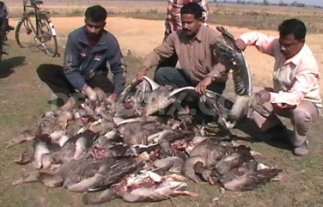
Landscape
An inland scenery
Movement
An act of moving
Attraction
Faculty of attracting
Migratory
Wandering
Unlawful
Illegal

Slide 18
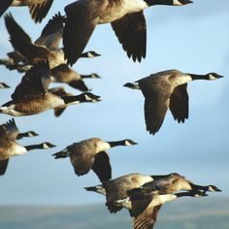
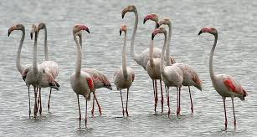
The haor is a very important resting place for migratory waterfowls flying in from the north .

Slide 19
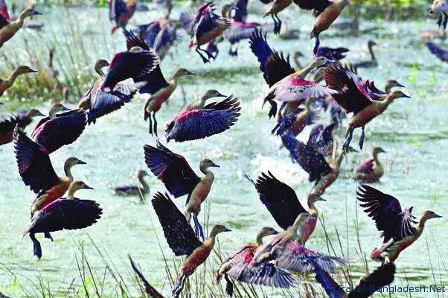
These species of waterfowls make the haor their temporary home

Slide 20
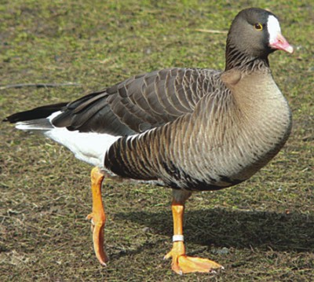
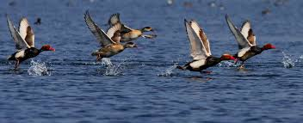
The most important species is the Barheaded Goose

Slide 21
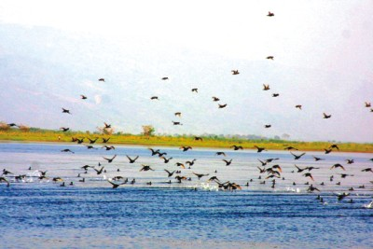
Many other important species of waterfowls make the haor their temporary home.

Slide 22
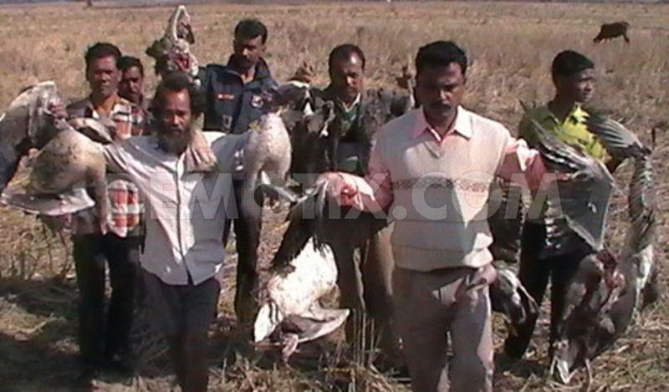
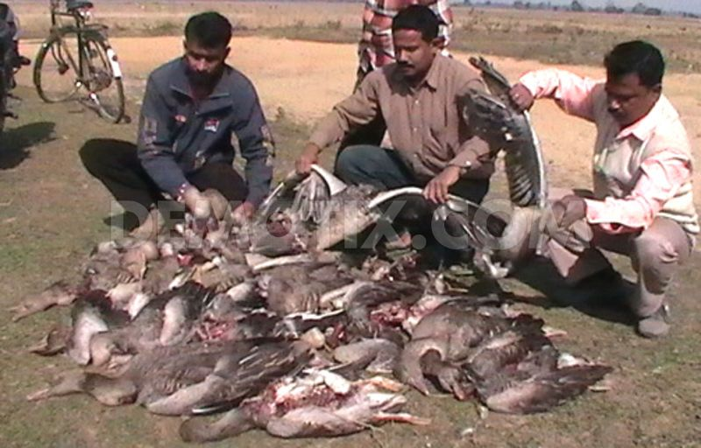
Illegal poaching has been a threat to the water fowl population in this vast wetland.

Slide 23
Evaluation
Answer the following short questions :
1.What are ‘mother fisheries? What do they do ?
2.What bird species are seen in Hakaluki Haor in winter ?

Slide 24
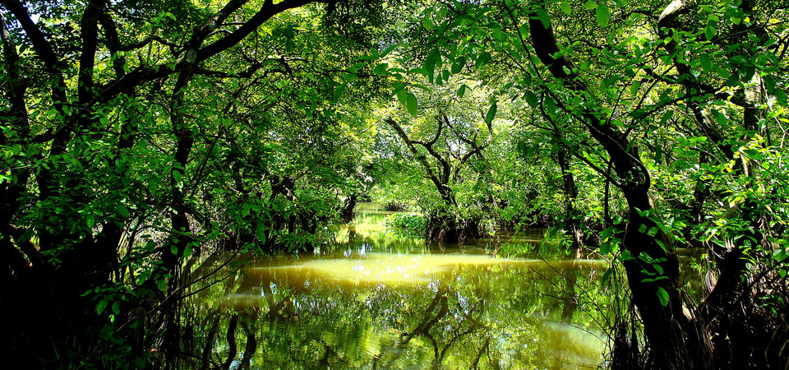
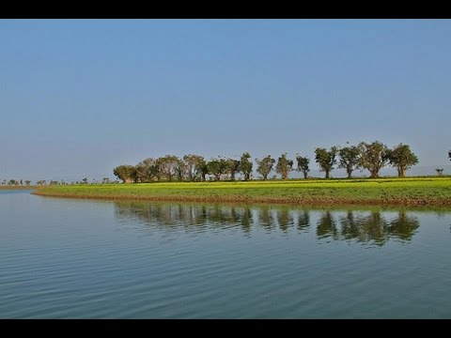
Before
Present day
The Haor had very dense swamp forest in the past, but deforestation and a lack of conservation practices have virtually destroyed this unique forest in last two decades.

Slide 25
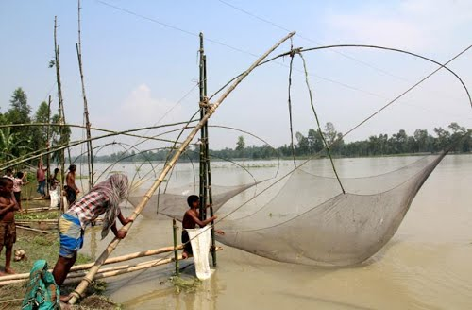
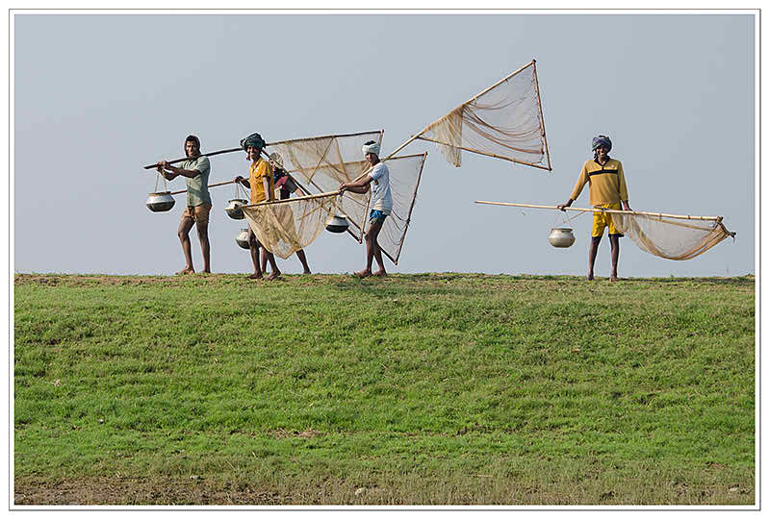
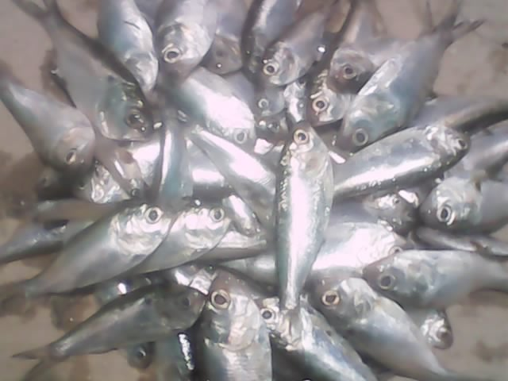
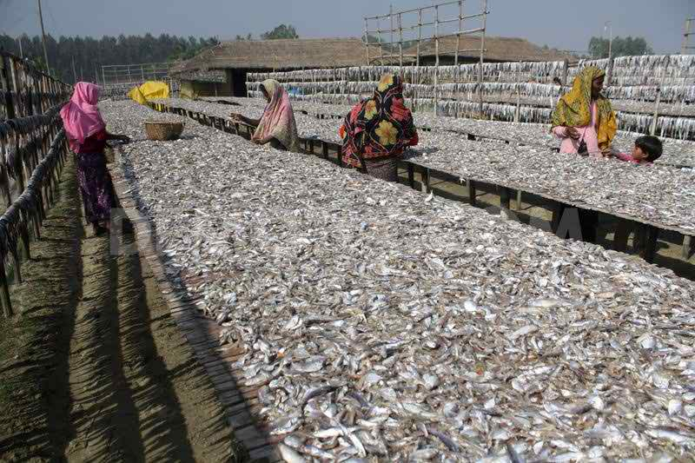
The haor system provides a wide range of economic and non-economicbenefits to the local people as well as to the people of Bangladesh.
Fish production

Slide 26
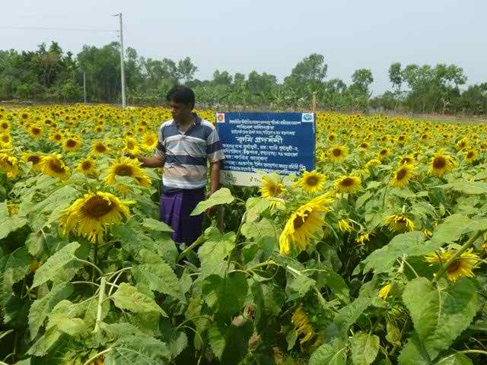
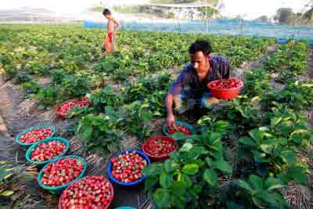
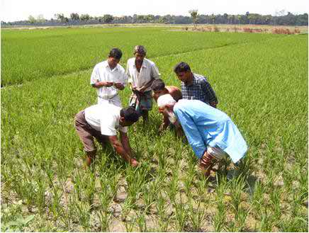
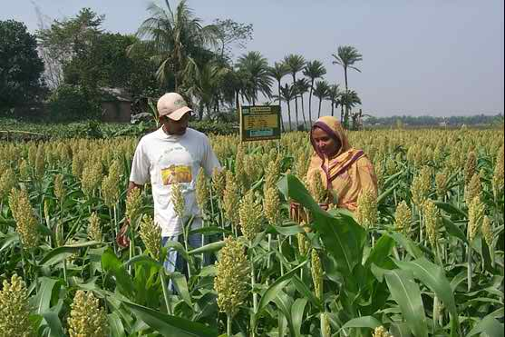
Rice,fruit,oilseed
production

Slide 27
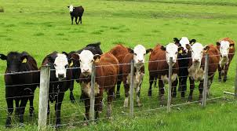
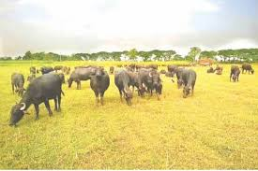
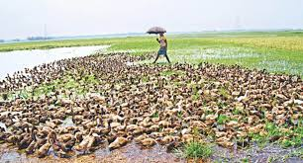
Cattle and buffalo rearing
Duck rearing

Slide 28
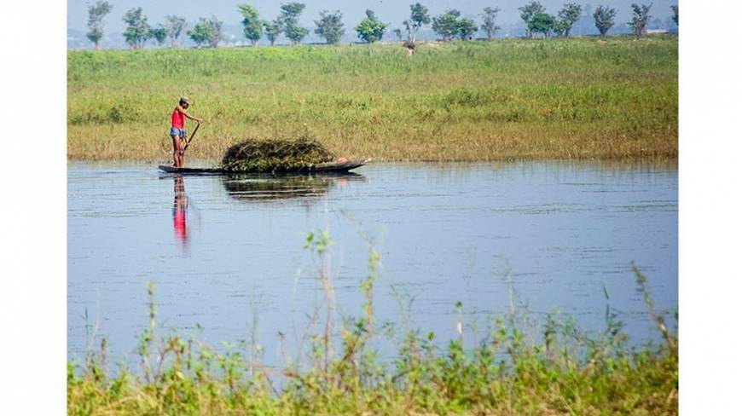
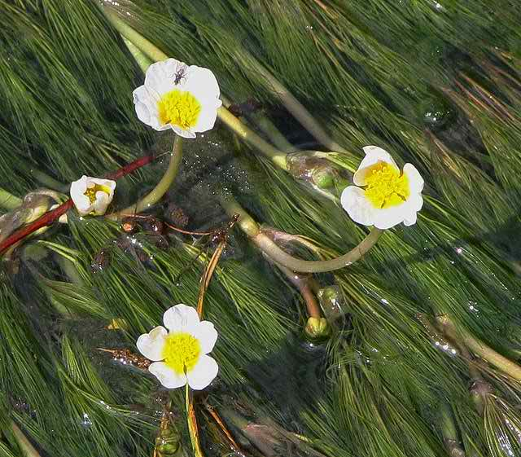
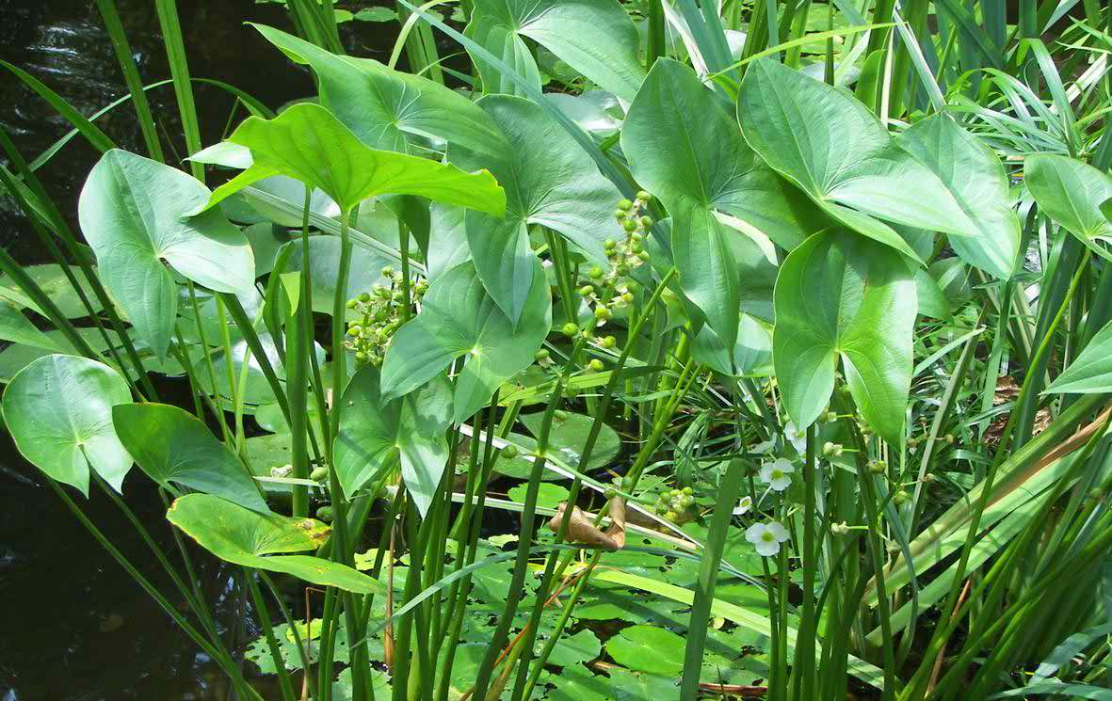
Collection of reeds and grasses
Collection of aquatic and other plants

Slide 29
Green grassland
The Hakaluki Haor in dry season

Slide 30
The Hakaluki Haor in monsoon
Natural bowl of water

Slide 31
Home work
Describe the natural beauty of Hakaluki Haor.

Slide 32
Thanks to all

