Slide 1
Welcome to my today class.

Slide 2
Identity
Teacher
NAME:ROMJAN ALI
Assistent teacher
Majer gaon govt primary school.
Companigonj, Sylhet.
Mobail :01724354399
Lesson
Class:five
Sub:english
Unit :one,
Lesson :one,page,2
Activity:A
Date :01/02/2021
Time:40 MINITE

Slide 3
What is this?
This is our English text book
Please,be ready with your EFT book, not book and pen.

Slide 4
Let’s sing a song together.
Hello, Hello

Slide 5
Our today lesson
Hello, Hello
Unit:One,lesso:one ,page :Two
Activities,A

Slide 7
New word
.
At first ,lets go some new words
We are going to learns new words.
Word
বাংলা অর্থ
English meaning
Introduce
পরিচয় প্রদান করা ।
To make known by name.
Myself
আমি নিজে ।
The reflexive pronoun of I.
Holiday
A time of rest from work.
ছুটি বা অবকাশ ।

Slide 8
New word
.
Word
English meaning
বাংলা অর্থ
Really
Used to refer to what is true or real.
সত্যি ।
Leave
.To go away from somewhere
ত্যাগ করা ।
Journey
Travelling from one place to anther.
ভ্রমন।

Slide 9
New word
.
Word
English meaning
বাংলা অর্থ
Nice
সুন্দর বা আনন্দদায়ক
Amusing time.
Fun
মজা বা আনন্দ
Pleasant.
Meet
When two people see and talk to each other.
সাক্ষাৎ

Slide 10
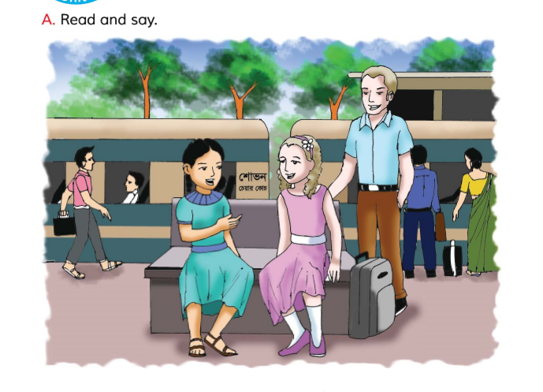
Look at the picture
What can you see in the picture?
People,tree,train,building,travling bag.
Where are the people?
The people are in the relwaystation.
What are the people doingin the picture?
Two girl are seating on a plat from chair.
They are talking with each other.
Some people stand are moving in the station .Some people are seating in the train and waiting.
Some people are moving.

Slide 11
Look at the pictur
Look at them and enjoy the conversation

Slide 12
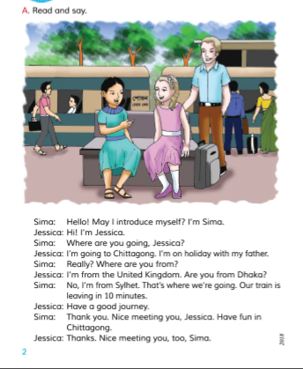
Take your book Open your book At page No 2

Slide 13
Teacher read loudly

Slide 14
Student Reading with Teacher

Slide 15
G W Now Ask and answer the Questions.
Jessica is going to chattogram.
because,spend her holiday with her father.
Jessica come from United Kingdom
No,I am from Sylhet.
Sylhet.
10minute.
Railway station.

Slide 16
Student Read The Text Carefully

Slide 17
P W
Fill in the blanks with appropriate word from the box.
Comes | Holiday | Herself | pleased
lives | Railway | parents | Father
a)Sima introduces -----------------------------------to Jessica.
b)Both Sima and Jassica are at the-------------station.
c)Jessica is going to chattogram with her------------------.
d)Sima -------- -----------------------------------------from Sylhet.
e)Sima and Jessica are -------------to meet each other.

Slide 18
I W
True or flase
Jessica going to Sylhet.
Jessica come from the United kingdom.
.
Our train is leaving 15 minute.
.
Have a nice journey.
.
Nice to meeting you.
.

Slide 19
Evaluation
Read the tex one by one

Slide 20
Rebemember the lesson
আমরা কারো কাছ থেকে বিদায় নিতে বলবঃ
Good bay, Nicc meet you,Take care,see you again,
.
We have learnt how to introduce myself,greet people and take people take leave of someone.
.

Slide 21
Home Work
Write five sentences about yourself

Slide 22
No more Today
Thanks to all.

