Slide 3
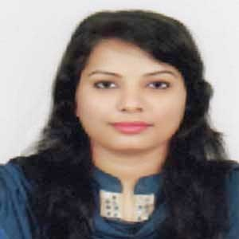
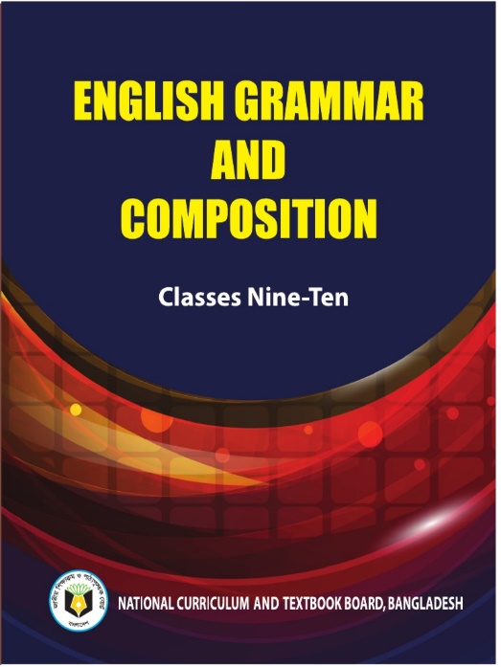
INTRODUCTION
RUBAIYA SULTANA
Assistant Teacher
Hafiz Ahmed High School
Barura, Cumilla.
English Grammar And Composition
Class: Nine-Ten

Slide 4
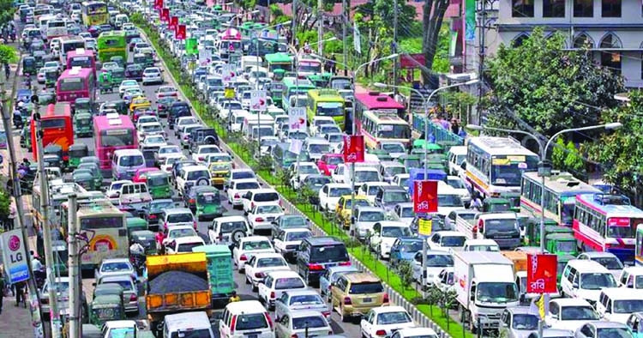
Our today’s lesson is-
Paragraph Writing
TRAFFIC JAM

Slide 5
5
Topics
What is Traffic jam?
Traffic jam in cities & Bangladesh
Causes
Effects
Solution
Concluding Sentence

Slide 6
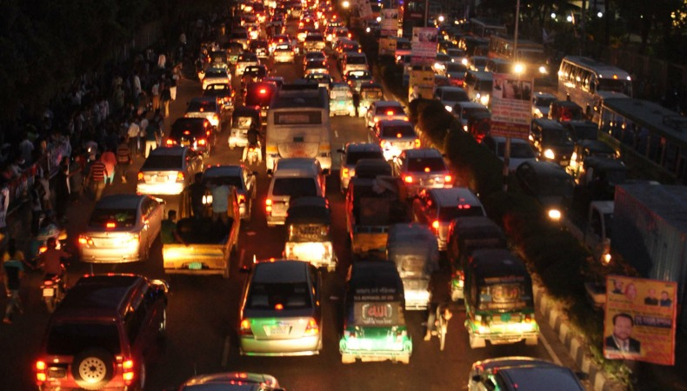
What is Traffic Jam?(Topic Sentence)
Traffic jam is a situation in which a long line of vehicles on a road have stopped moving or are moving very slowly.

Slide 7
Enlarging idea; Supporting Sentences: It is a common problem in big cities ‘and towns. It is one of the major problems in modern time. Everyman in the town has to face the nasty situation of a traffic jam.

Slide 8
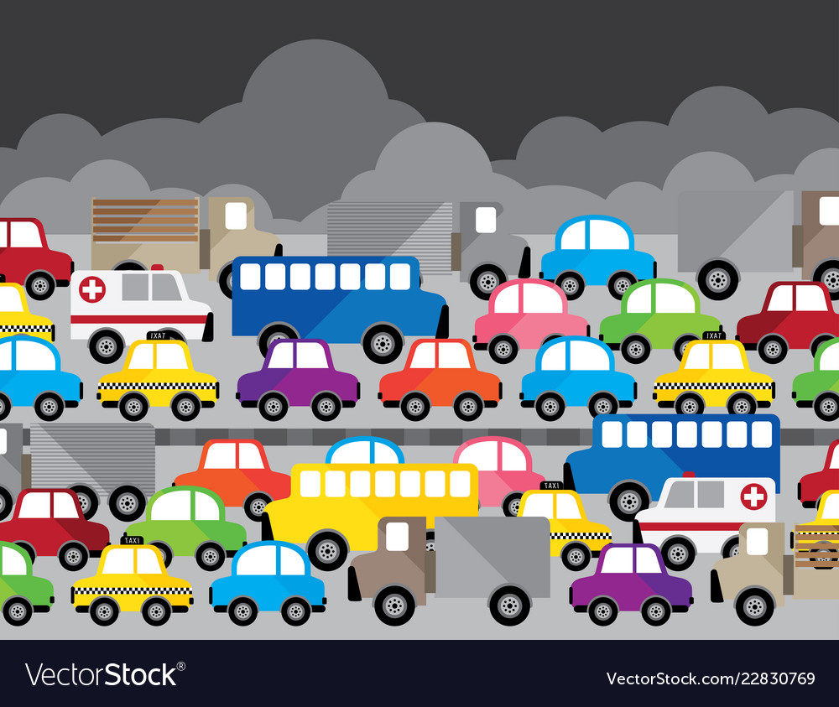
Causes
Insufficient amount of roads
Poor Traffic Administration
Wrong Parking
Unfit Vehicles & Illegal License
Construction Works
Hawkers
Political Meeting and Rally
Overtaking Tendency
Uneducated Drivers
Accident

Slide 9
There are many causes of traffic jam in Bangladesh.Bangladesh is a thickly populated country. So her towns are also thickly. The roads and streets of our towns and cities are not so wide. …………………………………………………………………………………………………………………………So they cause a traffic jam.

Slide 11
Traffic jam causes great harm to us. It creates a great problem for our social and individual life. Traffic jam created in the road kills a lot of valuable time. Hours after hours we have to wait for the jam. Students and the service-holders-can’t reach institutions and offices respectively in time. The traffic jam kills much time, many valuable lives of the hospital going patients.

Slide 13
To relieve the passengers of the suffering of traffic jam, some steps should be taken by the government. The drivers who do not abide by traffic rules should be punished. The traffic authority should be active to enforce the traffic rules and maintain the discipline on the roads.

Slide 15
The sooner the problem is solved, the better not only for saving time but also for saving a life.

Slide 16
Home Work
Write a paragraph about
“ Road Accident”

