Slide 1
Welcome to everyday

Slide 2
Identity
MITALI Halder
Assistant Teacher
Dumuria High School
Class: Eight
Subject: English 2nd paper

Slide 3
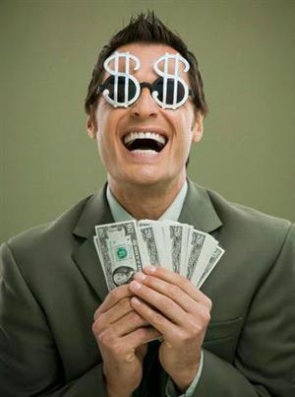
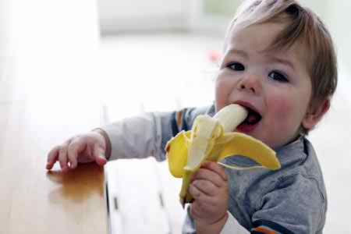
It rains cats and dogs
He has much money
The baby eats banana

Slide 4
Today’s topic is
Verb

Slide 5
Learning outcome
By the end of the lesson learners will be able to---
Say which words are verb.
Say what is verb?
Say the definition of verb .

Slide 6
Classification of verb
Verbs are mainly two kinds---
Finite verb and Non- finite verb
The verb which can be changed according to the number, person and tense is called Finite verb.
I teach the learners everyday.
Here ‘teach’ is Finite verb.

Slide 7
Finite verb
primary
Main verb
Auxiliary verb
modal
transitive
intransitive

Slide 8
Now
Non-Finite verb
The verb which can not be changed according to number, person and tense is called non-finite verb.
Taking a bath is important to our health.
Reading books helps us to gain knowledge.
The colored words are non-finite verb.

Slide 9
Group work
At first be divided into two groups and by asking one another, try to practice the above mentioned topic.

Slide 10
evaluation
What is finite verb?
What is non-finite verb?
Make the classification of finite verb.
Ok, more will be in the next class.

Slide 11
Home task
After going home, try to classify primary and modal auxiliary verb and get it by heart.

