Slide 2
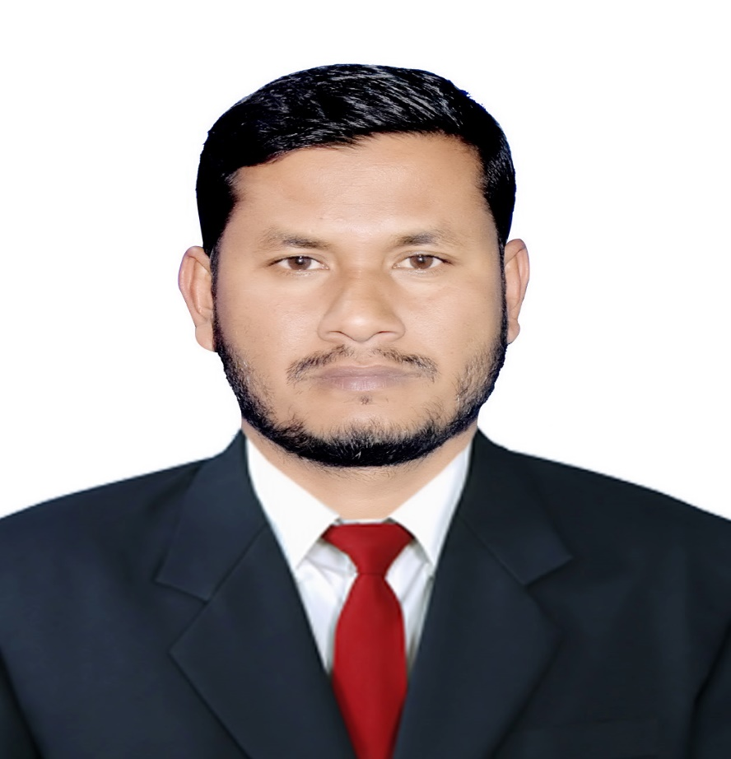
Teacher’s Identity
Md Sazzadur Rahman
Assistant Teacher
Jaliarpar Govt Primary School
Companigonj, Sylhet.

Slide 3
Lesson Identity
Class : Five
Subject : English
Unit : One
Lesson : 01
Lesson Tittle : Hello !
Page no : 2

Slide 4
Let’s to watch“ Greeting song”

Slide 5
Lesson title
Hello!

Slide 6
Learning Outcomes
Students will be able to-
Listening:
3.2.1 understand questions about family and friends of students.
3.4.1 understand statements made by the teacher and students.
Speaking:
1.1.1 say words, phrases and sentences with proper sounds and stress.
8.1.1 take part in conversations on appropriate topics.
Reading:
1.5.1 read words, phrases and sentences in the text with proper pronunciation ,stress and intonation.

Slide 7
Look and say about this picture

Slide 8
Discussion about showing picture
Who are there in the picture?
Answer: They are Sima and Jessica.
2. Where are they?
Answer: they are at a railway station.

Slide 9
Open your book at page2

Slide 10
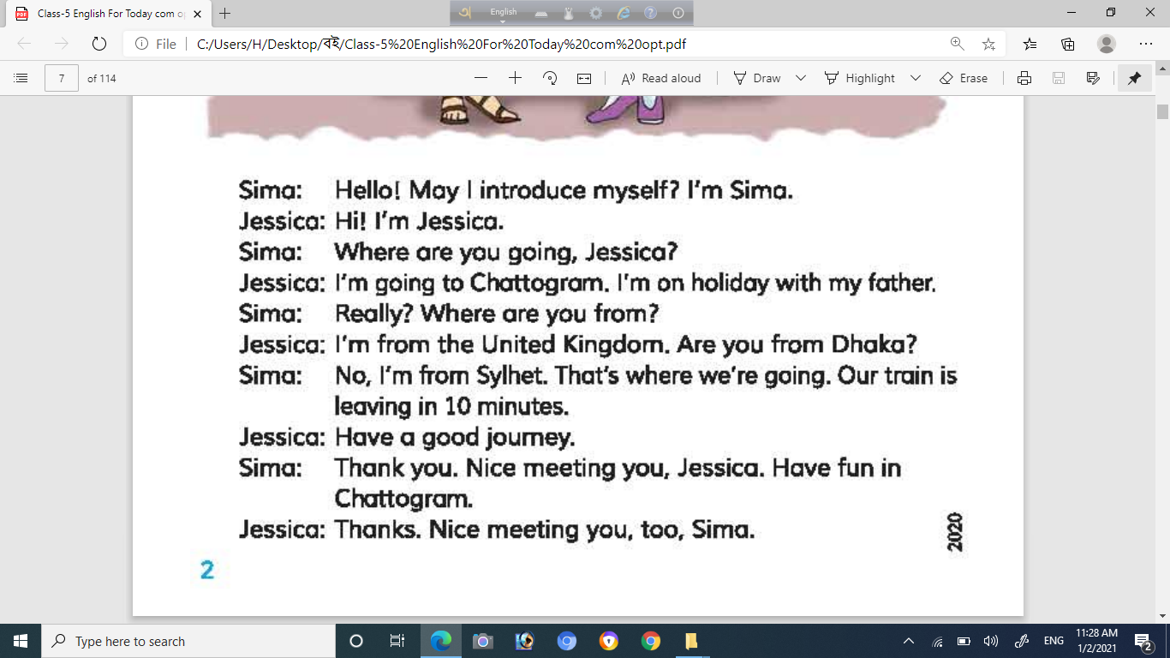
Teacher’s reading

Slide 11
Students reading with practice
Sima: Hello ! May I introduce myself ? I’m Sima.
Jessica:Hi! I’m Jessica.
Sima: Where are you going, Jessica ?

Slide 12
Jessica: I’m going to Chittagong. I’m on holiday with my father.
Sima: Really ? Where rae you from ?
Jessica: I’m from the United Kingdom. Are you from Dhaka ?

Slide 13
Sima: No,I’m from Sylhet.That’s where we’re going. Our train is leaving in 1o minutes.
Jessica: Have a good journey.
Sima:Thank you. Nice meeting you, Jessica. Have fun in Chittagong.
Jessica:Thanks.Nice meeting you, too, Sima.

Slide 14
New words in this lesson
Introduce
পরিচয় করানো
Formally known by name to another in person..
Really
সত্যি
in actual fact
Holiday
ছুটি
an extended period of leisure and recreation
Meeting
দেখা হওয়া
formal discussion
Leaving
ছেড়ে যাওয়া
go away from

Slide 15
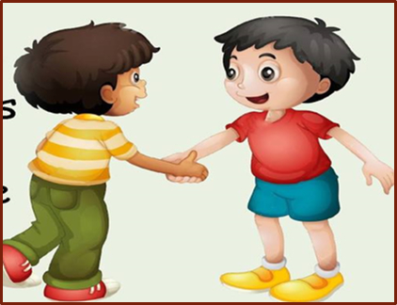
One day One word
Introduce
পরিচয় করানো
make (someone) known by name to another in person, especially formally.

Slide 16
Recognize with Wh questions
Wh word
Where used
Where
A place
How
In what way or manner
What
Which thing or action
Why
Reason or cause
Who
A person

Slide 17
Indivitual Work
Write ‘True’ for correct statement or ‘Folse’ for incorrect statement .
( a ) The train leaving in 15 minutes.
( b ) Jessica comes from United Kingdom.
( c ) Sima comes from Sylhet.
( d ) On holiday, Jessica came to Dhaka.

Slide 18
Pair work
Dear students, To make conversation to each other about your first meet.

Slide 19
Evaluation
Answer the following questions
Where is Jessica going?
Why is Jessica going there?
Where is Jessica from?
Is Sima from Dhaka?
Where is Sima going?
When is Sima’s train leaving?

Slide 20
Home task
Students will be solved this questions.
a) Where is Jessica going?
b) Where is Sima from?
c) Where are Sima and Jessica?
d) Where is Sima going?

Slide 21
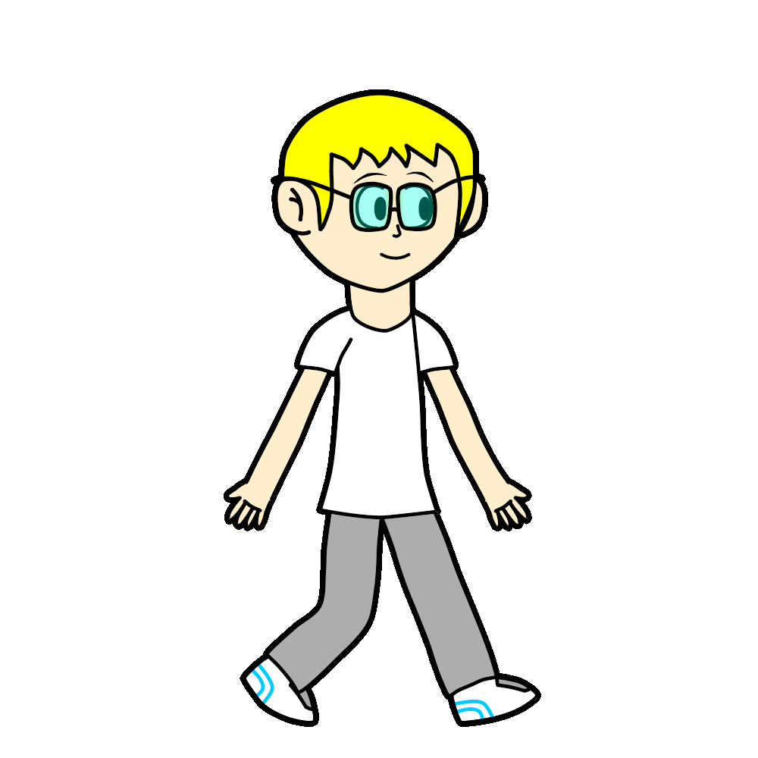
Thank you everybody.See you later.

