Slide 3
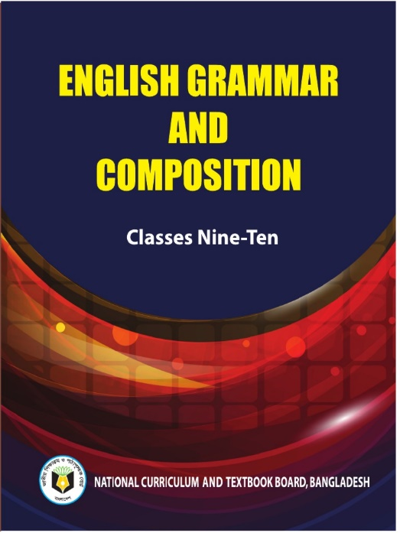
INTRODUCTION
RUBAIYA SULTANA
Assistant Teacher
Hafiz Ahmed High School
Barura, Cumilla.
English Grammar And Composition
Class: Nine-Ten

Slide 4
Learning Outcomes
Students will be able to learn-
How to write Topic Sentence
How to enlarge idea
How to write concluding sentence

Slide 5
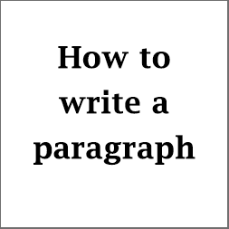
Our Today’s Lesson Is-

Slide 6
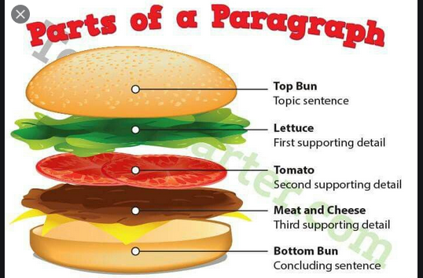

Slide 7
What is a Paragraph?
A paragraph is a group of sentences that focuses on a single idea. In order for a paragraph to be effective,it must begin
with a topic sentence, have sentences that support the main idea of that paragraph, and maintain a consistent flow.

Slide 8
What are Topic Sentences?
The topic sentence is the sentence in a paragraph that gives the reader insight into what the paragraph is about.It will give the main idea that the paragraph is going to focus on.

Slide 9
What are Supporting Sentences?
The supporting sentences of a paragraph develop the main
idea you presented in the topic sentence. When writing supporting sentences you should be giving examples, reasons, or descriptions to support your topic sentence. Supporting sentences should focus on the following:
- They should provide the main supporting points for the paragraph's main idea (topic sentence) - There are usually 2 - 4 supporting sentences in a paragraph. - They should be arranged in a logical order. - They should not begin a new topic or introduce a new idea.

Slide 10
What is a Concluding Sentence?
The conclusion is the last sentence in your paragraph. Here are a few DO's and DON'T's of conclusion sentences.
DO - Restate the topic sentence using synonyms. - Restate the topic sentence using a different kind of sentence. - Wrap up your paragraph.
DON'T - Copy the exact wording of the topic sentence. - Include a new topic. - Focus on a small idea.

Slide 11
Paragraph Editing
Grammar and Spelling 1. Check for correct spelling. 2. Check your grammer. 3. Read your paragraph aloud. 4. Check that each sentence has a subject. 5. Check subject verb agreement. 6. Make sure each sentence makes sense.

Slide 12
Style and Organization.
1. Make sure paragraph has a topic sentence. 2. Make sure your supporting sentences stick to a main idea. 3. Make sure you have a closing sentence. 4. Check your paragraph for varied and interesting sentences.

Slide 13
Home Work
Write a paragraph about
“ Traffic Jam”

