Slide 1
Welcome to my class

Slide 2
Introduce
MITALI HALDER ASSISTANT TEACHER DUMURIA HIGH SCHOOL
CHITALMARI, BAGERHAT.
Class : Six
Sub:English 2nd paper

Slide 3
Test of pre-knowledge
1.He eats rice/Rice is eaten by him.
2.I have done the sum/The sum has been done by me.
3.He has to do the work / the work has to be done by him.
4.He told me a story / I was told a story by him.or A story was told me by him
5.Rome was not built in a day/The Romans did not build Rome in a day.

Slide 4
Voice Change

Slide 5
By the end of the lesson the learners will be able to learn-
Changing voice from active to passive
And vice versa
Rules of changing voice

Slide 6
In this video we can see-
Fleck kicked the ball
The ball was kicked by Fleck.
Fleck
subject
kick
verb
The ball
object

Slide 7
The first sentence tells us what Fleck did.
Fleck kicked the ball.
So it is active voice.
The second sentence tells us what was done to the ball.
The ball was kicked by Fleck.
So it is passive voice.

Slide 8
Rules of Changing Voice from active to passive
Rule-1 : Place to the object as the subject at the beginning of the sentence
Fleck kicked the ball.
was
The ball
kicked
by Fleck.
Rule-2 : Place “to be” verb before main verb according to their tense & person.
Rule-3 : Place participle form of the main verb.
Rule-4 : Place to the subject with it’s objective form at the end of the sentence with by or to.

Slide 9
Rule-5 : In the present indefinite tense we use am, is, are as “to be” verb before main verb according to it’s subject and person.
For Example :
Active
Raj knows him.
They call me.
Passive
He is known to Raj.
I am called by them.
You give them food.
They are given food by you.

Slide 10
Rule-6 : In the past indefinite tense we use was, were as “to be” verb before main verb according to it’s subject and person.
For Example :
Active
I knew you
He called me
Passive
You were known to me
I was called by him
He made a noise
A noise was made by him

Slide 11
Rule-7 : In the future indefinite tense we use only be as “to be” verb before main verb.
For Example -
Active
I shall teach you.
He will invite me.
Passive
You will be taught by me.
I shall be invited by him.
He will write a letter.
A letter will be written by him.

Slide 12
Let’s see some more examples:
Active
The man catches a fish.
Helen drew a picture.
Passive
A fish is caught by the man.
A picture was drawn by Helen.
I shall work out the sum.
The sum will be worked out by me.

Slide 13
Evaluation-
Give an example active/passive voice.

Slide 14
Home Work
Change the voice
I eat rice.(Passive)
He was eaten rice.(Active)
He plays cricket.(Passive)
Mitu made a cup of tea.(Passive)
He is known tome.(Active)

Slide 15
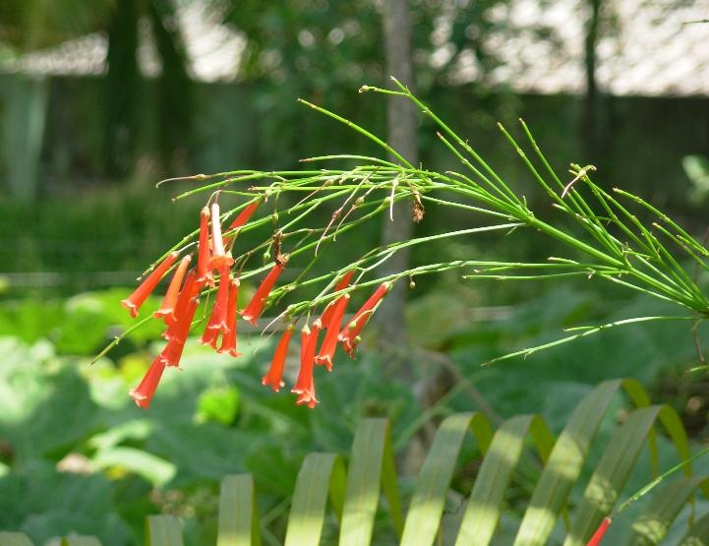
Thanks to All

