Slide 1
Welcome

Slide 2
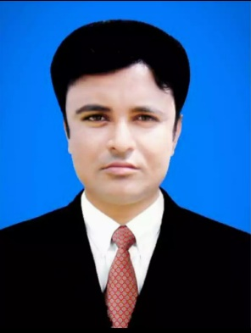
IDENTITY
TEACHER
LESSON
Class: Eight
Subject: English 1st paper
Unit: 01
Lesson: 09
Time: 50 Minutes
Md. Jahangir Alam
Assistant Head Teacher
Durgapur High School
Aditmari, Lalmonirhat.
E-mail: jahangir7385@gmail.com

Slide 3
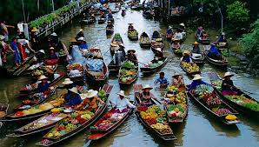
Let’s see the following picture

Slide 4
Now see the following video

Slide 5
TODAY`S LESSON IS
THA KHA FLOATING MARKET

Slide 6
LEARNING OUTCOMES
By the end of the lesson Students will be able to…
Read and understand the text.
Learn and say to the new vocabulary.
Give answer the Question.
Write main idea of the text.

Slide 7
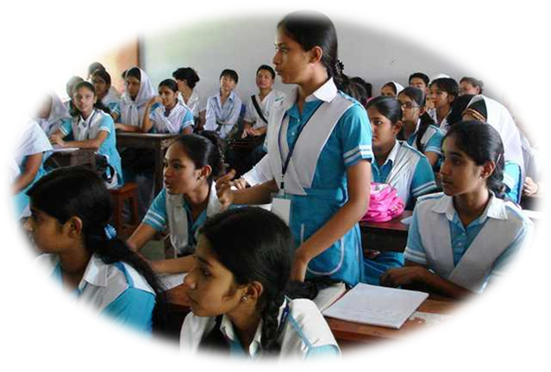
LOUD READING
It was Sunday. Mita, Zara, juma Islam and Mazharul Islam woke up very early. They quickly got ready and started for Tha Kha ------
Teacher will help the Students.

Slide 8
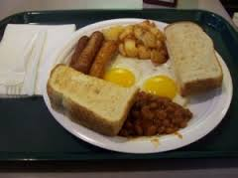
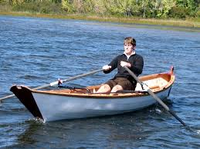
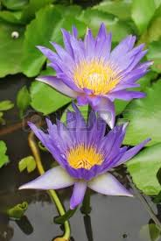
NEW VOCABULARY
Breakfast =
First meal of the morning
Slowly =
Less than the usual speed
Seller =
One who sells things
Lotus =
A kind of water lily

Slide 9
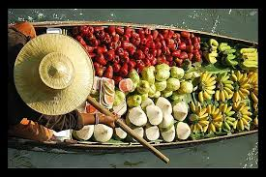
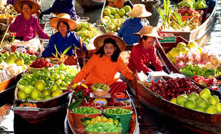
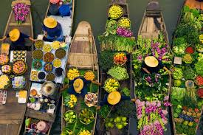
Here we see more pictures
Pic no-01
Pic no-02
Pic no-03
Pic no-04

Slide 10
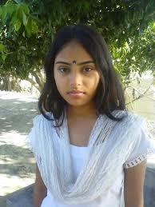
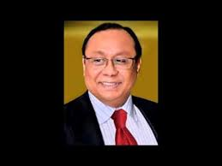
Mita
Zara
Juma Islam
Majharul Islam
They are tourists person they live in Bangladesh. Now they visit Tha Kha floating Market in Thailand. They hired a Boat for see the Market.

Slide 11
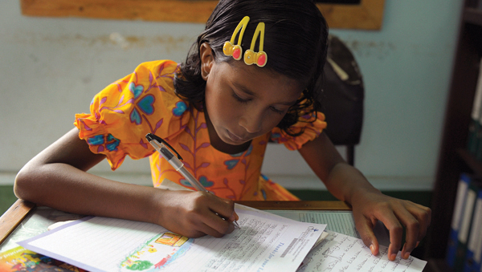
INDIVIDUAL WORK
Write the meaning of the following words.
Breakfast
Slowly
Seller
Lotus

Slide 12
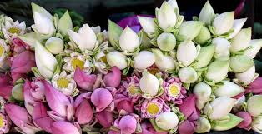
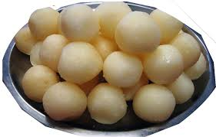
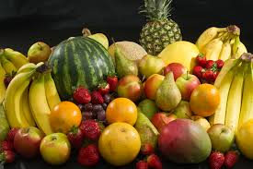
Lotus flower
Delicious Sweets
fruits

Slide 13
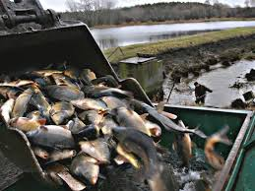
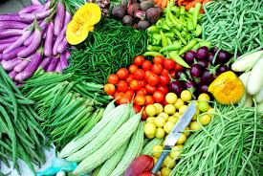
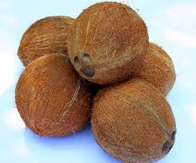
Farm fish
Local vegetables
Coconut

Slide 14
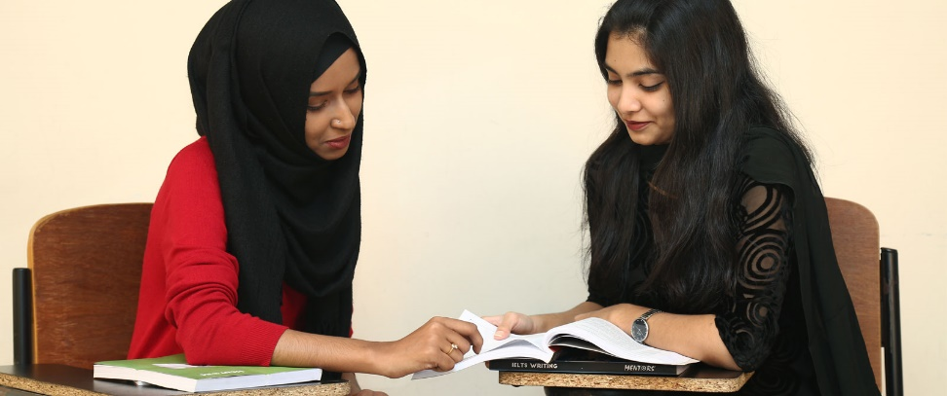
PAIR WORK
What things are mainly selling in the market?

Slide 15
EVALUATION
Who were the selling their goods?
Who is the visitors of the market?
What kind of market was it?

Slide 16
HOME WORK
Summarize the text shortly in your own words

