Slide 1











Slide 2

Teacher’s Information
Md. Shamsul Alam
BA(Hons.)MA in English.
Assistant Teacher( English)
Nabodoy Girl’s High School
Shailkupa, Jenaidah.
Phone:01917-452052,01722-922691
Email:shamsul101085@gmail.com

Slide 3
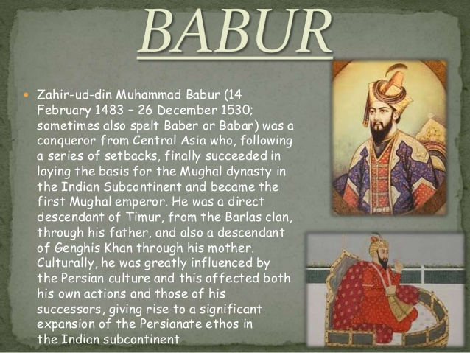
LET’S SEE SOME PICTURES
The Mughal emperor babur

Slide 4
So, Our Today`s Lesson is
Unseen Passage
On Mughol Emperor BaBur

Slide 5
Learning outcomes:
After we have studied the unit, we will able to
☞ Know about Mughol Emperor BaBur
☞ Complete the table
☞ Summering the passage

Slide 6
Read the following passage carefully and find new words
Emperor Babur is known as the founder of the Mughal Empire in India .He was born on the 14th February 1483 in Fargana provinces, Uzbekistan. Babur was a military genius and a skilful warrior. He was also a lover of fine arts and poetry. He was a direct descendant Timur Lang and Genghis Khan. In 1495.at twelve years of age Babur succeeded his father as the ruler of Fargana. His uncles were against him so Babur spent a large portion of his early life without shelter or in exile. In 1497 he gained control of the city of Samarkhand. He lost it again. In 1501, he captured Samarkhand again. In 1504, he was able to cross the snowy Hindu Kush mountains and captured Kabul. However, in the battle of Panipath in 1526, Babur defeated the ruler of Delhi, Ibrahim Lodi and took possession of Delhi and Agra. Thus he founded the Mughal Empire in India. He died at the age of 47 on January 5,1531.

Slide 7
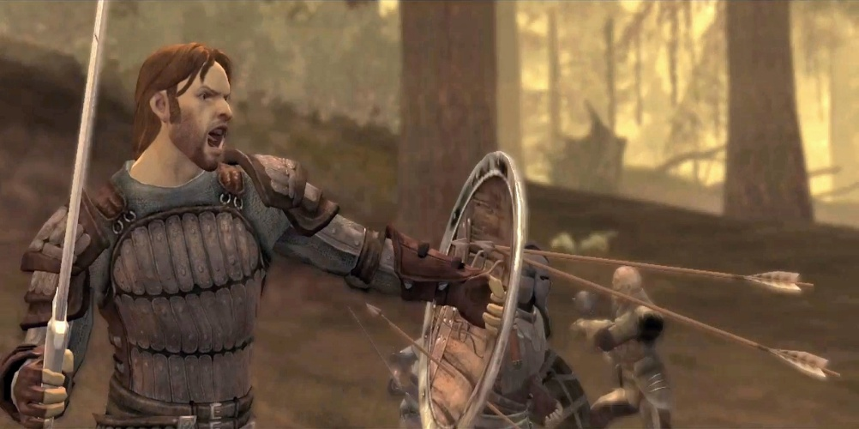
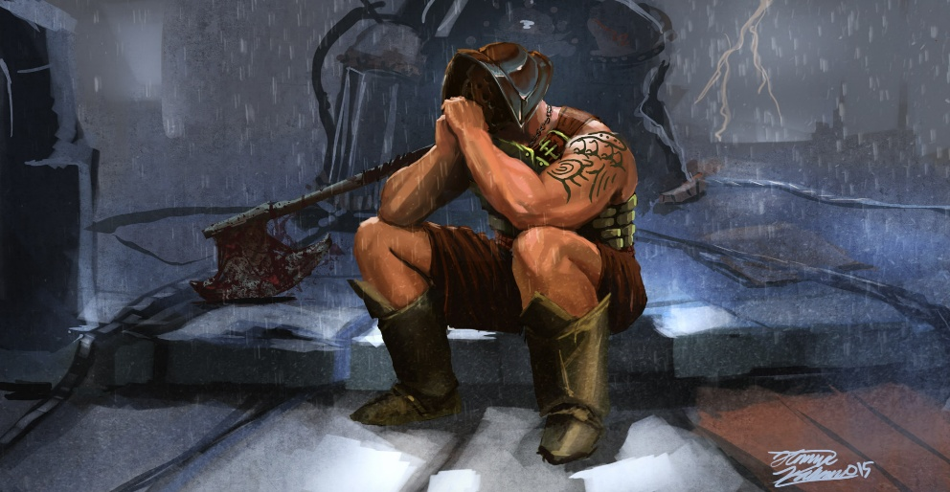
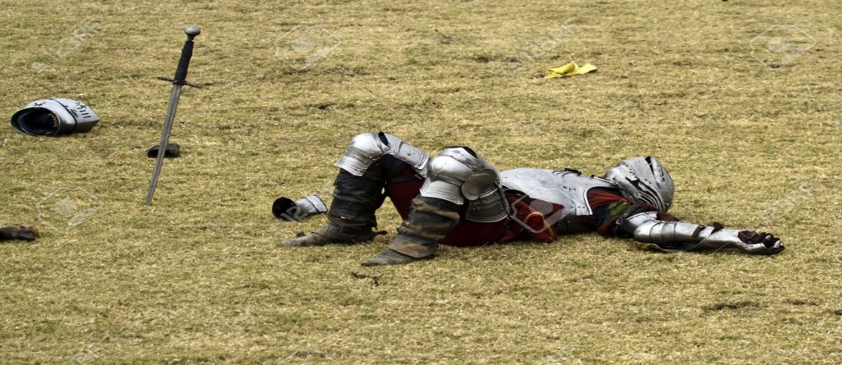
New words:
Soldier, fighter
warrior.
exile
Expel, drive away
defeated
Loss, ruin

Slide 8
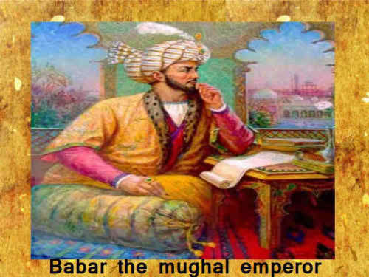
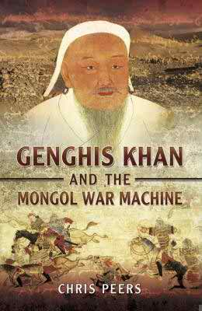
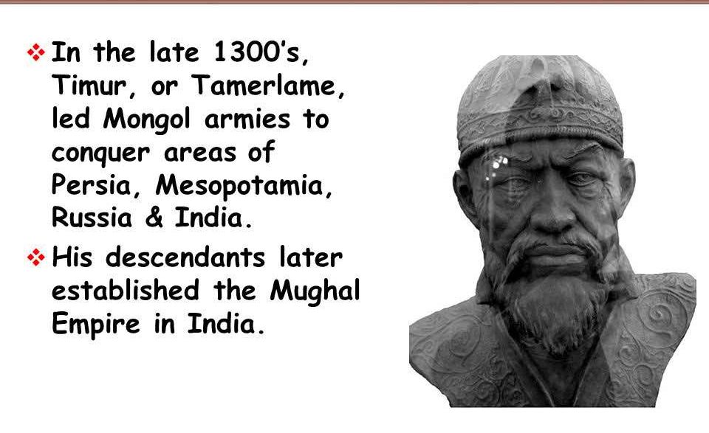
Details discussion on text
Emperor Babur is known as the founder of the Mughal Empire in India .He was born on the 14th February 1483 in Fargana provinces, Uzbekistan. Babur was a military genius and a skilful warrior. He was also a lover of fine arts and poetry. He was a direct descendant Toimur Lang and Genghis Khan

Slide 9
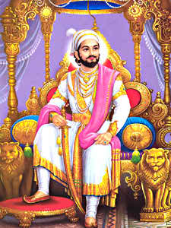
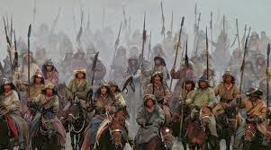
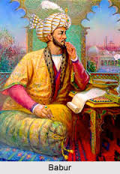
Details discussion on text
In 1495.at twelve years of age Babur succeeded his father as the ruler of Fargana. His uncles were against him so Babur spent a large portion of his early life without shelter or in exile. In 1497 he gained control of the city of Samarkhand. He lost it again. In 1501, he captured Samarkhand again.

Slide 10
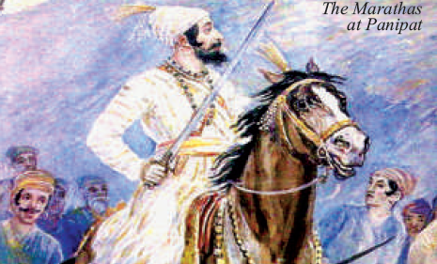
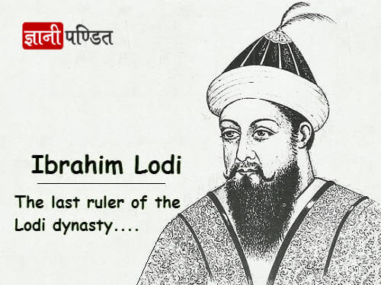
Details discussion on text
In 1504, he was able to cross the snowy Hindu Kush mountains and captured Kabul. However, in the battle of Panipath in 1526, Babur defeated the ruler of Delhi, Ibrahim Lodi and took possession of Delhi and Agra. Thus he founded the Mughal Empire in India. He died at the age of 47 on January 5,1531.

Slide 11

Read the text again carefully and answer the Question no 4 & 5
Evaluation

Slide 12
Emperor Babur is known as the founder of the Mughal Empire in India .He was born on the 14th February 1483 in Fargana provinces, Uzbekistan. Babur was a military genius and a skilful warrior. He was also a lover of fine arts and poetry. He was a direct descendant Timur Lang and Genghis Khan. In 1495.at twelve years of age Babur succeeded his father as the ruler of Fargana. His uncles were against him so Babur spent a large portion of his early life without shelter or in exile. In 1497 he gained control of the city of Samarkhand. He lost it again. In 1501, he captured Samarkhand again. In 1504, he was able to cross the snowy Hindu Kush mountains and captured Kabul. However, in the battle of Panipath in 1526, Babur defeated the ruler of Delhi, Ibrahim Lodi and took possession of Delhi and Agra. Thus he founded the Mughal Empire in India. He died at the age of 47 on January 5,1531.
Read the following passage carefully and complete the table below with information from the passage.
Who/What | Event/Activity | Year/Time | Place
Emperor Babur | born | 1443 | (i)..........
He | Captured Kabul | (ii).......... | Fargana
He | became the rulr | (iii)..........
He | defated Ibrabim Lodi | In 1526 | (iv).......
He | died | (v).......
Fargana.
1495
1504
Battle of panipath
1531

Slide 13
Emperor Babur is known as the founder of the Mughal Empire in India .He was born on the 14th February 1483 in Fargana provinces, Uzbekistan. Babur was a military genius and a skilful warrior. He was also a lover of fine arts and poetry. He was a direct descendant Timur Lang and Genghis Khan. In 1495.at twelve years of age Babur succeeded his father as the ruler of Fargana. His uncles were against him so Babur spent a large portion of his early life without shelter or in exile. In 1497 he gained control of the city of Samarkhand. He lost it again. In 1501, he captured Samarkhand again. In 1504, he was able to cross the snowy Hindu Kush mountains and captured Kabul. However, in the battle of Panipath in 1526, Babur defeated the ruler of Delhi, Ibrahim Lodi and took possession of Delhi and Agra. Thus he founded the Mughal Empire in India. He died at the age of 47 on January 5,1531.
5. Write a summary of the passage in no more than 90 to 100
words. =10

Slide 14
THANK YOU
All

