Slide 1
Welcome

Slide 2
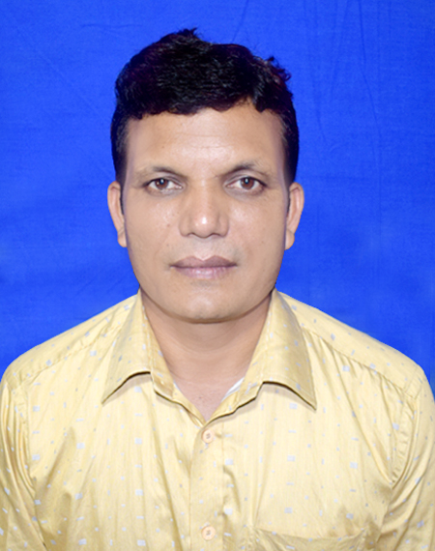
Teacher’s identity
A F M Saiful Islam
Head Teacher
Musrat Madati Govt. Primary School
Kaligonj, Lalmonirhat .

Slide 3
Subject: English
Class: 5
Unit 2
Lesson 1-2( see you)

Slide 4
Learning outcomes
Listening:
1.4.2 recognize and use intonation patterns for greetings and statements
Speaking:
2.1.1 exchange greetings and farewells.
3.1.1 ask and answer WH questions.
Reading :
1.6.1 Recognize and read statements, commends, greetings questions and answer.

Slide 5
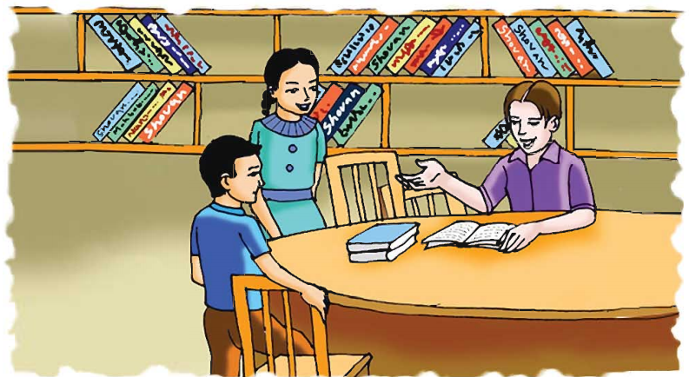
Preview class: Look at the picture. Answer the following questions
Where are Sima and Tamal?
They are in Town Hall Language Club.
Why do they go there?
They go there to practice speaking English.

Slide 6
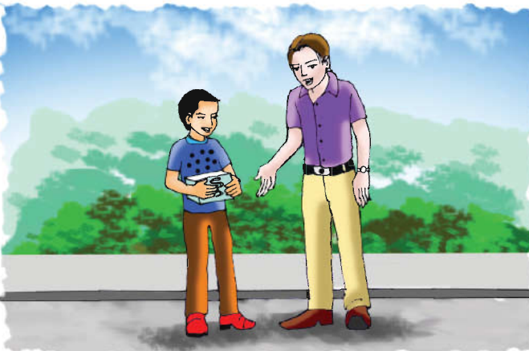
Do you know the people?
Yes, we know. The are Tamal and Andy.
What are they doing?
They are talking to each other.

Slide 7
Teaching vocabulary .
Medicine:
A compound used for prevent of diseases.
Right now:
Without delay.
Great :
Very good.( it’s an expression )

Slide 8
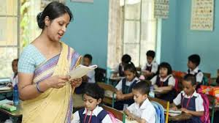
Teacher’s reading:
Students open at page 6. Listen to me.

Slide 9
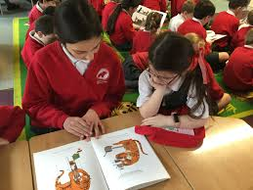
Students pair reading.

Slide 10
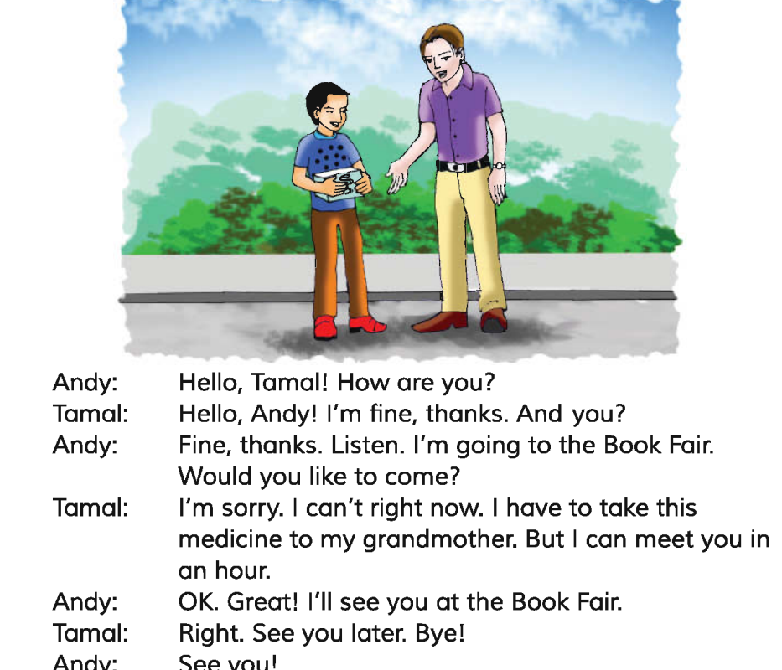
Pair practice
Teacher to student.
Student to student.

Slide 11
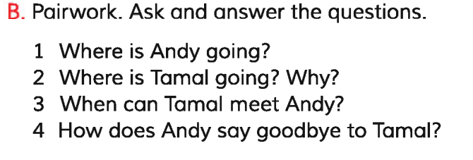

Slide 12
How did Andy and Tamal take leave of each other?
See you later. Bye!

Slide 13
What you have learnt from the content?
We’ve learnt how to greet people and take leave of someone.
To say goodbye:
Bye !
See you later.
See you!

Slide 14
Thanks.
See you!

