Slide 1
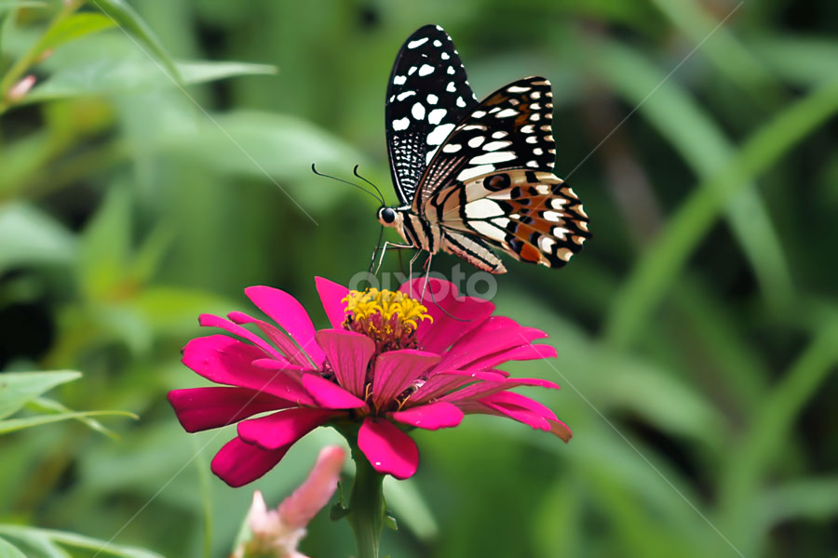
Welcome to all

Slide 2
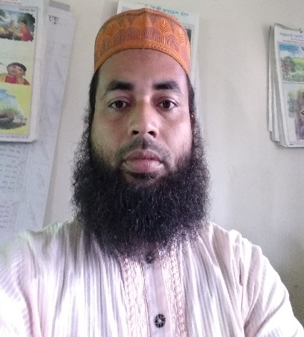
Teacher’s identity
Md. Afzal Hossain
Assistant teacher
Kuralia Govt. Primary School
Madhupur, Tangail

Slide 3
Lesson’s identity
Class: Four
Subject: English
Unit: 3
Lesson:1-2
Title’s of the unit :
Family
Date: 8.02.2021

Slide 4
Learning outcomes:
Listening:
1.1.1. recognize sound differences in the context of words.
1.2.1.recognize which syllable in a word is stressed.
3.2.1., understand questions about family and friends.
3.4.1.understand statement made by the teacher and students.
Speaking:
1.1.1. repeat after the teacher and say words, phrases
sentences with proper sounds stress and intonation.
6.2.1- talk about people, objects, events, etc.
Reading:
1.4.1. read words, phrases and, sentences in the text with proper pronunciation, stress and intonation.
5.1.1.read short paragraph, dialogues, simple letters and other text materials.

Slide 5
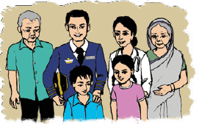
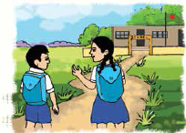
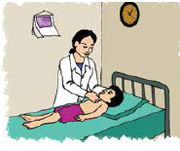
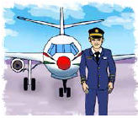
Let’s see some pictures
A family
The students go to school.
A doctor
A pilot

Slide 6
Today’s lesson
Family

Slide 7
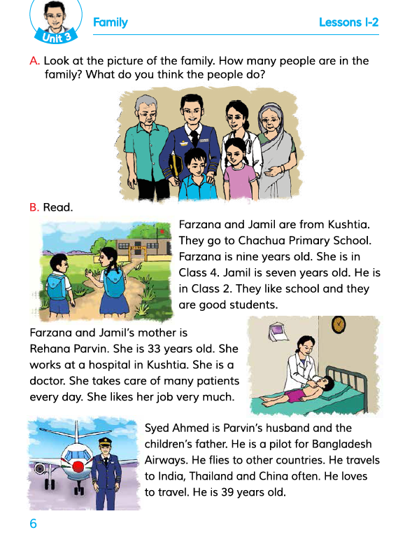
Open your book at page 6

Slide 8
Let’s see some new words
Government
control
School
educational institute
Student
learner
Hospital
health Centre

Slide 9
Doctor
physician
Take care
look after
Patient
sick people
Pilot
who flies plane
Travel
journey

Slide 10
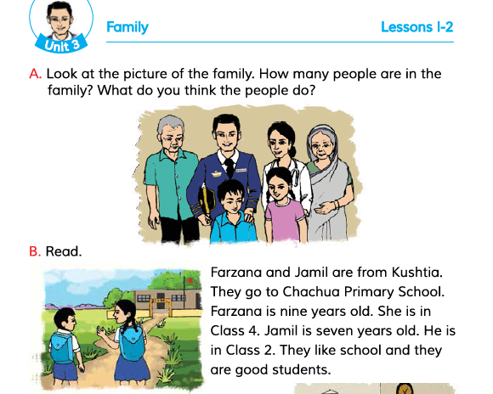
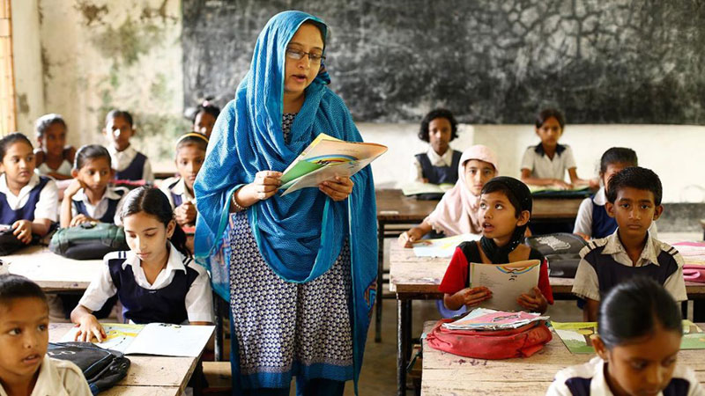
Teacher’s loud reading

Slide 11
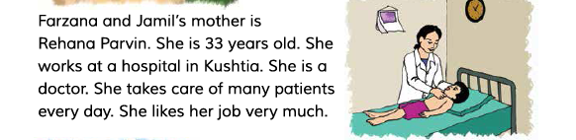

Slide 12
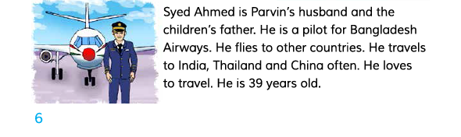
Aziz Ahmed is Farzana and Jamil’s father. He is a pilot of Biman Bangladesh Airlines. He flies to other countries. He travels to India, Thailand and Chaina often. He loves to travel. He is 39 years old.

Slide 13
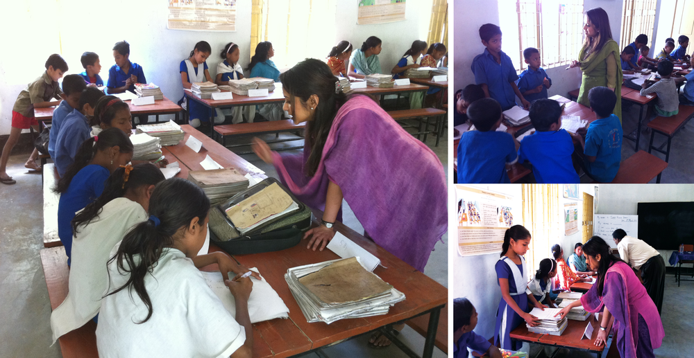
Match the words with their meanings
G .W
Column A | Column B
a) Student | i) look after
b)Hospital | ii) sick people
c)Patient | iii) journey
d)Take care | iv) health centre
e)Travel | v) learner

Slide 14
Cheek your G.W activity
Student – learner
Hospital – health centre
Patient - sick people
Take care – look after
Travel - journey

Slide 15
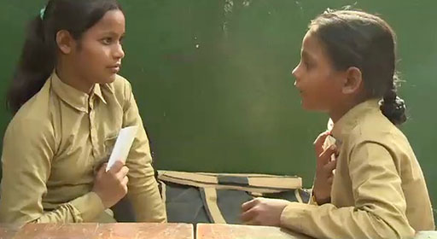
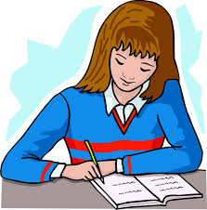
Say and write ‘true’ or ‘false’
P.W
a) Farzana is Jamil’s elder sister.
b) Only Jamil is a good student.
c) A doctor looks after the patients.
d) We go to the hospital when we feel ill.
I.W
e) Jamil’s mother works at a bank.
f) Aziz Ahmed loves to travel.

Slide 16
Answer the following questions
a) What’s the name of Farzana’s school ?
b) How is Jamil as a student ?
I.W
c) What is Rehana Parvin ?
d) How does a doctor help us ?
e) Where is Aziz Ahmed workplace?
f) Where does he travel often ?

Slide 17
Home work
Write a short composition about ‘your family’ in at least 5 sentences.

Slide 18

Good bye
Bye
Bye

