Slide 1
আজকের ক্লাসে সবাইকে স্বাগত

Slide 2
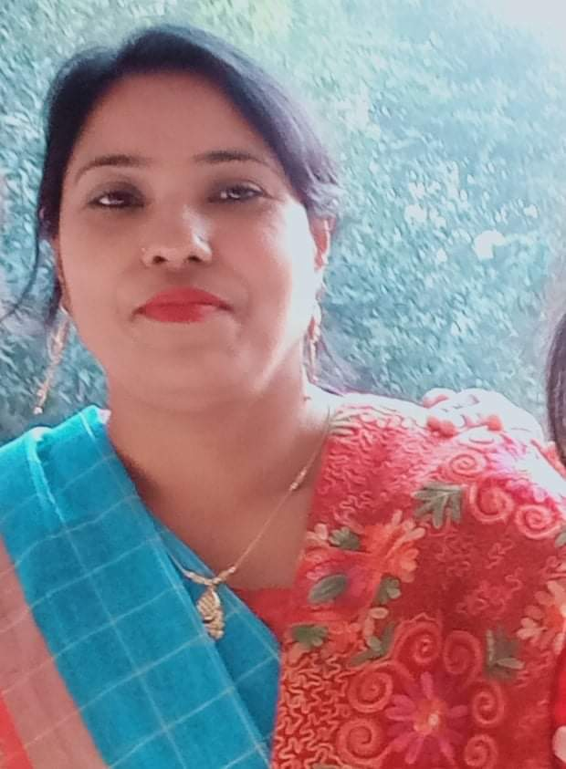
TEACHER IDENTITY
MOST. MARJU ARA BEGUM
HEAD TEACHER DOKKHIN BALAPARA GOVERMENT PRIMARY SCHOOL
DIMLA,NILPHAMARI.

Slide 4
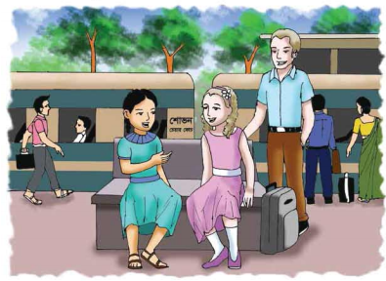

Slide 5
Today’s lesson is
Hello
Lesson: 1
Unit: 1
Part of the lesson: Sima: Hello! ---- Sima.

Slide 6
Student you look
I draw a circle
Pronounce it
Spell it
Definetion of hello
When we start talking on the phone almost all of us say the word hello first. Studies have shown that about % of people pronounce the word hello on the phone.
98

Slide 7
Introduce =
পরিচয়।
Myself =
আমার নিজের।
Holiday =
ছুটির দিন।
Really =
সত্যি।

Slide 8
Meeting | Holiday | Going | introduce
Fun | Good | Really | Train
May! I ______ Myself.
I’m on _______ with my father.
Our _______ is leaving in 10 minutes.
Have a ________ journey.
Nice _____ you.

Slide 9
True/ False? If true,write True and If false, write false.
Jessica going to Chattogram.
True
False
(b) Jessica on holiday with her brother.
(c) Sima from Sylhet.
True
False

Slide 10
Answer the following questions
Where is Jessica going?
Answer: Jessica going to Chattogram.
(b) Is Sima from Dhaka?
Answer: No, Sima is from Sylhet.

Slide 11
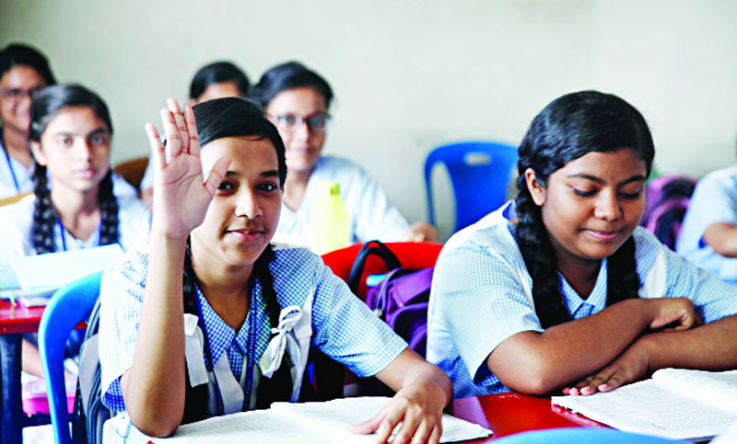
Evaluation

Slide 12
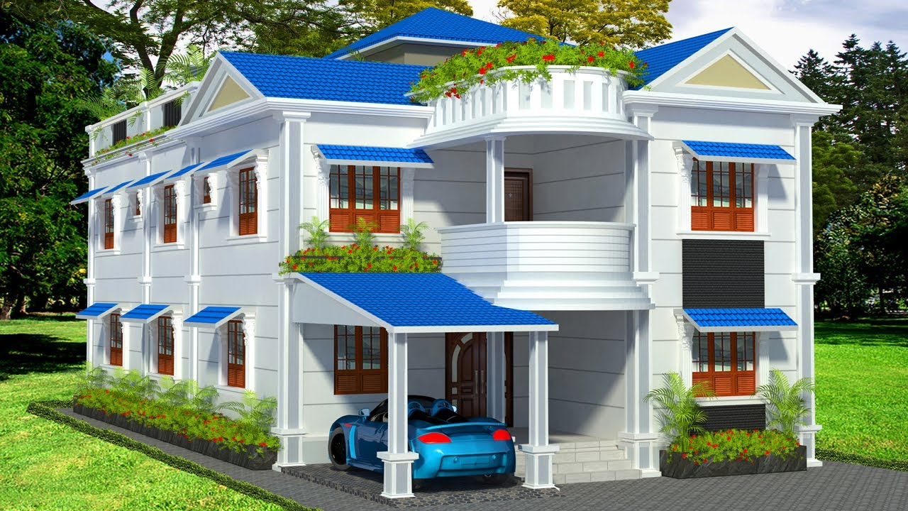
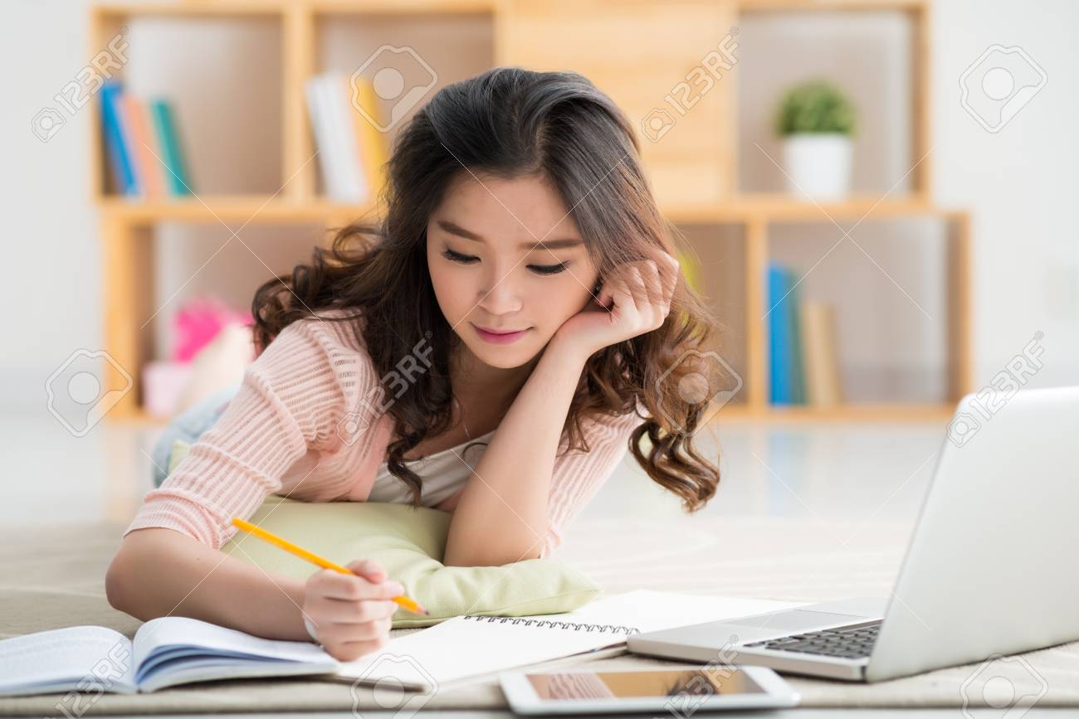
Homework
Write five sentence about Introduce yourself.
Email: marjuarua1982@gmail.com

