Slide 1
Welcome

Slide 3
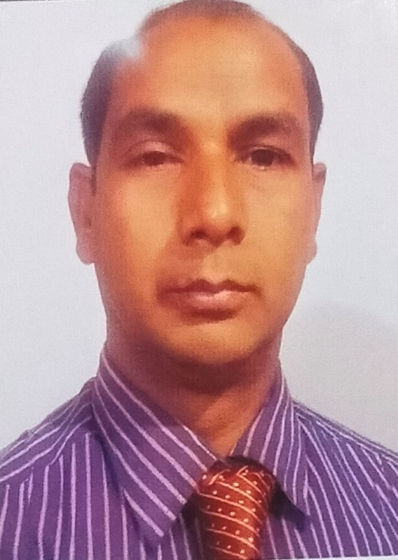
INTRODUCTION
Md. Moksed Ali
Assistant Teacher (English)
Bhabanipur Sefatia Kamil Madrasah,
Hatibandha, Lalmonirhat.
Mobile: 01717292475
Email:mmali2023782@gmail.com
CLASS : SIX TO TEN
SUBJECT : ENGLISH SECOND PAPER
UNIT : ONE
LESSON : THIRTEEN
TOPIC : PRESENT CONTINUOS TENSE

Slide 4
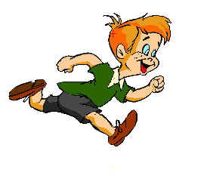
What will the boy be doing?
The boy will be running.
What will the bird be doing?
The bird will be flying.

Slide 5
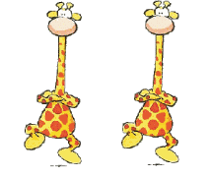
What will the giraffes bedoing?
The giraffes will be dancing.

Slide 6
Today’s Topic
Future Continuous Tense
The future continuous tense is used for something happening for the next time. The action will not be finished.

Slide 7
LEARNING OUTCOMES OF THE LESSON
By the end of the lesson the students will be able to
give questions’ answer using future continuous tense.
identify future continuous tense.
make sentences with future continuous tense .

Slide 8
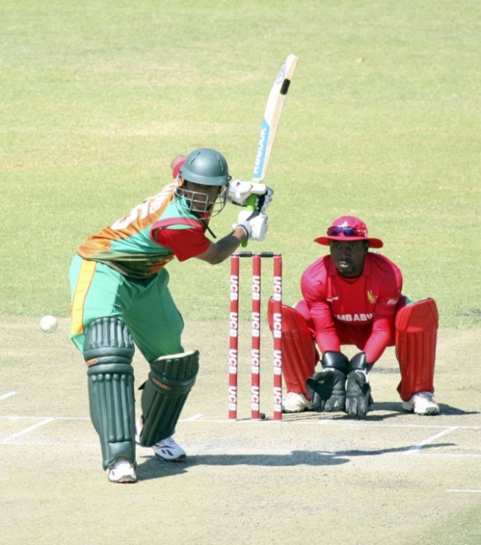
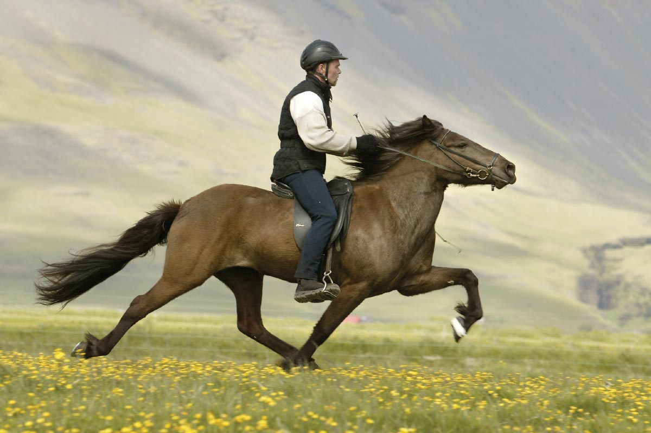
Answer the questions and notice the red colored words
What will they be doing?
They will be playing cricket.
Will the man be riding a bicycle?
No, the man will not be riding a bicycle?
What will the man be doing?
The man will be riding a horse.

Slide 9
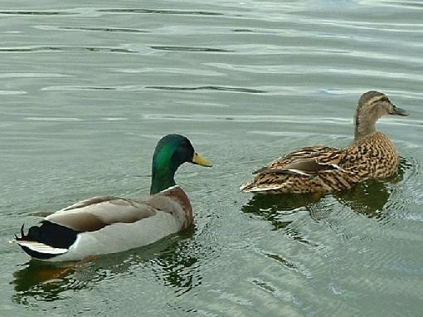
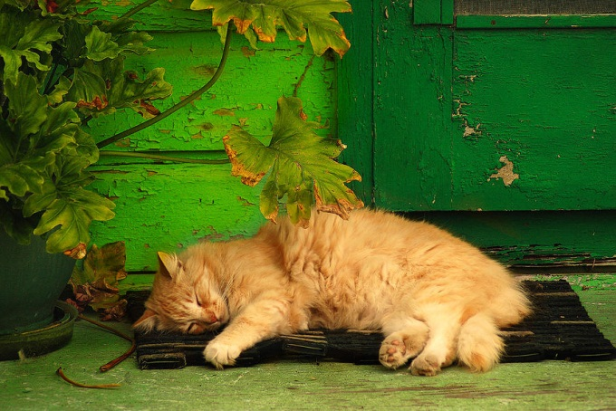
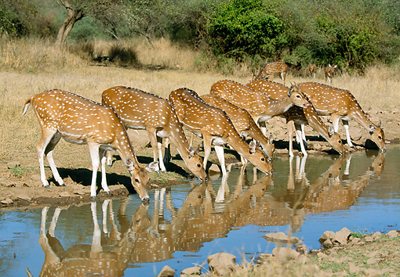
What will two ducks bedoing in the water?
Two ducks will be swimming in the water.
What will the cat be doing?
The cat will be sleeping .
What will deer be doing?
Deer will be drinking water.

Slide 10
Structure Of Future Continuous Tense
Affirm | Sub | Shall be/ will be | Verb+ ing | Other parts.
I shall be doing my homework.
Neg | Sub | Shall not be / will not be | Verb+ing | others
I shall not be doing my homework.
Int | Shall / will | Sub+ be | Verb+ing | Others + ?
Shall I be doing my homework ?

Slide 11
Where are these used?
Shall
I
He, She, 3rd person singular number, It, That
Will
We, You, They, 3rd person plural number
Will

Slide 12
Make sentences from the jumble words. (pair works)
Shall be
taking my bath.
I
Mangoes
looking green.
will

Slide 13
Read all the sentences first and find out which sentences are future continuous tense say tick for them if not say cross for them. (Pair work)
1. I shall be going to school .
x
2. Shima will be making a cup of tea.
_/
3. Amina will be playing badminton .
x
_/
4. It will not be raining now.

Slide 14
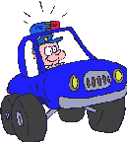
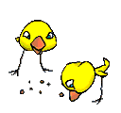
Look at the pictures and write what they are doing in each picture. Write them in 3 structures of future continuous tense (affirmative, negative and interrogative) for each picture. (Pair work)
1
2
3

Slide 15
Answer
A police will be driving a car.
A police will not be driving a car.
Will a police be driving a car?
A man will be digging soil.
A man will not be digging soil.
Will a man be digging soil?
The chickens will be eating.
The chickens will not be eating.
Will the chickens be eating?

Slide 16
Homework
At your home look around and write what the people are doing. Write 10 sentences with future continuous tense.

Slide 17
Allah Hafez

