Slide 2
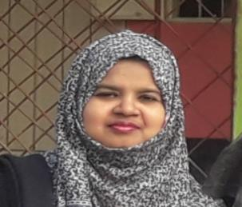
Teacher’s identity
Assistant teacher
Farjana Amin
Assistant teacher
Dhadash Govt. Pri. School
Puthia, Rajshahi.
Farjana Amin

Slide 3
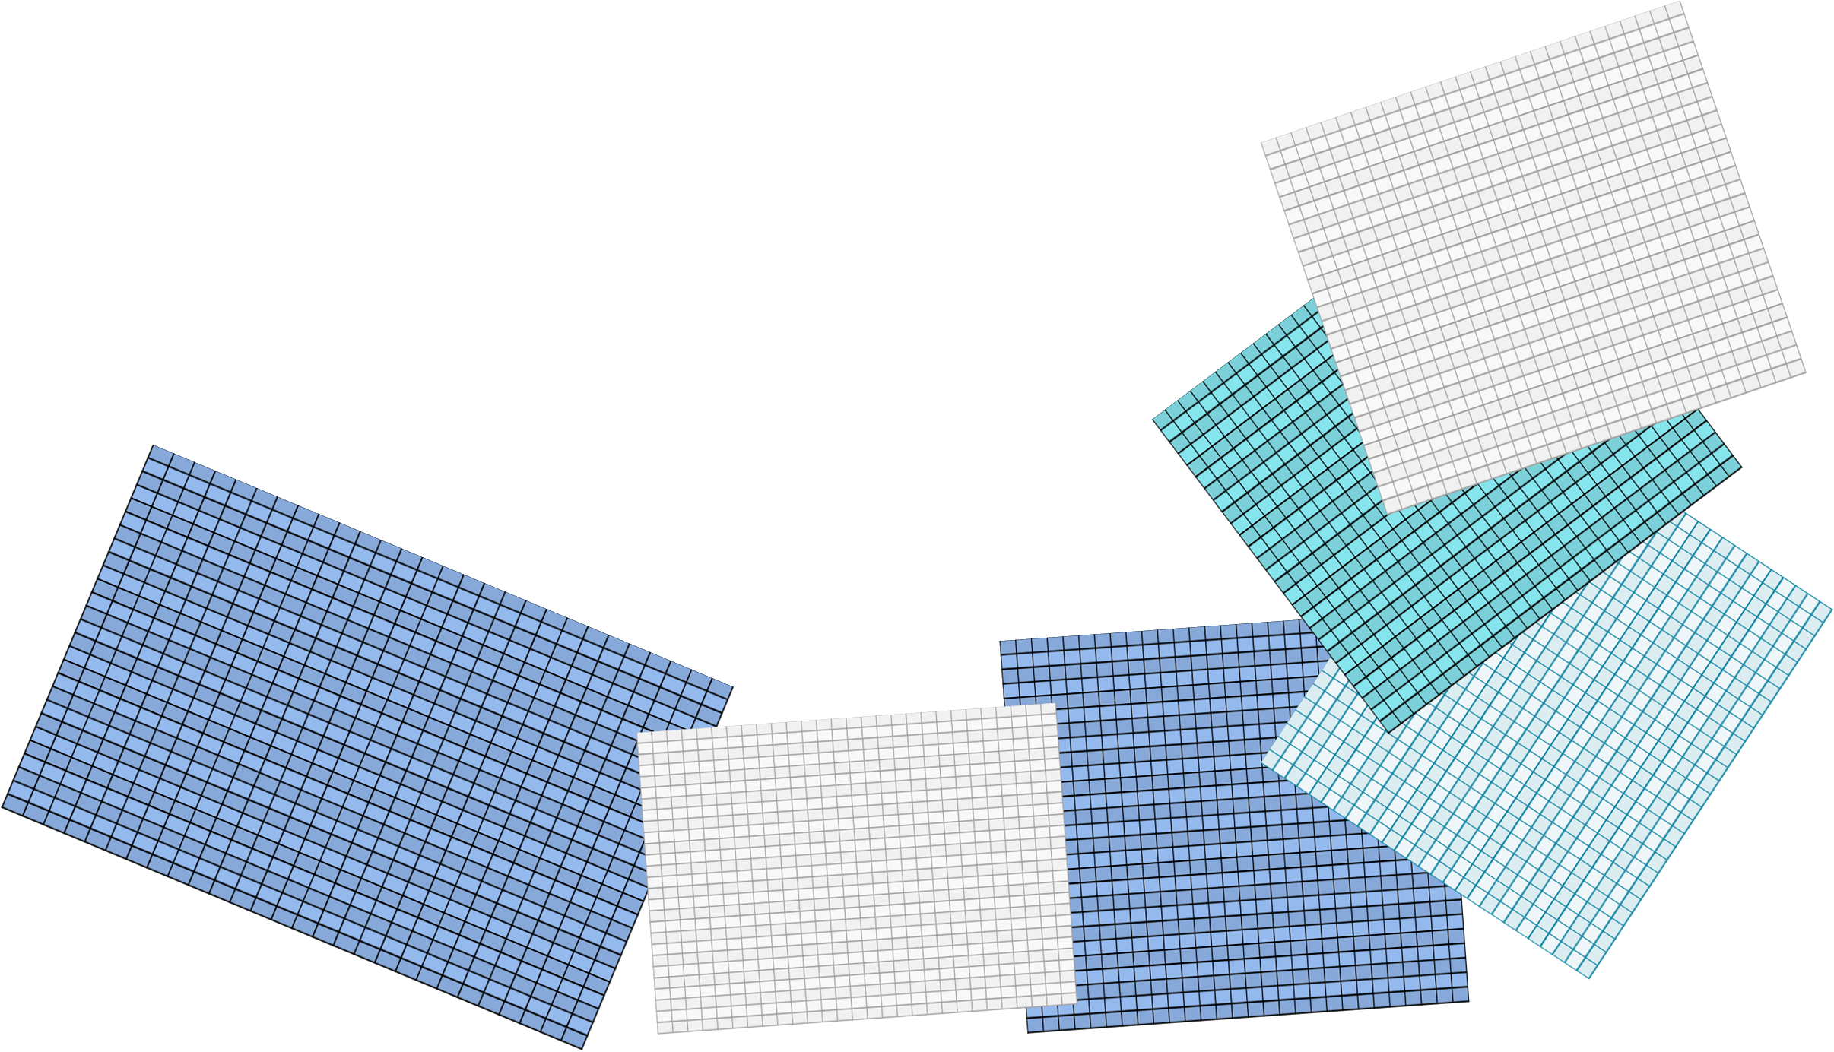
Lesson Identity
ENGliSH FOR TODAY
Class - 5
Class:5
Sub:English
Today’s Lesson
Unit:9- occupations (A long……..didn’t mind.)
Lessons 1-2

Slide 4
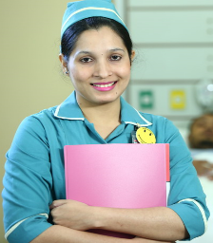
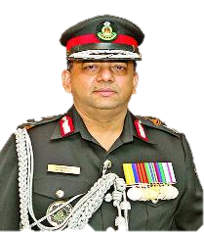
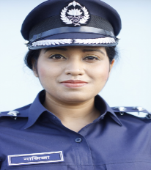
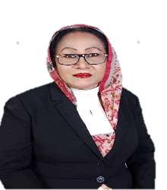
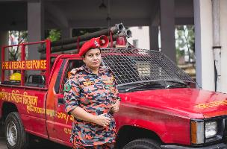
Do you know who are they ?
Doctor
Police
Rab
Nurse
Advocate
Firefighter
Teacher

Slide 5
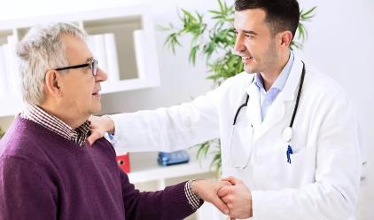
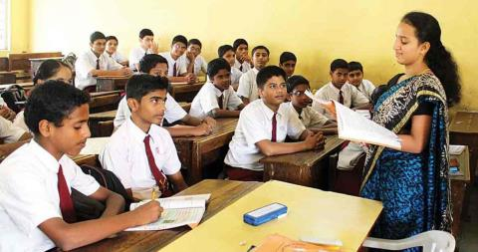
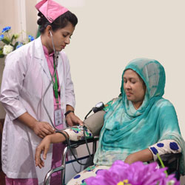
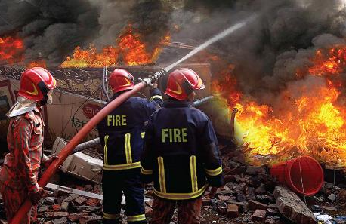
Can you please tell me what they do?
It’s called occupations

Slide 6
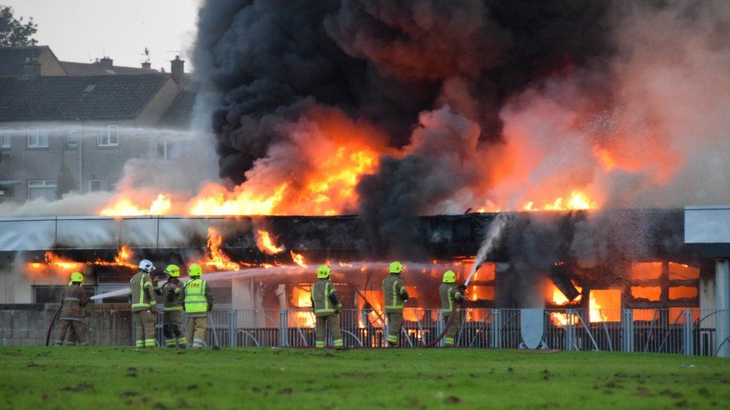
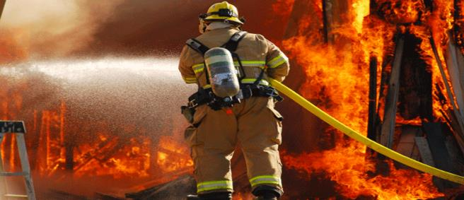
Let’s we see some pictures
Can you guess what’s our today’s topic
Do you know If there is a fire ,who put out the fire ?
A fire fighter

Slide 7
Our today’s topic is
Occupations

Slide 8
Learning outcomes
Students will be able to-
Listening: 4.2.1 Understand and enjoy simple stories.
Speaking: 6.1.2 Say what others are doing.
Reading: 7.1.1 Recognize punctuation marks and read accordingly.
Writing: 10.1 make sentences using words and phrases given in the text.

Slide 9
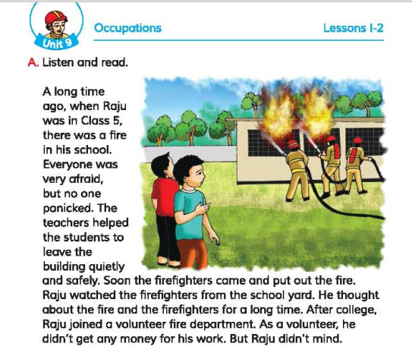
Open at page 34

Slide 10
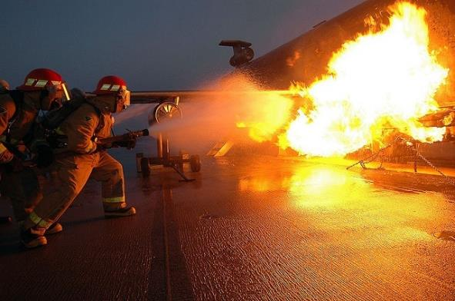
Let’s know the lesson with the pictures
A long time ago , when Raju was in class 5 , there was a fire in his school.

Slide 11
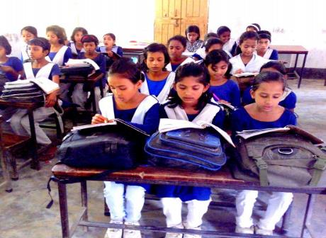
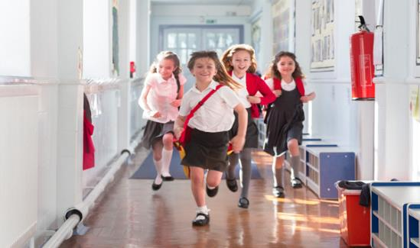
Let’s know the lesson with the pictures
Everyone was very afraid, but no one panicked.The teachers helped the students to live the building quietly and safely.

Slide 12
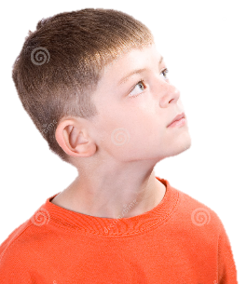
Let’s know the lesson with the pictures
Soon the firefighters came and put out the fire. Raju watched the fire fighters from the school yard. He thought about the fire and the firefighters for a long time.

Slide 13
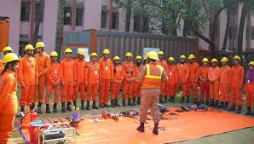
Let’s know the lesson with the pictures
After college, Raju joined a volunteer fire department. As a volunteer, he didn’t get any money for his work . But Raju didn’t mind.

Slide 14
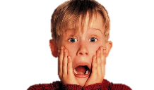
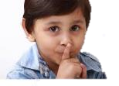
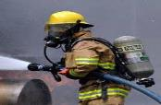
Teaching Vocabularies
Let’s find out new or difficult words
Panic
আতঙ্কিত হওয়া
To have fear.
Put out
নেভানো
To extinguish fire.
Quietly
নিরবতার সাথে
With quietness.
One who works without payment.
Volunteer
স্বেচ্ছাসেবক
One who works to extinguish fire.
Firefighter
দমকলকর্মী

Slide 15
Make sentences
IW
Firefighter
Raju is a firefighter.
Ago
One year ago I was in class 4.
Panic
The boy was panicked to see the accident .
Full-time
My father is a full-time worker.
Yard
We played in the yard.

Slide 16
Lets play a game (word game).
One can say only one word from our today’s lesson
Fear
Fire
Putout
Firefighter
Afraid
Quitely
Panic

Slide 17
Student’s Silent Reading

Slide 18
Student’s Chain Drilling.
A long time ago, when Raju was in class 5, there was a fire in his school.
Everyone was very afraid, but no one panicked.
The teachers helped the students to leave the building quietly and safely .
Soon the firefighters came and put out the fire.
Raju watched the firefighter from the school yeard.
He thought about the fire and the firefighters for a long time.
After college, Raju joined a volunteer fire department.
As a volunteer, he didn’t get mony for his work.
But Raju didn’t mind.

Slide 19
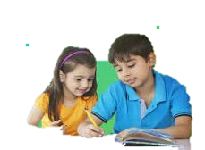
Group work
Group-A
Who was firefighter?
Group-B
Why were the students very afraid?
Group-C
What did Raju do after college?

Slide 20
Pair work
Write True for correct statement and False for incorrect statement
Let’s click on the sentences to know the right answer
a) Everyone was panicked.
False
b) The students left the building quitely.
True
c) Raju joined a volunteer in fire department after school.
True
d)The students were afraid to see the firefighters.
False
e) Raju watched the firefighters from house.
False

Slide 21
Match the words of column A with the similar meaning of Column B. Two extra meaning are given in column B.
Column A
Column B
a) Firefighter
i) in or within a short time.
ii) go or come to see something .
b) Volunteer
iii) a person who does some acts without fee.
c) Panic
iv) a person who puts out fire .
d) Quietly
v) a member of this organigation .
e) Soon
vi) without making any noise .
vii) a sudden anxiety.

Slide 22
Evaluation
a) What happened when Raju was in class 5 ?
b) How did the teachers help the students ?
c) From where did Raju watch the firefighters ?
d) Who put out the fire in Raju’s school ?
e) What did Raju think for a long time ?

Slide 23
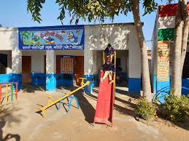
One day one word
Yard
আঙ্গিনা
We play in the school yard

Slide 24
Home work
Write 5 sentences about an occupation as you know.

Slide 25
Good bye

