Slide 2
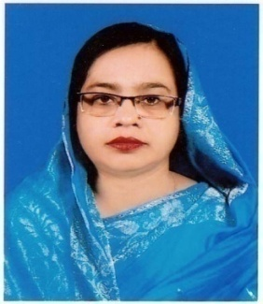
Identity
Teacher’s Identity
Amena begum
Assistant Teacher
B.D.P Secondary School
Gazipur Sadar, Gazipur.
Mobile no : 01911391483
Email : amenabegum77ict@gma
Lesson Identity
Class : Eight
Unit : 02
Lesson : 01
Topic : Good food
Time : 45 minutes

Slide 3
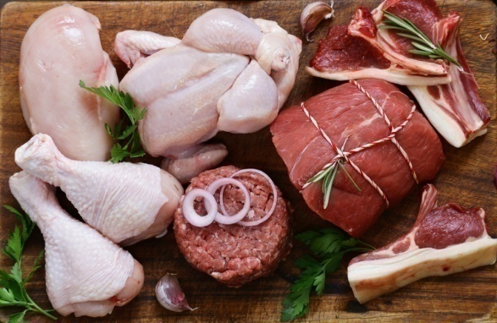
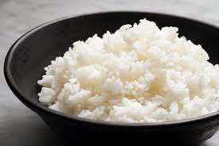
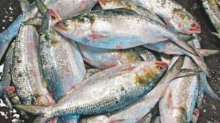
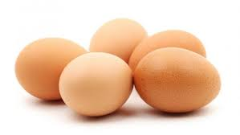
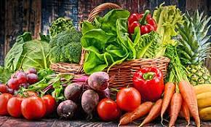
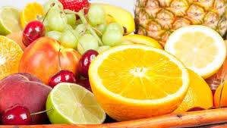
Look at the picture very carefully

Slide 4
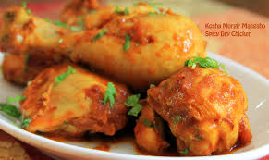
Lesson Declare
Good food

Slide 5
Learning outcomes
After we have studied this unit, we will be able to
Read and understand texts though silent reading.
Infer meaning from context.
Write answers to questions.
practice sounds

Slide 6
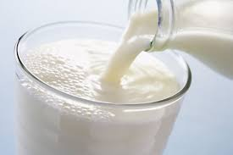
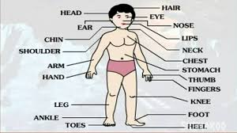
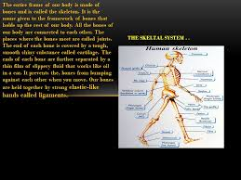
Vocabulary Teaching
Nutritious
healthful
Physical
bodily
Structure
frame

Slide 7
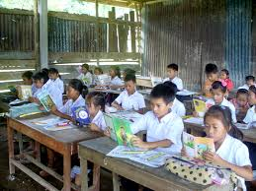
Read the text very carefully

Slide 8
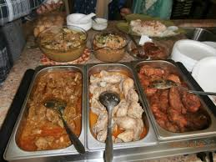
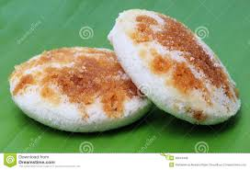
“Good food means the right kinds of food for good health,” says Ms Rehana. It is nutritious.

Slide 9
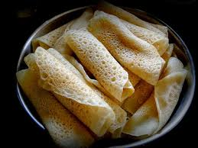
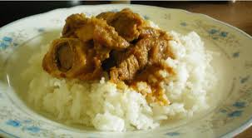
It must contain natural substances that body needs to grow properly and stay healthy.

Slide 10
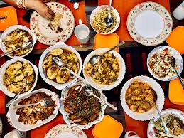
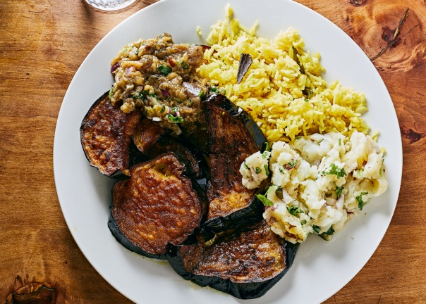
But remember, you must not eat too much though the food is good. Eating too much is bad for health.

Slide 11
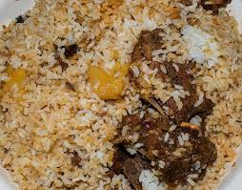
You have to eat only a certain amount of food that your body needs. So we do not need the same kind of food in the same quantity.

Slide 12
Group Work
Group A
01. What is good food ?
02. How much food does a person need to eat ?
Group B
01. Why do we eat food?
02. Does every one need the same amount of food ? Why ?

Slide 13
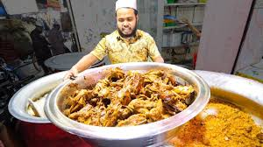
Evaluation
01. What is meant by nutritious food ?
02. Why do we eat food ?
03. What is Ms Rehana talking about ?

Slide 14
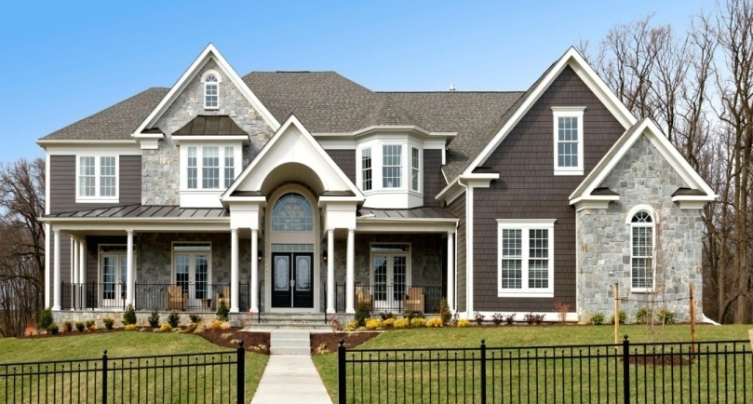
Home Work
Write a paragraph on “Balance diet.”

