Slide 1
SHITALPUR HIGH SCHOOL

Slide 2
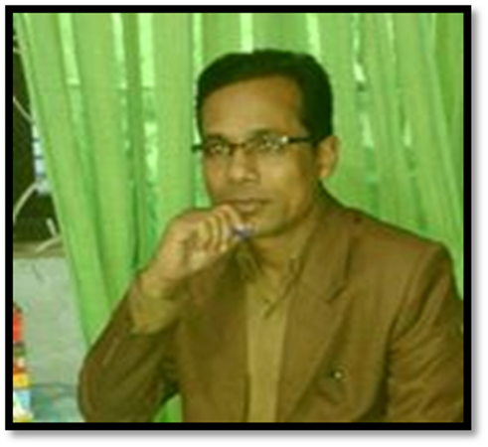
Md. Ismail Shaikh
B.A. B.Ed. M.A.(English) M.Ed. BOU
Senior Teacher in English
Shitalpur ML. High School, Chittagong.
Contact No- 01716086548, 01865228207
Email- ishaikhcitygate2014@gmail.com

Slide 3
Look at the picture
What can you see in the pictures ?

Slide 4
Our today’s Lesson is
‘E- learning’
Class: ix – x
English – First Paper
Time - 50 mins

Slide 5
Learning out come
By the end of the lesson the learners will be able to-
describe pictures.
talk about e-learning.
read intensively and answer questions.
explain the importance of e-learning.
differ between online education programme and e-learning.
choose the best answer.
write e-mail.

Slide 6
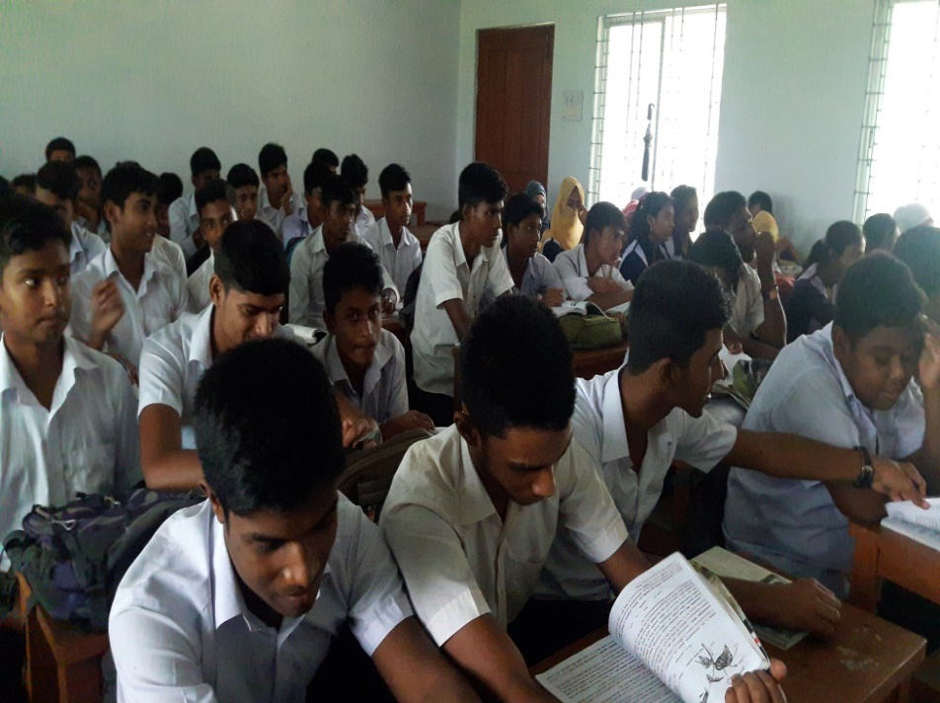
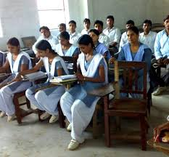
Silent Reading

Slide 7
E-Learning
A learning system based on formalized teaching but with the help of electronic resources is known as E-learning. While teaching can be based in or out of the classrooms, the use of computers and the Internet forms the major component of E-learning. E-learning can also be termed as a network enabled transfer of skills and knowledge, and the delivery of education is made to a large number of recipients at the same or different times.

Slide 8
Traditional Learning:
Text book based and teacher based study, traditional campus and learners’ physically attendance is must.
E-learning:
Students need not physically attendance in a virtual campus and the guardians can look after their kids from their houses.

Slide 9
Vocabulary
Word | Meaning
Thrill | frisson/goose-flesh
Virtual | unearthly
Kidding | naughty/roguery
Access | entrance
Cautious | alert/guarded
Conventional | Traditional /usual
Conduct | lead/propulsion

Slide 10
Evaluation

Slide 11
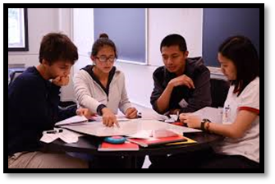
Pair Works
Fill in the blanks with suitable words:
Education experts (a) ……. utilizing the advantages of computer technology (b) …….. a long time. In E-learning , everything from admission to certification must (c) …… (d) …… electronically through computer and the internet technology in a virtual campus. In some online courses, one can (e) ……. his/her test online.
Ans: (a) are (b) for (c) be ( d) done (e) submit

Slide 12
Individual work
Read the text again and choose the best answer from the alternatives.
The assignment can be submitted by-
a
mobile
b
e-book
c
computer
✓
d
e-mail

Slide 13
2. Which of the following describes e-learning best?
a) online study
b) digital board
✓
c) ICT education
d)e-mail

Slide 14
Group Work
Write answer of the following questions:
What is E-learning?
What happens in the virtual learning?
What are the similarities and dissimilarities
How does Professor Khan contribute to e-learning?
How does social networking services help traditional education?

Slide 15
Ans:
a) A learning system based on formalized teaching but with the help of electronic resources is known as E-learning. While teaching can be based in or out of the classrooms, the use of computers and the Internet forms the major component of E-learning.
b) Both teachers and students can take part in the teaching and learning process from anywhere in the world in virtual learning. It is different than the traditional teaching learning process.
c) Everything is face to face and with paper and pencil in conventional education. Whereas everything connected to learning takes place online e-learning. In conventional teaching is tangible. E-learning is virtual.
d) Professor Khan has developed a framework in the practice of e-learning. This framework has been in practice in many parts in the world.
e) A huge number of young learners are involved in social networking worldwide. Many of them are students. This opportunity can be utilized to organize teaching and learning.

Slide 16
REFRESHMENT

Slide 17
Home Work
Write an e-mail to your teacher experiencing your feelings and opinion regarding the next mode of education- e-learning.

Slide 18
THANK YOU

