Slide 1
Welcome

Slide 2
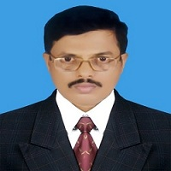
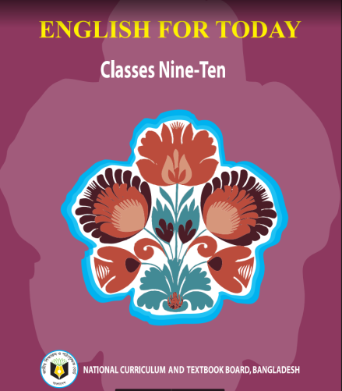
Md. Saiful Islam Chowdhury
Senior Teacher
C. J. M High School,
Mohara , Chandgaon , Chattogram.
saifulcjm@gmail.com Mob: 01991945882
ENGLISH FOR TODAY
Class : Nine-Ten
Unit-One, Lesson-2
Time: 40 minute

Slide 3
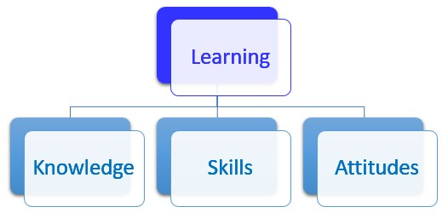
Look at the picture and try to guess what our today’s lesson is.

Slide 4
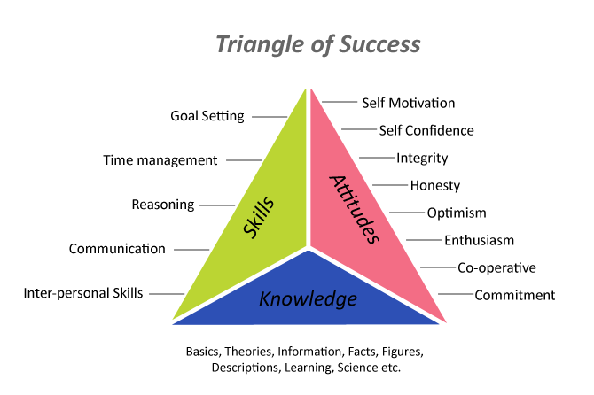
Today our Lesson is
Knowledge, Skills and attitudes
Unit-One ; Lesson – Two

Slide 5
Learning outcomes
After completing the Lesson students will be able to –
1. Read and understand texts through silent reading ;
2. Narrate incident ;
3. Participate in discussions ;
4. Listen to and understand others ;
5. Describe something in writing .

Slide 6
Vocabulary
Key word
Constitution
Meaning:
The system of laws and basic principles to govern a country.
As a good citizen we have to know about the constitution of our country.

Slide 7
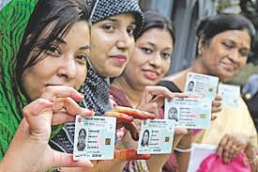
Vocabulary
Key word
Citizen
Meaning:
A person who lives in a particular place
Every citizen must pay taxes .

Slide 8
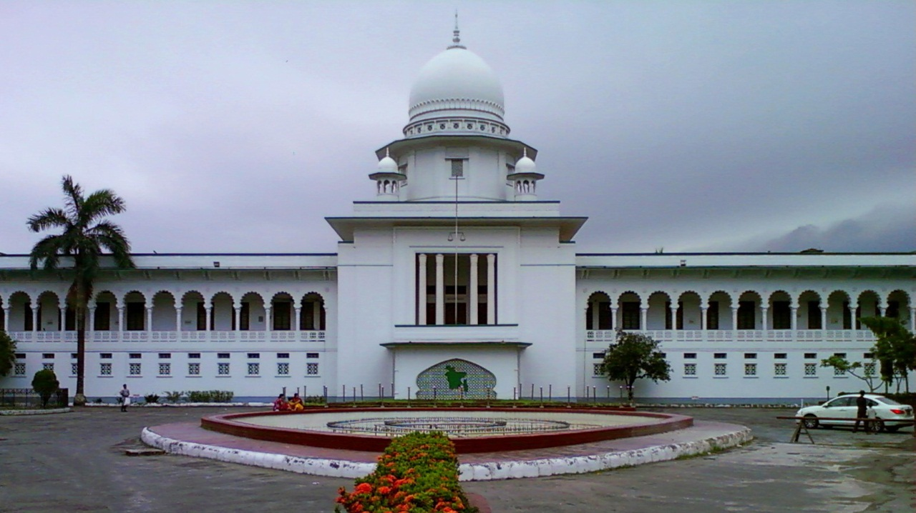
Vocabulary
Key word
Judicial
Meaning:
Relating to the administration of justice
It is very essential to know about the judicial system of a country.

Slide 9
Vocabulary
Key word
Literature
Meaning:
Pieces of writing that are valued as works of art.
Kazi Nazrul has made great contribution to Bangla Literature.

Slide 10
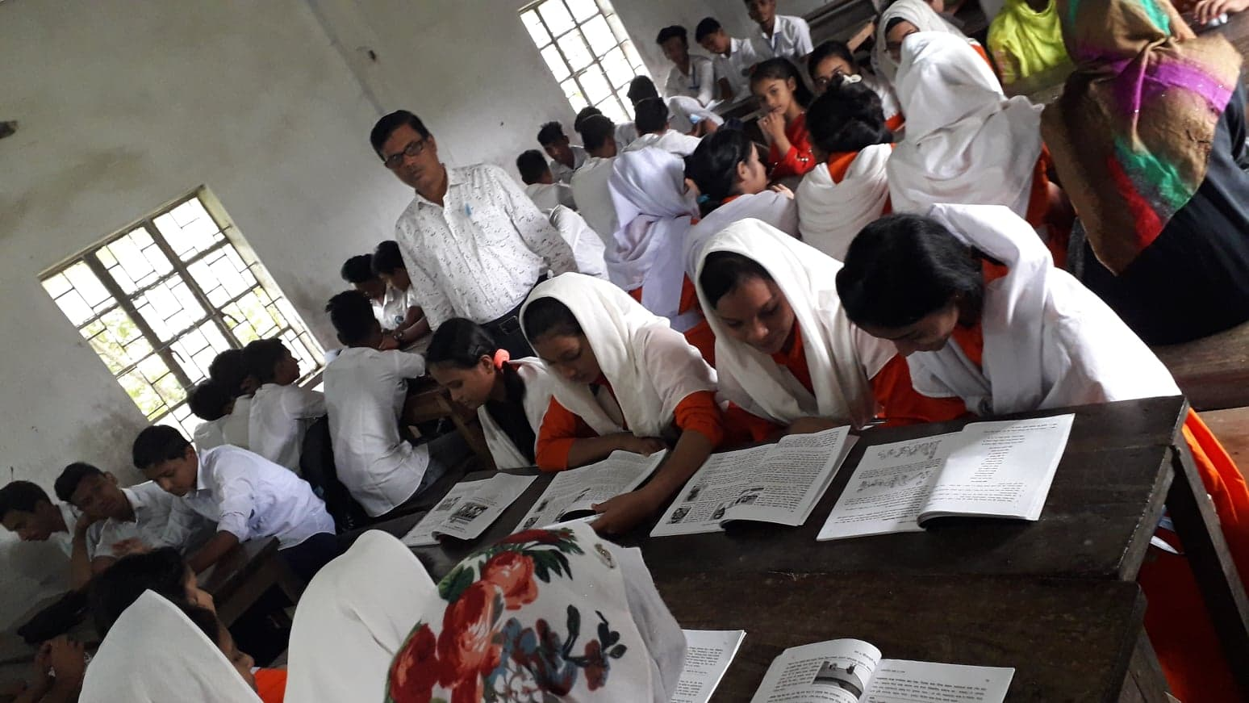
Vocabulary
Key word
Monitor
To observe and check the progress of someone or something.
Meaning:
Monitoring is very essential to make a fruitful class.

Slide 11
Listen the text attentively.
Teacher’s Model reading.
To be good citizen, you have to prepare yourself to do good work in society. Well , then how can you prepare yourself ?
First, you need knowledge. Today’s society is knowledge- based. Without having knowledge of modern sciences, technologies including ICT and other necessary subjects, you will have difficulty living a good life.

Slide 12
The other areas you, as a good citizen, should have knowledge about are :
Our country, its constitution, geography and people
Our state, its executive and legislative powers
Our judicial system
Our government and its structures and functions
Our history, cultures, traditions, literature, moral values and religions
Our socio- economic activities and educational system

Slide 13
Second, you need skills to do things. Knowledge is not enough. You must be able to apply your knowledge to do things practically.
Finally, knowing and doing things will bring about a change in your behaviour towards others. This behavioural change will show your attitudes towards others, that is , it will show how you think and feel about a person or thing.

Slide 14
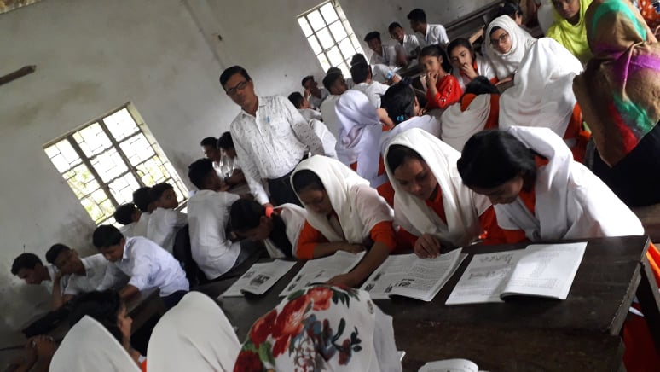
Let’s take an example, Suppose you, as a student, need to know about ‘group work’ in the classroom. So you ask yourself or your teacher or anyone else, “What is group work?” Or you may find about it in a book. In this way you may know or you may have the knowledge about group work. To do group work, the class has to be divided into groups. Each group is to do some tasks given by the teacher or in the textbook. The group members will discuss and share ideas and points, and finally, one member will write the answers.

Slide 15
Lastly, through regular group work it is expected that there will be noticeable changes in your behaviour. Possible changes are :
You will develop the skill of speaking freely in English with your classmates and teacher.
Your shyness will gradually disappear.
You will develop the attitude of helping and cooperating with each other.
You will learn to behave in a democratic way.
Most importantly, these behavioural changes taking place in you inside the classroom will be carried over outside the classroom in real- life situations.

Slide 16
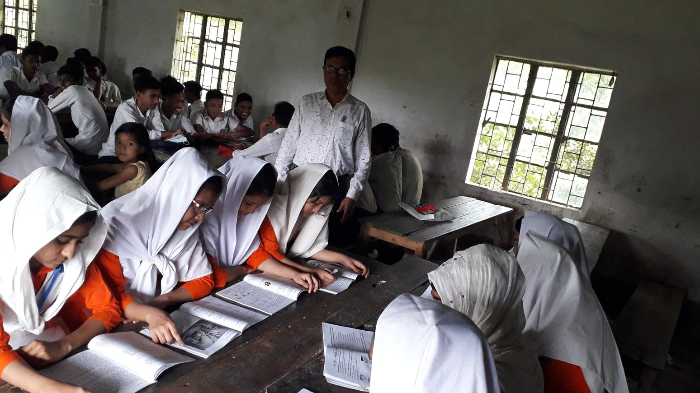
Student’s Model reading.
Go to the section “B” and start silent reading.

Slide 17
Choose the correct answer from the alternative.
Individual work
1. Knowledge is to…
do good job
ask questions
know something
reads books
2. What do you mean by skill?
to do things
to be a good citizen
to have nice attitude
to be able in the application of knowledge

Slide 18
Choose the correct answer from the alternative.
3. What is attitude?
all types of changes in behavior
feeling and thinking about others
thinking about others
feeling about others
4 What does the word ‘apply’ mean?
use
assist
affect
request

Slide 19
Choose the correct answer from the alternative.
5. The opposite meaning of ‘democratic’ is-
Autonomous
self- governing
Autocratic
Independent
6.To be a good citizen, you will have to prepare yourself to do good work in -
family
Classroom
society
School

Slide 20
Fill in the blanks with the correct words
work
knowledge
apply
behavior
attitude
The person who has prepared himself/herself to do good (a) ………… in society is called a good citizen. A good citizen must have (b) .…………….. about the history, cultures, constitutions and other important sectors of his/her country. Besides, he/she should have the ability to (c)…………….. his/her knowledge for the welfare of his/her state. These will bring a remarkable change in his/her (d) …………. .This behavioral change will give him/her a positive (e) …………… ..towards others.

Slide 21
Group Work
Discuss in groups. Write how K S A can be shown in the following topics:
K = knowledge, S = Skill and A = Attitude
Or saline
Debate
E-mail

Slide 22
Evaluation
1.What is Knowledge?
Knowledge is the fact or condition of knowing something with familiarity gained through experience or association
2.What is attitude?
Attitude means feeling and thinking about others
3. What do you mean by group work?
By group work, I mean doing a work not all by oneself but collectively.
4. What do you mean by ‘real – life situations’?
‘Real – life situations’ means practical necessity.

Slide 23
Home Work
Write a paragraph about how can you become a good citizen by gaining proper knowledge, skill and attitude.

Slide 24
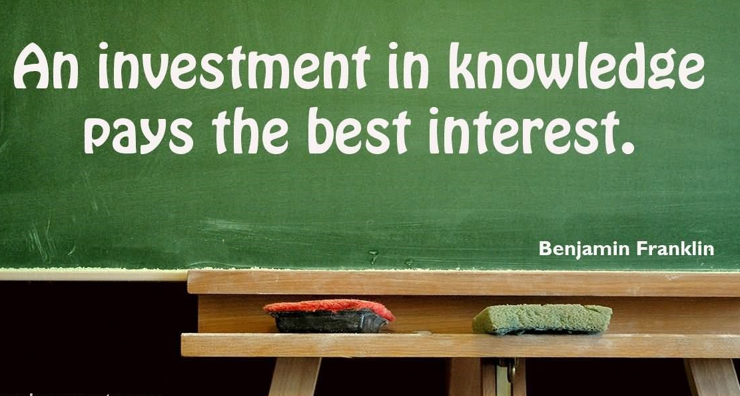
Thank you all

