Slide 1
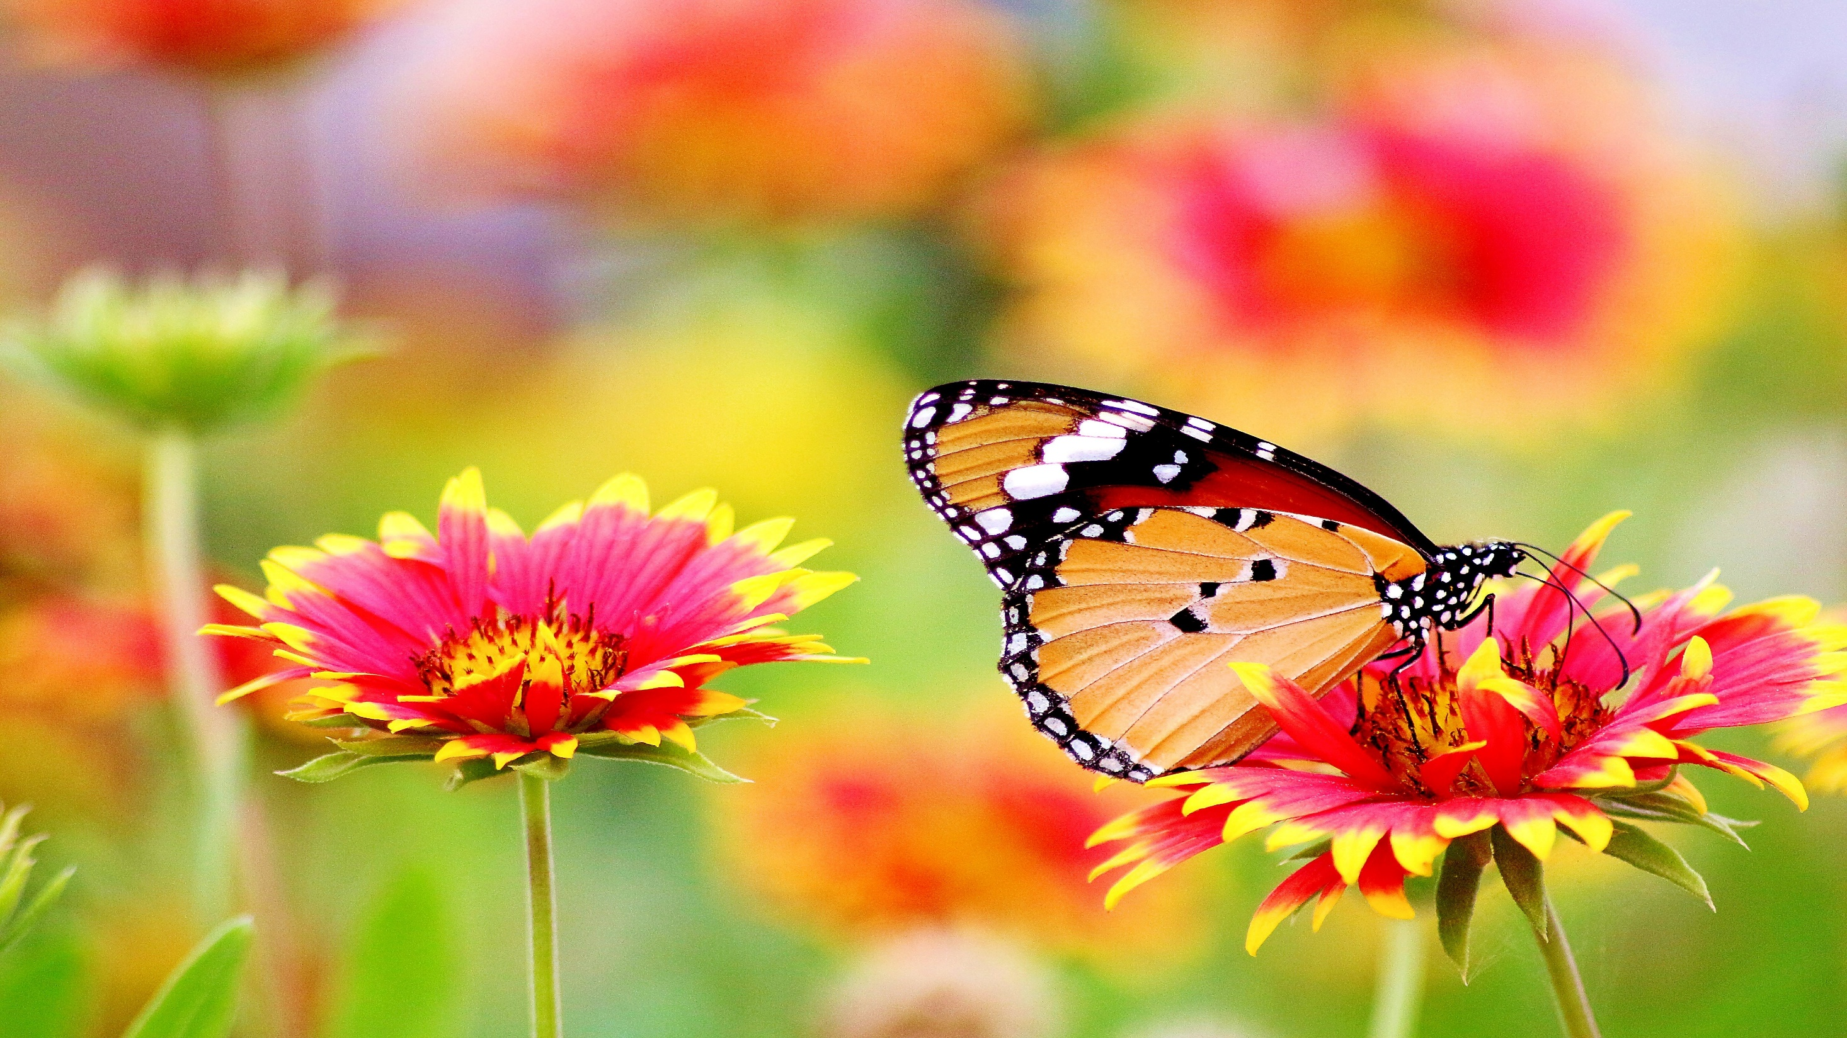

Slide 2
WELCOME

Slide 3
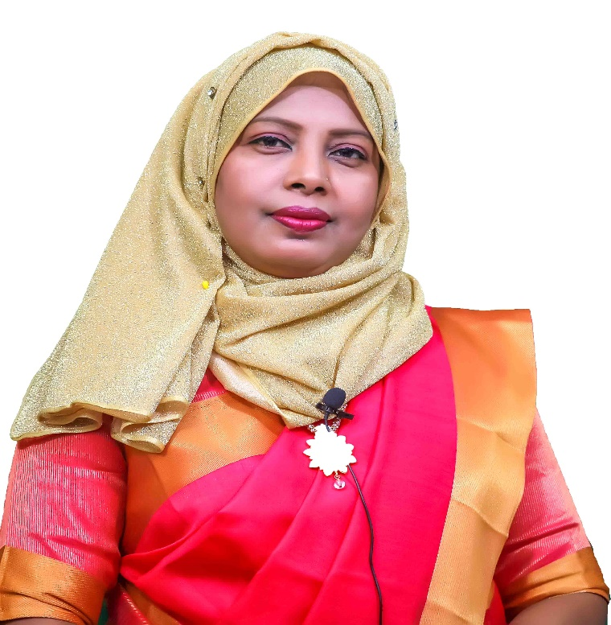
CLASS : SEVEN
SUBJECT : ENGLISH 2nd PAPER
TIME : 50 MINUTE
DATE :
Mis Shirin Sultana
Assistant Teacher
Mirpur Pilot High School
Mirpur, Kushtia.
shirinmirpur99@gmail.com

Slide 4
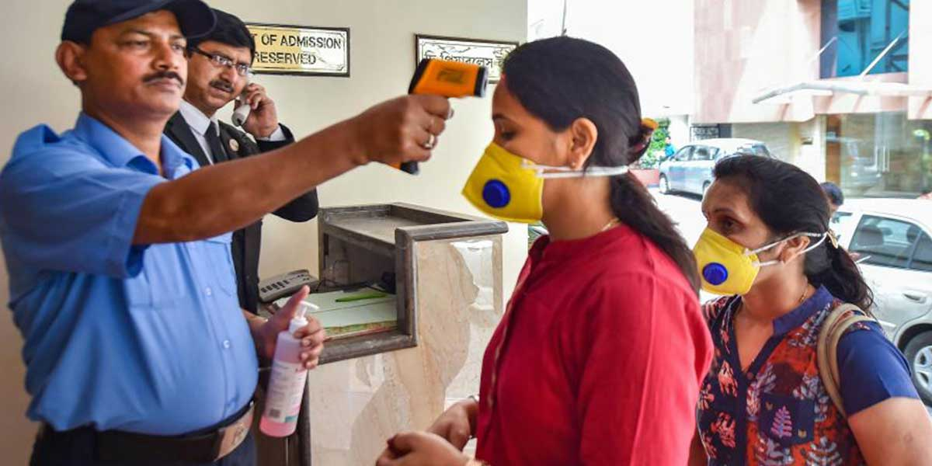
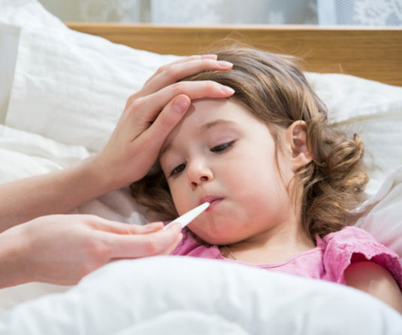
ছবি গুলো দেখো এবং চিন্তা করে বলো
Notes:
আজকের পাঠের বিষয় কি হতে পারে।

Slide 5
LESSON TITLE
DEGREE

Slide 6
LEARNING OUTCOMES
Students at the end of this lesson………….
1. Degrees can tell ;
2. Degree Can tell what the types are ;
3. Be able to analyze degree changes.

Slide 7
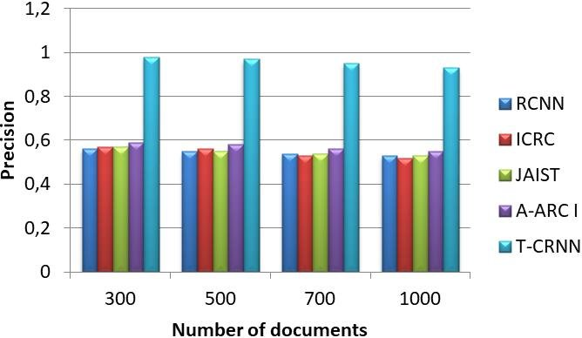
What is degree ?
Degree শব্দের বাংলা অর্থ হলো তারতম্য বা তুলনা।

Slide 8
Types of degree
Degree
Positiv degree
Comparative degree
Superlative degree

Slide 9
Positive degree
Positive degree এর মধ্যে কোন তুলনা হয় না।
Example :
1. Mohan is a tall boy
2. She is beautiful girl

Slide 10
Comparative degree
Comparative degree তে দুইজনের মধ্যে তুলনা হয়।
Example:
1. The train runs faster than the bus
2. I am richer than he

Slide 11
Superlative degree
Superlative degrre তে দুই বা ততোধিক বা দুইয়ের অধিক হতে হবে। দুই এর অধিক , ব্যক্তি , বস্তু ,প্রানী ,সময়কে বোঝায়।
Example:
1. Mita is the strongest girl in his class
2. Lead is the heaviest metal

Slide 12
Positive degree :
Adjectives : rice , pretty , handsome , good.
Adverbs : slowly , beautifully.
Comparative degree
Adjectives : richer , prettier , more handsome , better.
Adverbs : more slowly , more beautifully.
Superlative degree :
Adjectives : richest , prettiest , most handsome , best .
Adverbs : most slowly , most beautifully.

Slide 13
Positive degree | Comparative degree | Superlative degree
beautiful | More beautiful | Most beautiful
big | bigger | biggest
black | blacker | blackest
bright | brighter | brightest
clean | cleaner | cleanest
clever | cleverer | cleverest
fast | faster | fastest
fat | fatter | fattest
old | older | oldest
poor | poorer | poorest
small | smaller | smallest
strong | stronger | strongest
tall | taller | tallest
wise | wiser | wisest

Slide 14
Positive , comparative and superlative
Positive : I am as strong as him.
Comparative : He is stronger than me.
Superlative : He is strongest me
Positive : No other metal is as precious as gold.
Comparative : Gold is more precious than any other metal.
Superlative : Gold is the most precious of all metals.

Slide 15
Comparative থেকে Superlative
Rule 1 : subject + verb+ the+ comparative এর superlative form + other এর পরের অংশ
Comparative : He is the better than any other player in the team.
Superlative : He is the best player in the team
Rule 2 : Than most other / than few other যুক্ত comparative কে superlative এ রুপান্তর করার নিয়ম : subject +verb +one of the +comparative এর superlative form +most other / few other এর পরের অংশ
Comparative : Vatican city is smaller than most other countries in the world.
Superlative : Vatican city is one of the smallest countries in the world

Slide 16
Superlative থেকে Positive
Rule 1: No other + sentence- এ প্রদত্ত superlative পরের অংশ +verb + s0 / as + superlative এর positive form + as + প্রদত্ত sentence এর subject
Superlative : Saira is the tallest girl in the class
Positive : No other girl is as tall as saira
Superlative : Shakib is the best player
Positive : No other player is as good as shakib

Slide 17
THANKS

