Slide 1


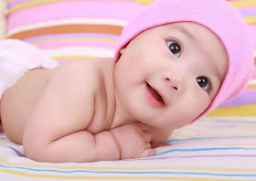
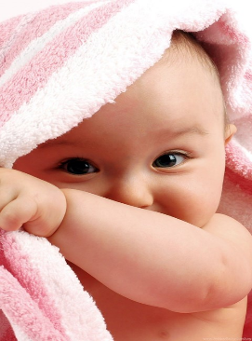
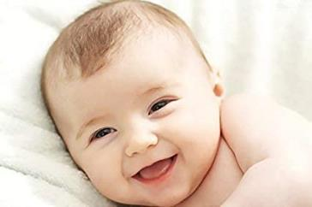

Welcome to my class
enjoy
joy
joyful

Slide 2
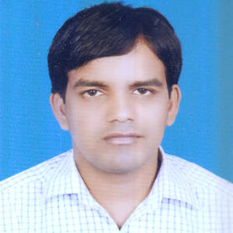

Suffixes and Prefixes
Introduction
MD. SAROAR
English Teacher
Kadvanu Memorial Girl’s High School & College.
E-mail: sohel6555@gmail.com
Phone number: 01717-504570

Slide 3
Let’s enjoy a video clip

Slide 4
Observe.
en joy
joy
joy ful
affix
beginning
affix
at the end
affix
meaning to add something

Slide 5
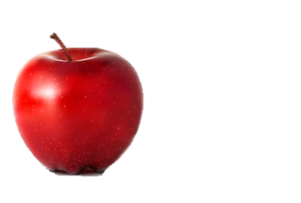
Observe, think and say.
un
+
root word-divided
divided
undivided
undivided

Slide 6
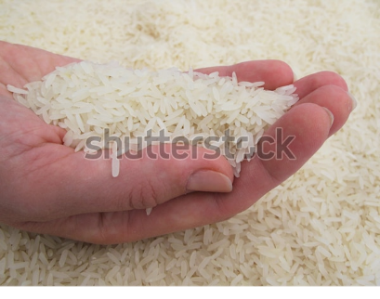
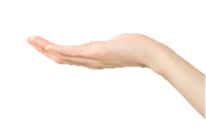
handful
hand
hand
+
ful

Slide 7

Could you guise what lesson we are going to enjoy today?
enjoy
joy
joyful
class: eight
U-10-L-1
So, our today’s lesson is—
Suffixes and Prefixes

Slide 8
Learning outcomes
After the end of the lesson the learners will be able to---
1.
define prefix and suffix.
2.
explain the characteristics of prefix and suffix.
3.
use prefix and suffix in their real life.

Slide 9
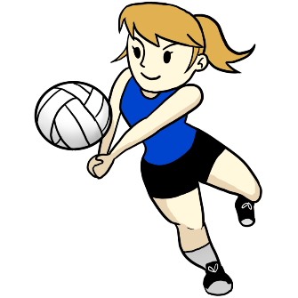
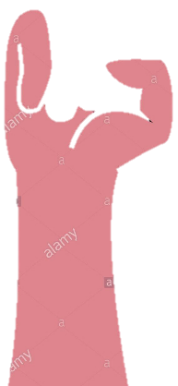
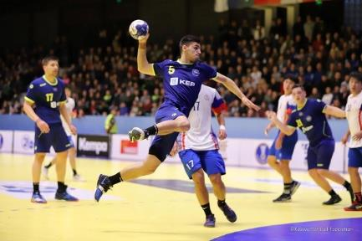
Now follow the words below
hand
+
root word
+
under
hand
hand
ful
an affix
Called suffix
an affix
Called prefix
+
hand
hand
hand
+
ball
up
an affix
Called suffix
an affix
Called prefix
Note: An affix is a group of letters added at the beginning of a word is known as prefix and when added at the end of a word is known as suffix.

Slide 10
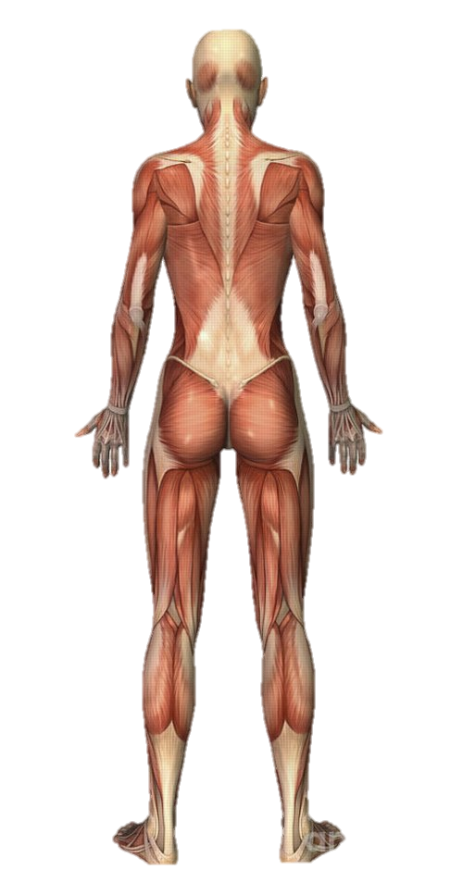
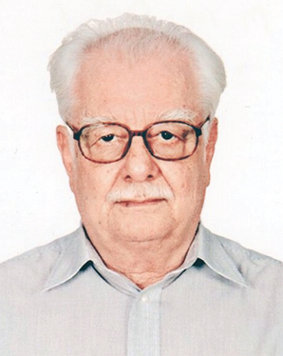
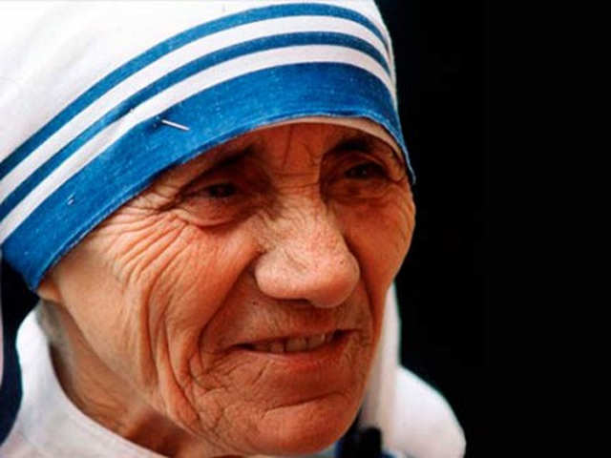
new word
root word
new word
man
human
humanity
meaning
any man
meaning
ethnic
meaning
Mankind
Part of speech
Noun
Part of speech
adjective
Part of speech
noun

Slide 11
characteristics
Root word
Changes into
New word
Root word
Changes into
New word
Changes
meaning
prefix
suffix
Changes
meaning
position
position
beginning
at the end
Changes
Part of
speech
Changes
Part of
speech

Slide 12

Individual work 4min
Answer the following questions.
1. What is the common name of the group of letters added to the root word to form new words?
To check answers click here
2. What is prefix?
3. What is suffix?
4. Why do we use prefix and suffix?

Slide 13
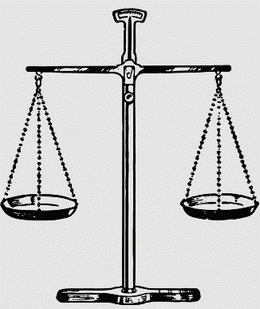

Observe some prefixes
just
unjust
balance
imbalance

Slide 14
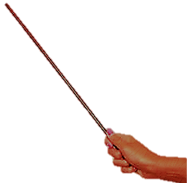
Most common prefixes
prefix | Meaning | Examples
en un re In, im, ir dis non over il | increasing not again not opposite not above/extra opposite | enrich, encourage, enlarge, enjoy unhappy, unjust, uncommon, unpaid rewrite, reenter, recall, return, rethink incorrect, impossible, irrelevant dislike, discomfort, dishonor, dismiss nonsmoker, nonstop, nonregistered, overtime, overtake, overtime, illegal, illiterate, illegible, illogical, ill-practice

Slide 15

prefix | Meaning | Examples
under co mal de fore mis sub anti | small/little with/together opposite/bad opposite front/before wrong under against | undersize, underpaid co-author, coordinator, co-operate, malpractice, malnutrition deforest, deform forehead, forecast misdeed, mistake, misguide, misunderstand substation, submarine, subcommittee anti-nuclear, anti-aircraft, anti-liberation

Slide 16
Pair work 5min
Make five sentences using prefix with the root words below.
click to check answer
common
uncommon
call
recall
like
dis/unlike
take
mistake
forest
deforest

Slide 17
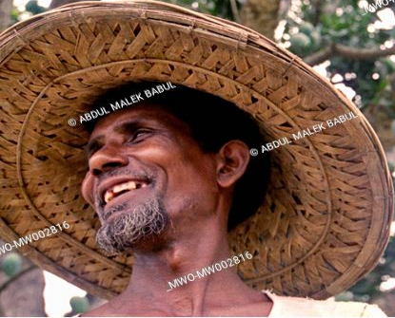
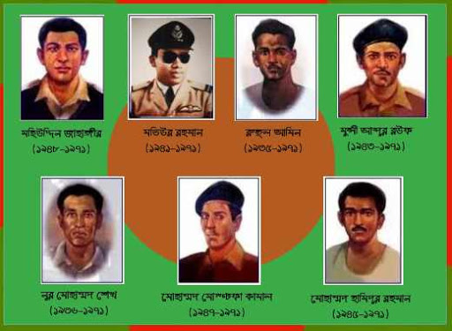
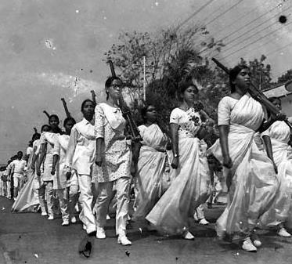
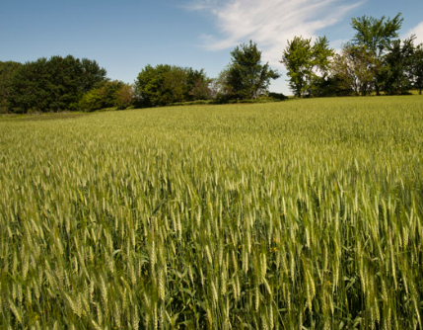
Observe some suffixes
patriot
farm
farmer
patriotic

Slide 18
Most common suffixes
prefix | Meaning | Examples
s, es ed ing ly er ic able, ible ness ful ment | pluralize/make a verb singular past tense/past participle/adj present participle/adj/gerund indicate how, where, when etc. 1. indicate person’s particular work 2. comparative degree having qualities able to be indicate state/condition having something completion | books, goes helped running slowly, friendly player, farmer bigger, taller heroic, patriotic comparable, visible brightness, kindness powerful, handful payment, punishment

Slide 19
Group work 10 min
Answer the questions below.
click

Slide 20
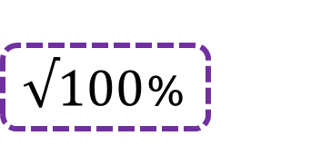








Evaluation
Tick ($√$) the correct answer from alternatives.
1. What is the correct form of prefix of the word “rich”?
(b) enrich
(a) malrich
    $√100$%
    $$×$$
(d) nonrich
(c) riches
    $$×$$
    $$×$$
2. What is the correct form of suffix of the word “pay”?
(a) payes
(b) unpay
    $$×$$
    $$×$$
(c) payment
    (d) impay
    $√$100%
    $$×$$

Slide 21





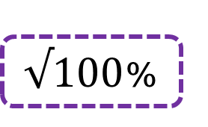






3. what is the correct form of prefix-suffix both of the word “joy”?
(a) enjoy
(b) enjoyment
    $$×$$
    $√100$%
(c) joyment
(d) misjoy
    $$×$$
    $$×$$
4. what is the correct form of prefix of the word “operate”?
(a) operation
(b) operator
    $$×$$
    $$×$$
(c) co-operate
    (d) co-operation
    $√$100%
    $$×$$
5. what is the correct form of prefix-suffix both of the word “employ”?
(a) unemploy
(b) employee
    $$×$$
    $$×$$
(c) unemployment
    (d) nonemploy
    $√$100%
    $$×$$

Slide 22
Home work
Read the following text and use affixes where needed.
Farhana start her journey when she received an urgent call of her
mother. Her journey was comfort because of bad weather. She was look for an auto. It was rain heavy outside. Her journey would be ejoy if there was no rain. However, luck she got an auto for lift.

Slide 23




See you next class

