Slide 1
Welcome to my class

Slide 2
Md. Saifuddin Khan
Lecturer in English
Hajee Goyes Uddin Mohila Fajil Madrasah
Bhangura, Pabna.
Mobile Number :01710449379
E-mail : skhan84bd@gmail.com
English 2nd paper.
Part : A (Grammar)
Class :ix, x &Alim .

Slide 3
This is the most beautiful scenery .
This is more beautiful than any other sceneary

Slide 5
Today our topic is:
Transformation of sentence
Superlative to comparative

Slide 6
Learning outcomes
At the end of the lesson, ss will be able to—
identify the structure of changing superlative into comparative.
change from superlative to comparative.

Slide 7
Structure of Superlative degree
Subject + verb + the/one of the +superlative form of adjective + extension
How to change into comparative degree
Subject + verb +comparative form of adjective + than any/most/all other+ extension
Dolphin is the most interesting aquatic creature.
Dolphin is more interesting than any other aquatic creature.

Slide 8
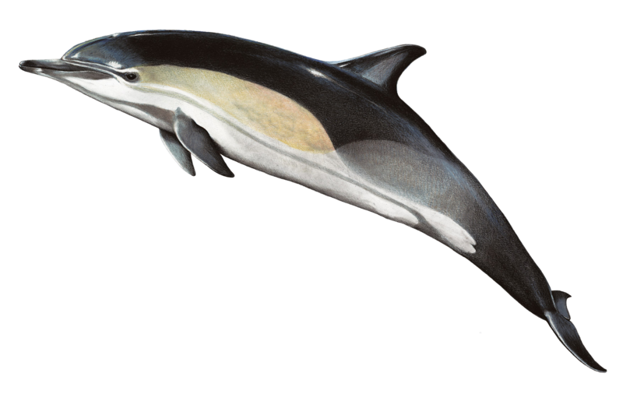
How to change superlative (with ’of all’) into comparative.
Subject + verb +comparative form of adjective + than all other+ extension
This dolphin is better than all other dolphins.
This dolphin is the best of all dolphins.

Slide 9
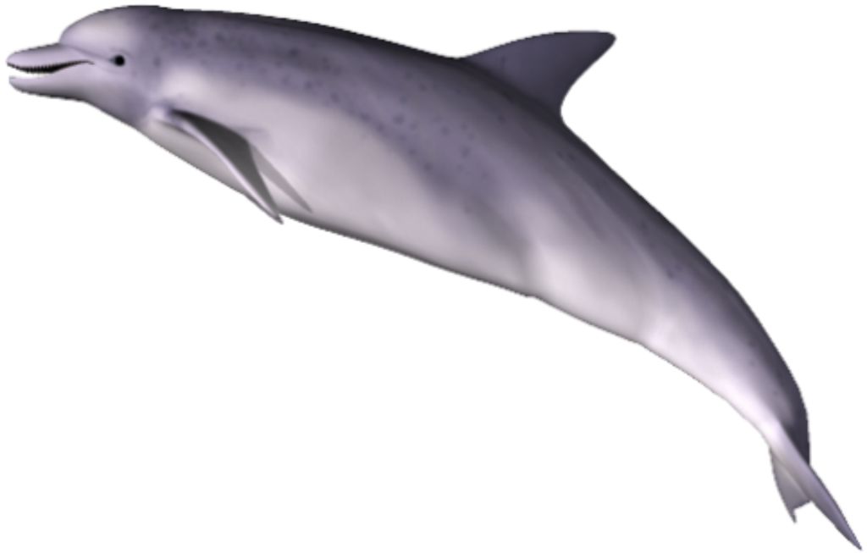
Single work
smallest
It is the smallest of all dolphins.
Comparative

Slide 10
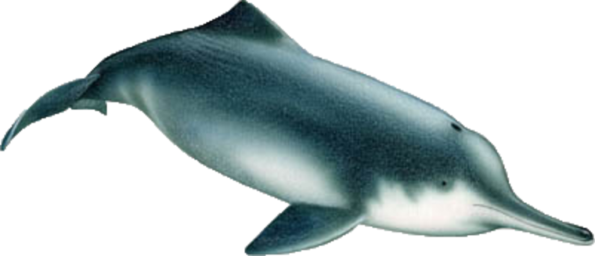
Pair work
This is the fattest of all dolphins (Comparative)

Slide 11
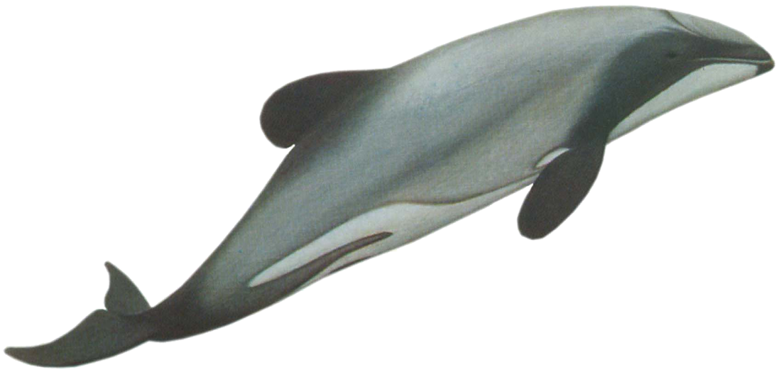
How to change superlative (With ‘one of the the’) into comparative
Subject + verb +comparative form of adjective + than most other+ extension
It is bigger than most other dolphins in the sea.
It is one of the biggest dolphins in the sea. (Comparative)

Slide 12
Group work
This is one of the most beautiful sceneries in the sea.
Comparative

Slide 13
Evaluation
Change the sentences into comparative
The dolphins is the most attentive creature.
It is the strongest creature also.
It can show the most beautiful performance in games

Slide 14
Home work
Change the sentences into comparative
The Dolphin is one of the attractive aquatic creatures.
It is the most skilled of all creatures.
It is one of the cleanest creatures also.
It can imitate the best performance of all creatures.

Slide 15
Thank you all

