Slide 1
Welcome

Slide 2
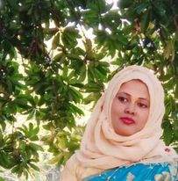
Teacher’s Introduction
Mst.Sharmin Akter
Assistant teacher
Matoin Govt. Primary School
Hajigonj, Chandpur
E-mail:
mstsharminakter1985@gmail.com

Slide 3
Lesson Identity
Class : Two
Subject : English
Lesson :4-6 (A)
Unit:29
Parts of the lesson : The………no eggs !
Time : 40 min

Slide 4
Learning Outcomes
Student’s will be able to-
Listening:1.1.1-become familiar with English sounds by listening to common English word.
Speaking:1.1.2-say simple words and phrases with proper sounds and stress.

Slide 5
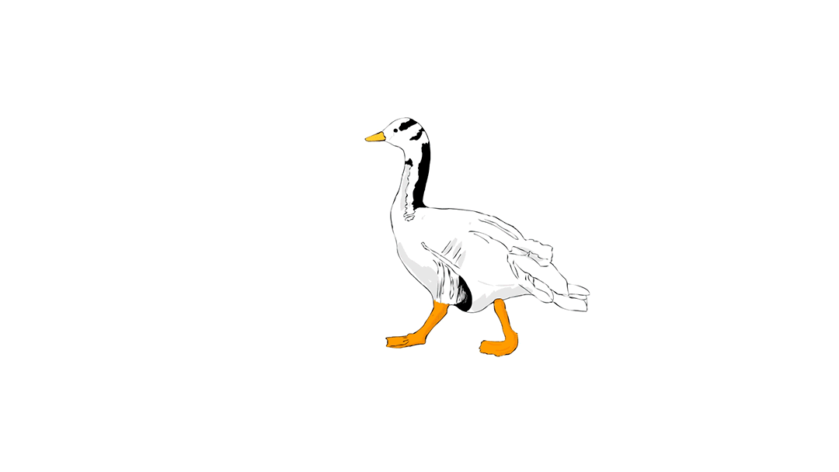
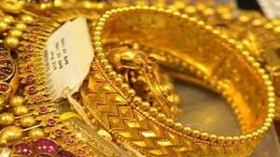
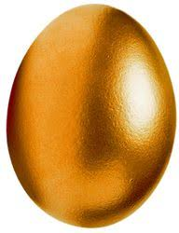
Look at the picture.

Slide 6
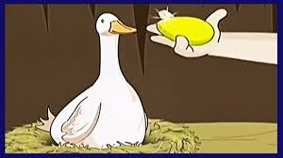
Todays lesson is The golden goose.

Slide 7
rich
idea
New word
belly
inside
kill

Slide 8
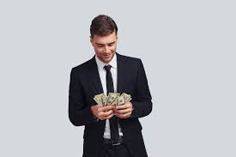
rich
wealthy

Slide 9
idea
concept

Slide 10
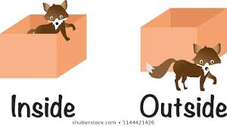
inside
within

Slide 11
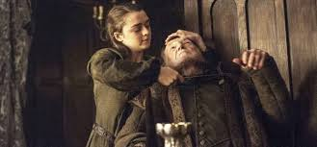
kill
zap

Slide 12
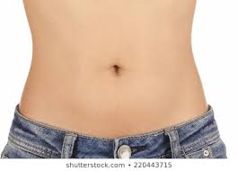
belly
tummy

Slide 13
Teacher’s Reading

Slide 14
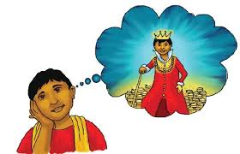
The farmer thinks, ”I want to be rich. I have
an idea!”
The farmer thinks all the eggs are inside the
goose.

Slide 15
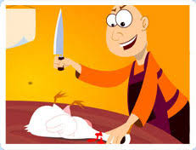
He kills the goose.
He opens its belly, but
There are no eggs!

Slide 16
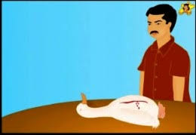
He opens its belly, but
there are no eggs!

Slide 17
Open your book at page 59.

Slide 18
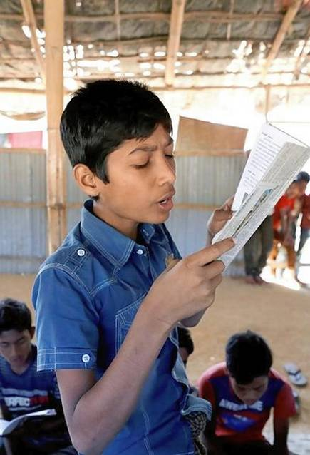
Student’s reading

Slide 19
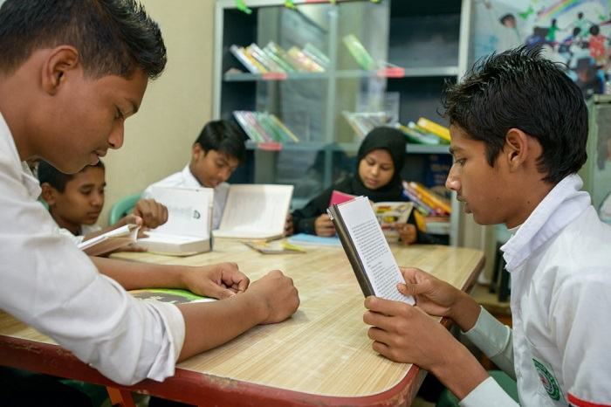
Group reading

Slide 20
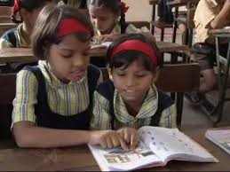
Read in pair

Slide 21
Question’s
How was the farmer ?
What does the farmer think ?
What does he do with the goose ?
What did he find after open it’s belly ?

Slide 22
Answer’s
1.The farmer was greedy.
2.The farmer thinks all the eggs are inside the goose.
3.He kills the goose.
4.After open its belly he found nothing.

Slide 23
One day one word
Rich-ধনী

Slide 24
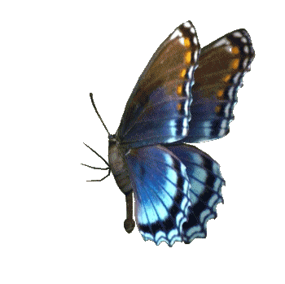
That’s all for today.

