Slide 1
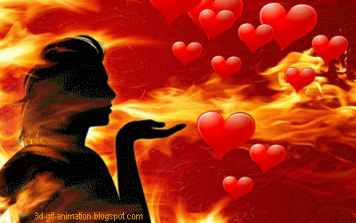
Welcome to my class

Slide 2
Teacher’s Identity
Md. Shariful Islam
-Physical Teacher
Mirpur Mahmuda Chowdhury College
Mirpur, Kushtia
sharif.stc@gmail.com
Fb/msislameditor
01911 220440

Slide 3
?
Love
Heart

Slide 4
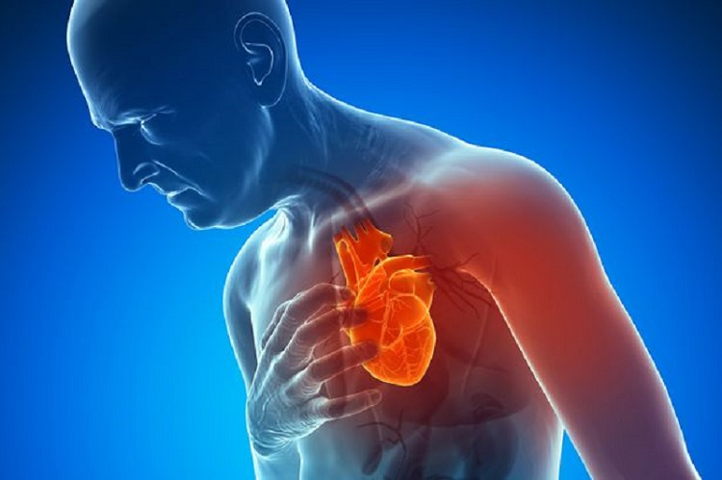
?
Heart

Slide 5
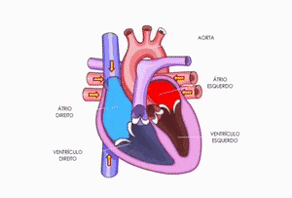
?

Slide 6
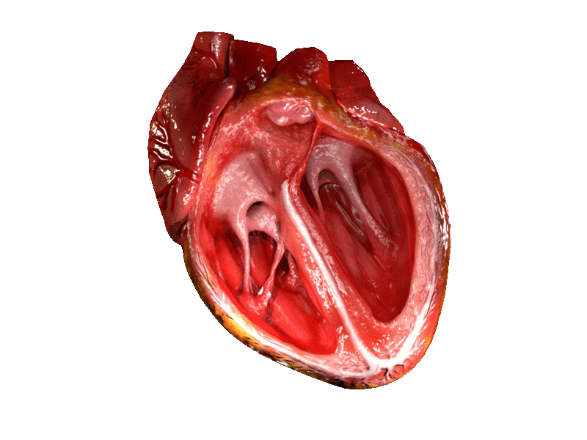
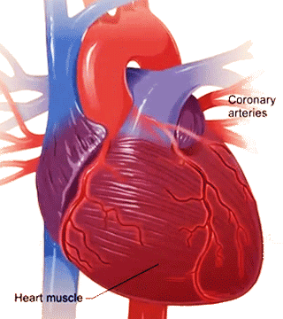
Human Heart and it’s function

Slide 7
After this lesson students will know
What is heart?
Function of heart

Slide 8
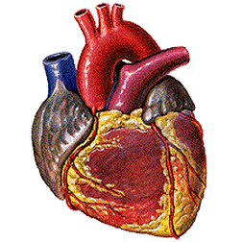
Heart
Your heart is a vital organ. It is a muscle that pumps blood to all parts of your body.

Slide 9
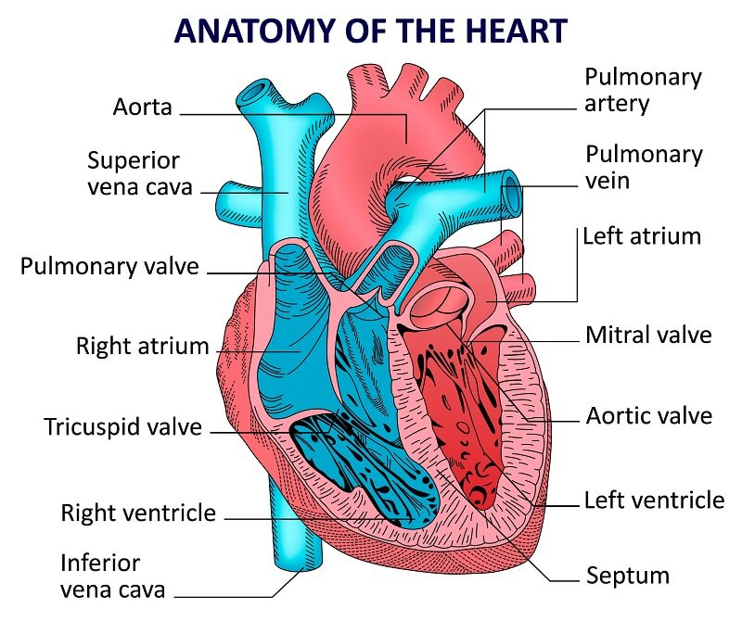

Slide 10
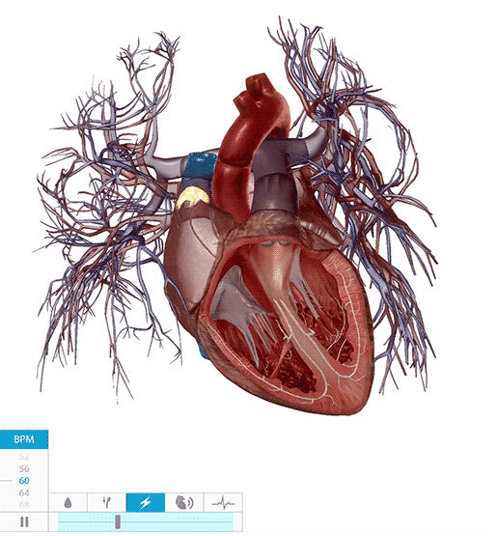
Functions of Heart
The blood pumped by your heart provides your body with the oxygen and nutrients it needs to function.
Your heart is about the size of a clenched fist, and weighs between 300 and 450 g.

Slide 11
Pair work
Write down five elements of heart

Slide 12
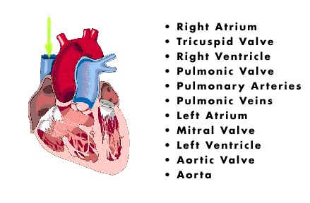
Elements of heart

Slide 13
Evaluation
1. Heart provides your body with the oxygen
True False
1. Heart pumps blood to all parts of your body.
True False

Slide 14
Draw A picture of human heart
and show it’s deferent parts

Slide 15
Thank you very much for your kind cooperation

