Slide 1

GOOD MORNING
WELCOME

Slide 2
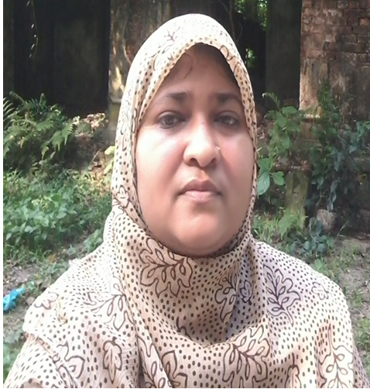


Teacher’s Introduction
Zannaton Nahar
Head Teacher
Teknogpara Govt. Primary School
Gazipur citycorporation, Gazipur.
Mobile-01768031223
Mail-zannatonnahar@gmail.com

Slide 3

Class:Two
Subject: English
Unit:02
Lesson:4-6
(Alphabet:F,G,H,I,J.)
Time..40 Min.
Lesson identity

Slide 4
Learning outcomes.
1.1.1.become familiar with English sounds by listening to common English words.

Slide 6
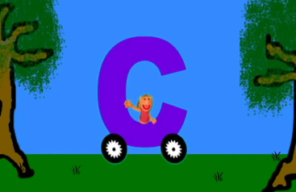
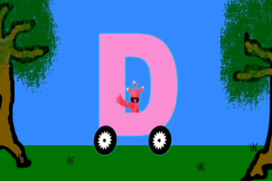
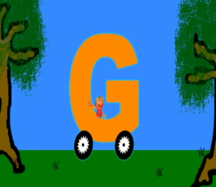
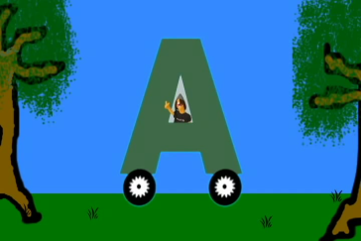
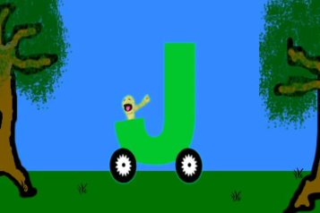

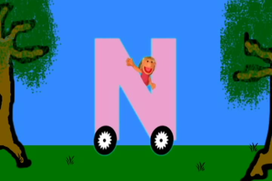
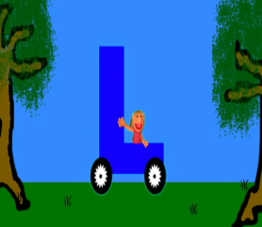
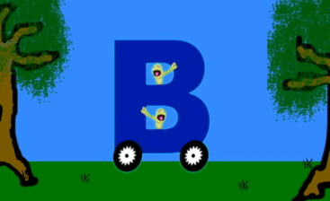
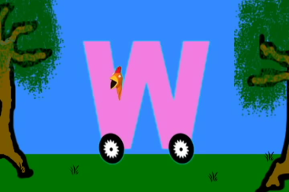
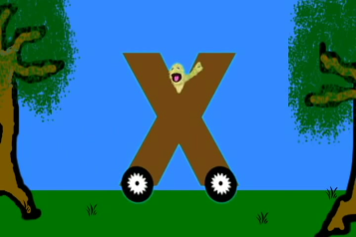
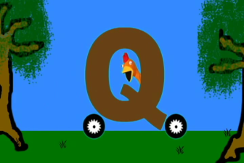
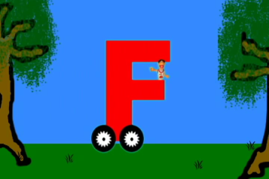
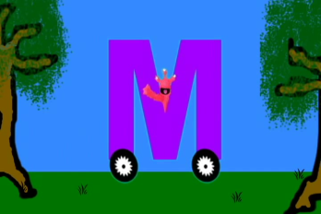
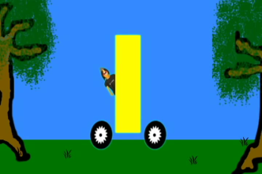

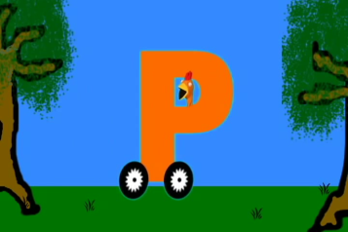
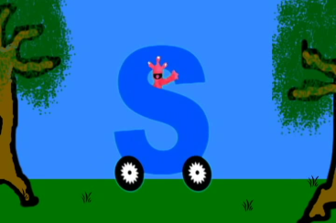
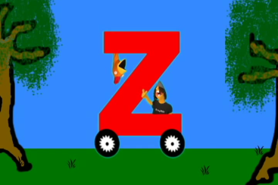
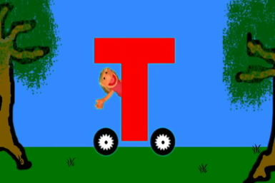
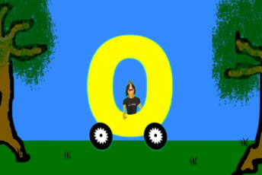
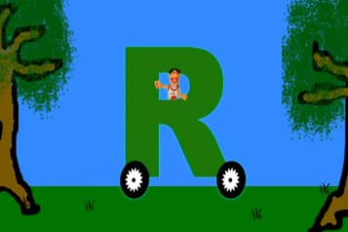
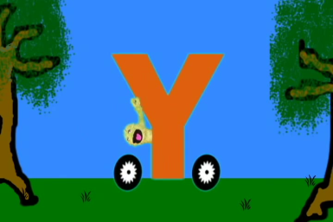
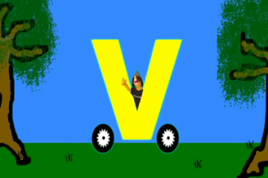
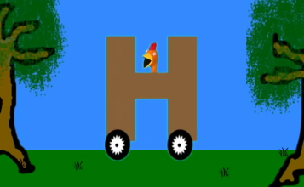
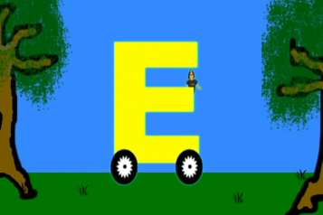

Slide 7



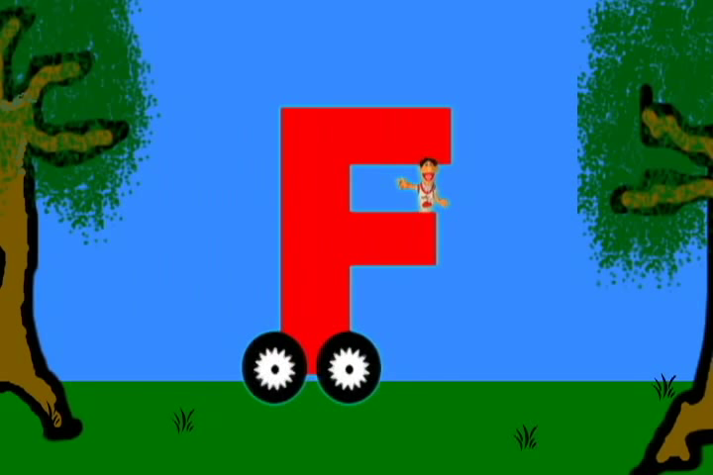


Slide 8
Lesson declaration
Unit:02
Lesson:4-6
(Alphabet:F,G,H,I,J.)
Page no.:05

Slide 9
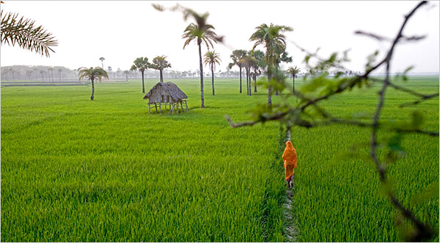

Slide 10
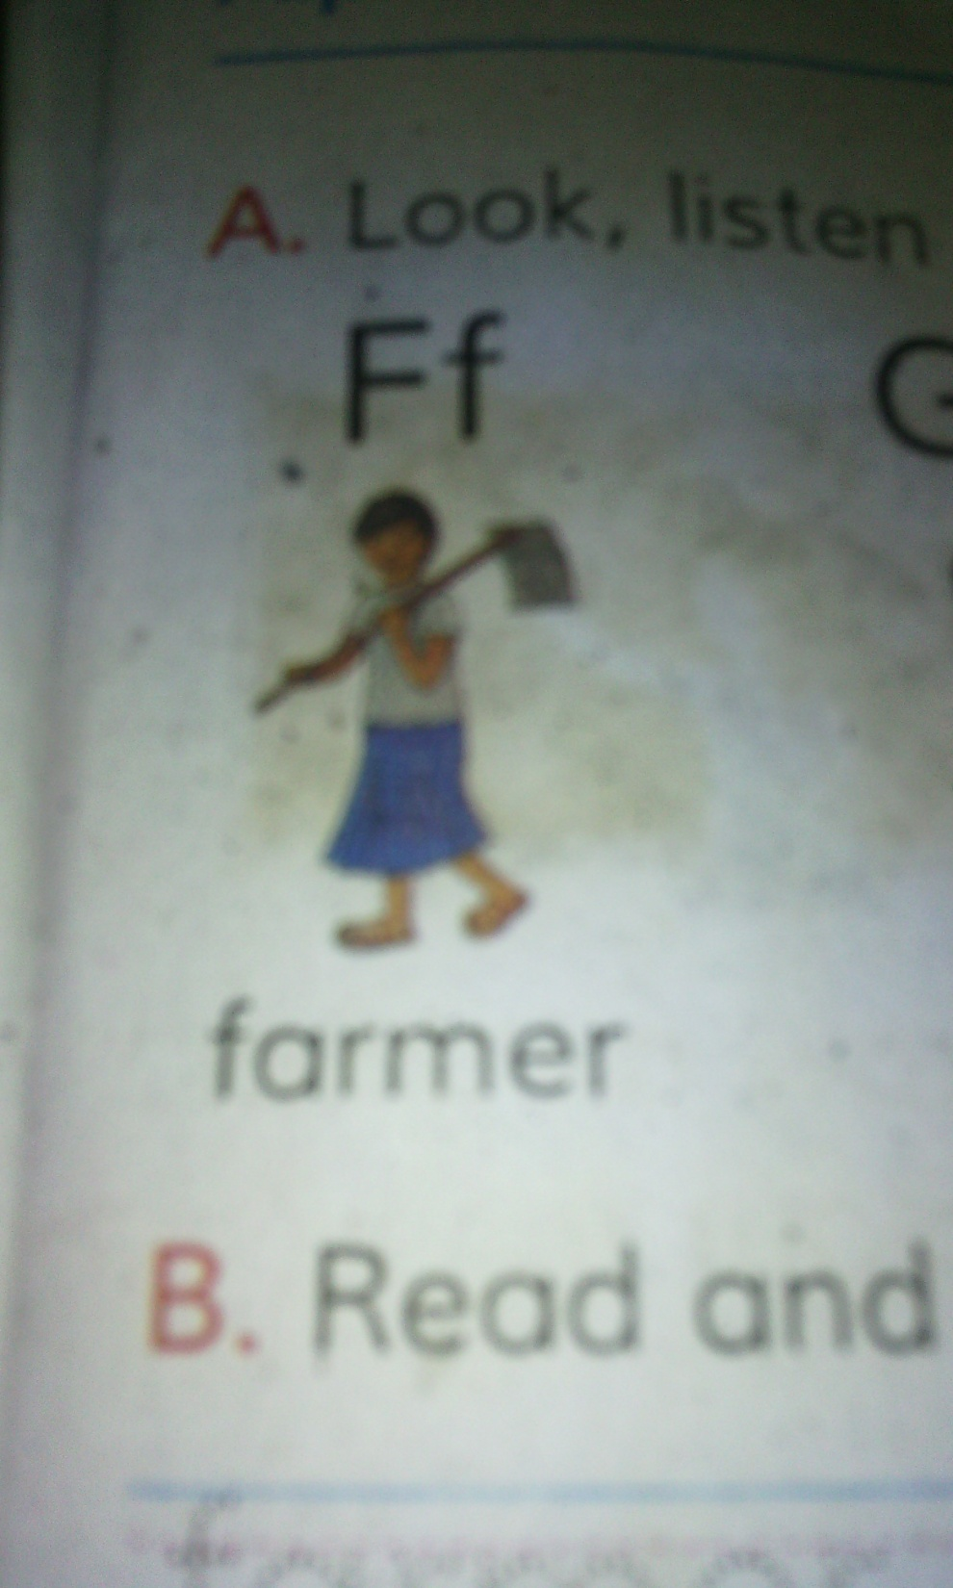
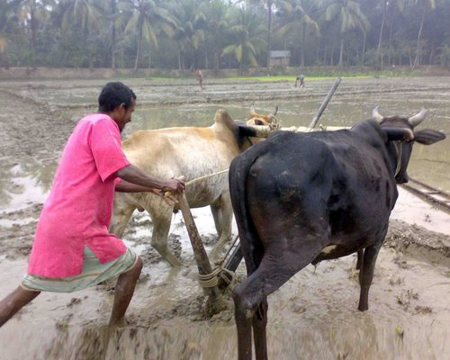
F
f
Farmer

Slide 11
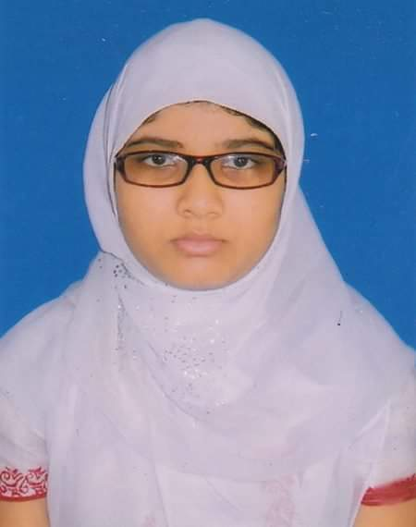
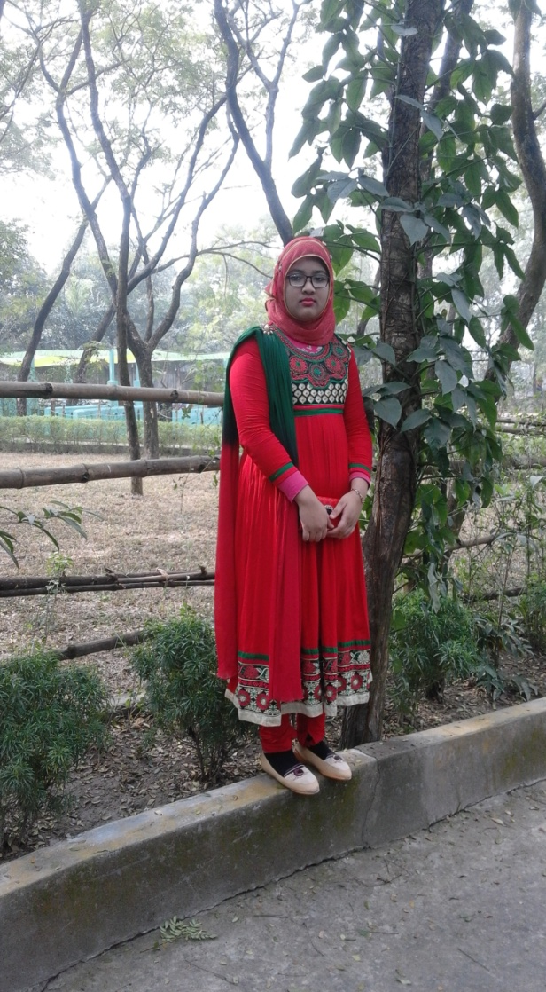
G
g
Girl

Slide 12
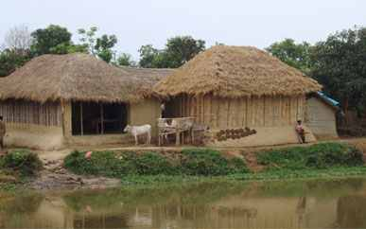
H
h
Hut

Slide 13
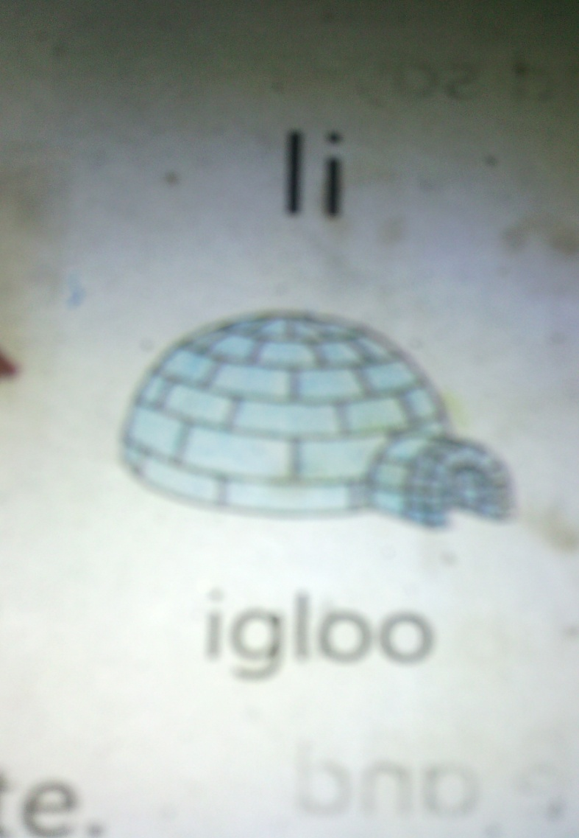

I
i
Igloo
Igloo

Slide 14
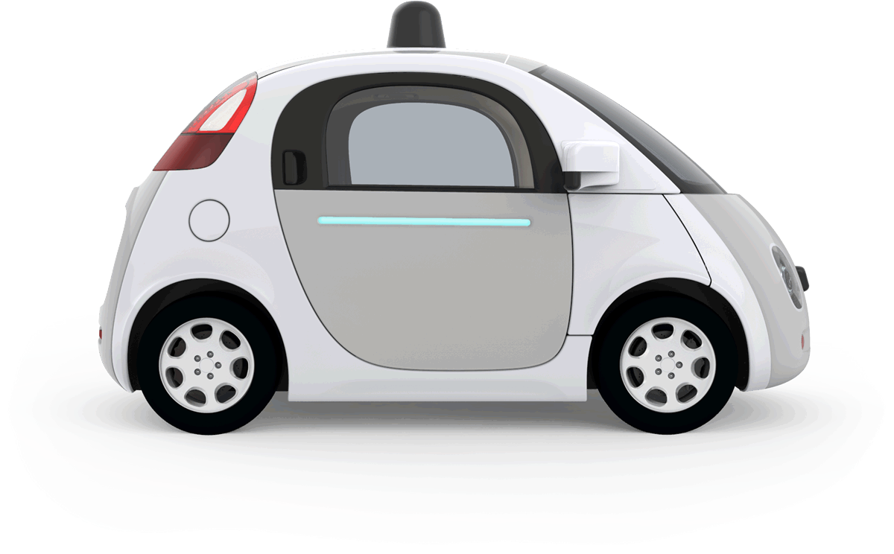
J
j
Jeep

Slide 15
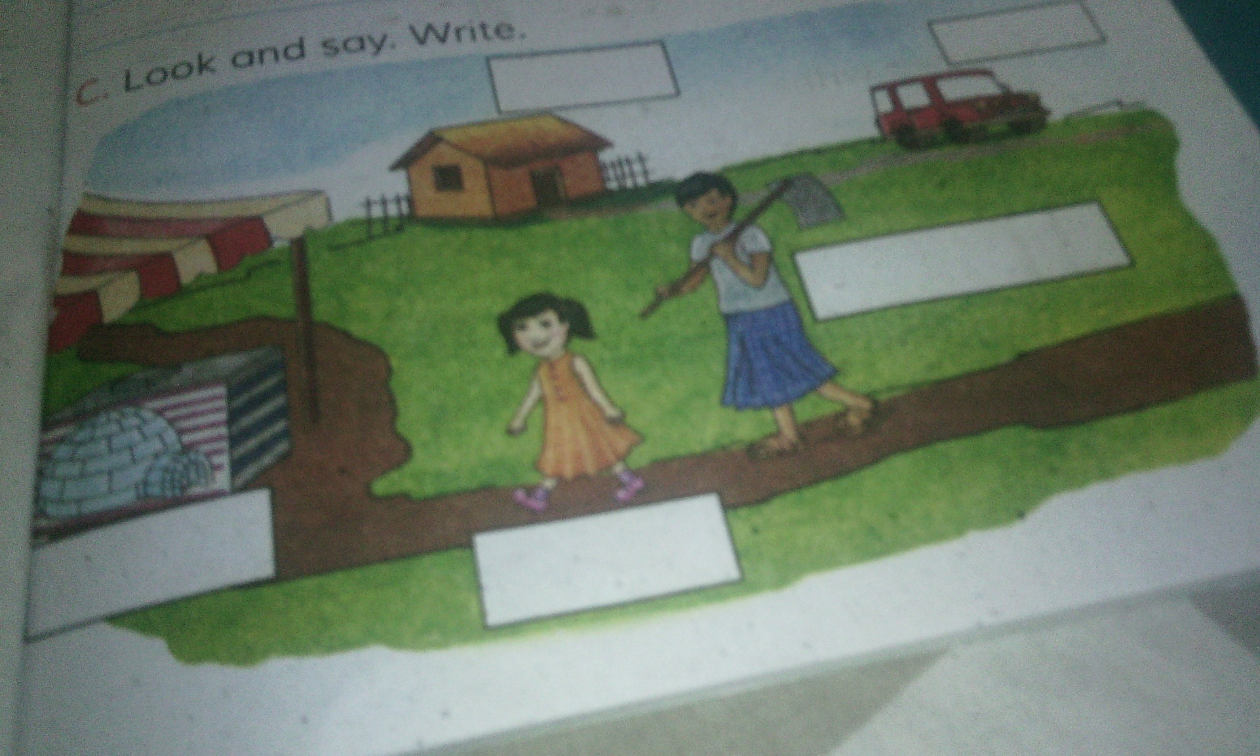
Open your book page no.5

Slide 16
Open your book page no.5
Look, Listen and say in pair
Ff - Farmer
Gg - Girl
Hh - Hut
Ii - Igloo
Jj - Jeep

Slide 17



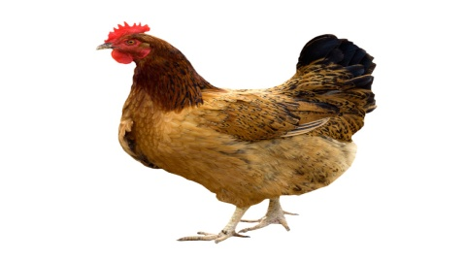

Let’s learn another new words
F- Fish
J - Jug
G- Gun
H - Hen
I – Ice-cream

Slide 18
Group work
Group-1: write 2 words of F
Group-2: write 2 words of G
Group-3: write 2 words of H
Group-4: write 2 words of I
Group-5: write 2 words of J

Slide 19
Answer of Group work
F- Farmer; Fish
Group-1
Group-2
G- Girl; Gun
H- Hut; Hen
Group-3
Group-4
I- Ice cmeam; Igloo
Group-5
J- Jeep; Jug

Slide 20

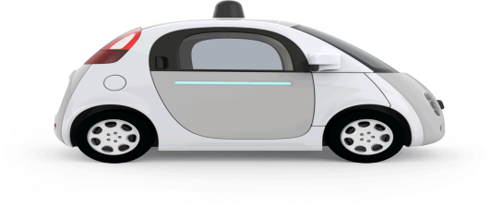
Word meaning
Farmer – কৃষক।
Girl- বালিকা।
Hut- কুঁড়েঘর।
Igloo- বরফের ঘর।
Jeep- জিপ গাড়ি।

Slide 21

Individual work
Write one word by using
F, G, H, I, J

Slide 22

Evaluation
Write their names in English
3
1
2
4
5
6

Slide 23
Home work
Write two words by using F, G, H, I, J

Slide 24

THANKS

