Slide 1
WEL-COME
TO
EVERYBODY

Slide 2
Teacher’s Information
Md. Shamsul Alam
BA(Hons.)MA in English.
Assistant Teacher( English)
Nabodoy Girl’s High School
Shailkupa, Jenaidah.
Phone:01917-452052,01722-922691
Email:shamsul101085@gmail.com

Slide 3
Information of Topic
Class: Nine/ Ten
Subject: English 2nd Paper
Topic: Voice Change
Date: 15.02.2021

Slide 4
What do you mean by this picture?

Slide 5
Today’s lesson
Voice Change

Slide 6
Learning Outcomes
At the end of the lesson students will be able to-
identify the active and passive voice.
define active and passive voice.
change them.
use them in English language.

Slide 7
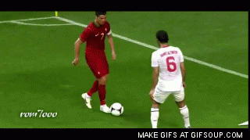
Classification of voice
Active and passive voice
Voice
Active
Passive
The focus is on the action
What subject does
Active: Riad is playing football.
Passive: Football is being played by Riad.

Slide 8
Active: Yameen plays football.
object
Subject
Present form
Past participle form
Passive: Football is played by Yameen.
Object will be subject and subject will be subject.

Slide 9
Rules of passive voice:
Rule – 1:
If the verb of the sentence is present form ----
Subject
am /is/ are
past participle form of verb
by
Object
Example: They play football.
Football is played by them.

Slide 10
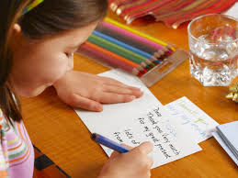
Rule -2:
If the verb is present continuous form----
Subject
am being/ is being/ are being
past participle of verb
by
Object
Example: She is writing a letter.
A letter is being written by her.

Slide 11
Rule -3:
If the verb is present perfect form---
Subject
have been( plural)/ has been(singular)
past participle of verb
by
Object
Example: I have seen the bird.
The bird has been seen by me.

Slide 12
Pair work
Sadia reads newspaper.
They have played cricket.
Sonia is drawing a nice picture.
We see a bird.
I have seen the flower.

Slide 13
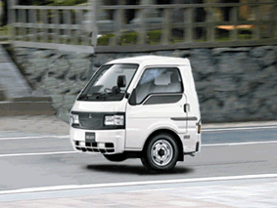
Rule – 4:
If the verb is past form ----------
Subject
was /were
past participle of verb
by
Object
Example: We saw a nice car.
A nice car was seen by us.

Slide 14
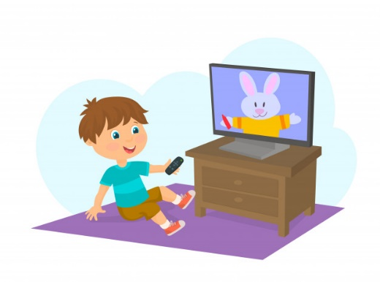
Rule -5 :
If the verb is past continuous form ----Subject
was being /were being
Past participle of verb
by
Object
Example: He was watching television.
Television was being watched by him.

Slide 15
Rule – 6:
If the verb is past perfect form –
subject
had been
Past participle of verb
by
Object
Example: They had solved the problem.
The problem had been solved by them.

Slide 16
Group work
Change the following sentences into passive. Write down the tense of each sentence.
My friend invited me.
Riad had eaten rice.
Anoara was writing an eassy.
He walked ten miles.
She made a cup of tea.

Slide 17
Voice without object
Some Passive voice has no object. For this, we can use object (me, us, them, him, someone, one, people, police etc). For Active voice we can use these objects as Subjects.
a. English is spoken all over the country. ( Active)
= People speak English all over the country.
b. He has been called. ( Active)
= Some one has called him.

Slide 18
d. More and more books should read. ( Active)
= We should read books more and more.
e. Flowers are used in different occasion . ( Active)
= We use flowers in different occasion.
f. The thief was punished. ( Active)
= The police punished the thief.
g. Rome was not built in a day. ( Active)
= The Romans didn’t built Rome in a day.
h. The boy has been kidnapped. ( Active)
= The kidnaper has kidnapped the boy.
i. My has been stolen. ( Active)
= Some one has stolen my pen.

Slide 19
There are some Quasi passive where there is no Object .
a. The book is printing. ( Active)
= The book is being printed.
b. The cow is milking. ( Active)
= The cow is being milked.
c. The building/ house is building.
= The building / hose is being built.

Slide 20
If there is- Have to, has to, had to, use to, ought to, is going to, was going to in the sentences, be+ past participle will be in passive voice.
a. I am going to build a building.
= A building is going to be built by me.
b. He is going to open a bank account.
= A bank account is going to be opened by him.
c. I had to do the duty.
= The duty had to be done by me.

Slide 21
There are some verbs where other prepositions without by in passive voice.
1. Filled with -------------পরিপূর্ণ হওয়া
2. Seized with------------আচ্ছন্ন হওয়া
3. Satisfied with---------সন্তুষ্ট হওয়া
4. Pleased with----------সন্তুষ্ট থাকা
Displeased with---- অসন্তুষ্ট থাকা
Blessed with.--------আশির্বাদপুষ্ট হওয়া
7. Annoyed with-------বিরিক্ত হওয়া
8. Annoyed at-----------বিরক্ত হওয়া
9. Known to--------------চেনা/জানা
10. Request/order to---আদেশ/অনুরোধ করা
11. Surprised at------আশ্চর্য হওয়া
12. Marvelled at----- আশ্চর্য হওয়া
13. Shocked at------- ব্যথিত হওয়া
14. Stunned at-------আঘাত দিয়ে অজ্ঞান করা
15. Charmed at------মুগ্ধ হওয়া
16. Interest in--------আগ্রহী হওয়া
17. Contained in-----ধারন করা
Frightened of------ভীত হওয়া
Worried about---- চিন্তিত হওয়া
Handed to ---------হস্তান্তর হওয়া

Slide 22
There are some verbs where other prepositions without by in passive voice.
1. She annoyed me.
= I was annoyed with her.
2. His behavior annoyed me.
= I was annoyed at his behavior.
3. I know the man.
= The man is known to me.
4. The news pleased us very much.
= We were pleased very much at the news.

Slide 23
Evaluation
What is subject?
What is the object of the word ‘they’?
How many kinds of voice?
d. More and more books should be read.( Active)
The book is printing. (Active)

Slide 24
Homework
Write 5 sentences on present perfect tense and change them with Active and passive voice.

Slide 25
To be continue………

