Slide 1
WELCOME

Slide 2
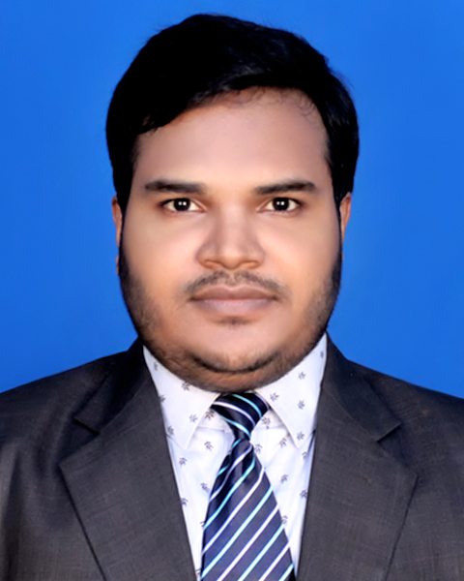
Introduction
Mostafizur Rahman
Assistant Teacher ( English)
Chunarughat Pilot Girls High School
Chunarughat, Habigonj
E- mail: mostafiz01papon@gmail.com
Class : 7
Subject: English 1st Paper
Unit: :1
Lesson: 1

Slide 3
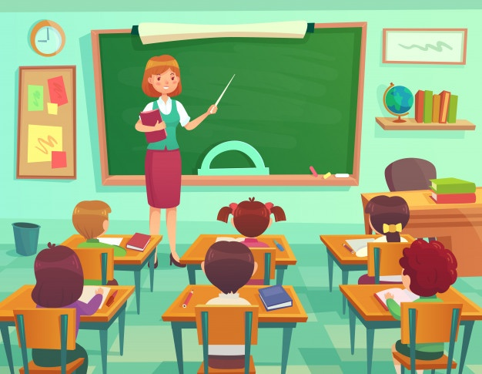
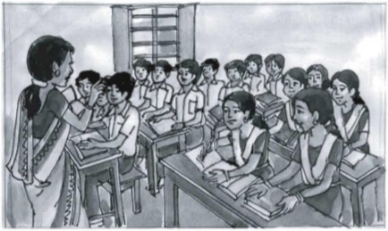
What do you see in these pictures?
These are the picture of classroom .

Slide 4
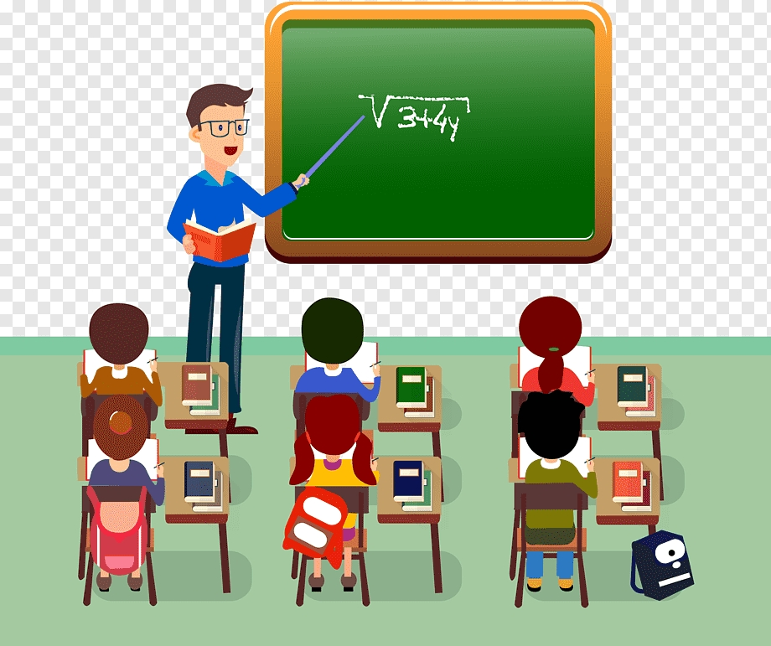
So, what will be our today’s lesson?
In the Classroom

Slide 5
Learning outcome
After we have studied this lesson, we will be able to,,,,,,,
Follow commands, request and act accordingly.
Ask and answer questions.

Slide 6
New words
1, Conversation ---------------talk between two or more people.
2, Often----------------- again and again.
3, Remember----------- think back.
4, Watch------------- look at.
5, Welcome------------ receive gladly.

Slide 7
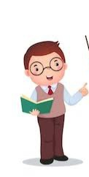
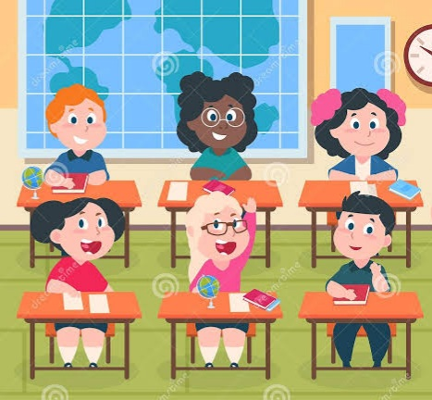
Listen and say
Good morning and welcome everybody
Good morning teacher

Slide 8
Are you ready for the class?
Yes, teacher.
Have you got your new books?
Yes, teacher, we have.

Slide 9
Good! Please remember to bring your English book every day. And speak English with me and with your classmates.

Slide 10
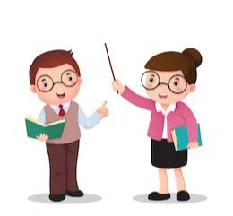
Pair work
10 minutes
Read the conversation and act it out in pairs.

Slide 11
05 minutes
Now discuss this question with your partner
What does the teacher ask the students to do?

Slide 12
Evaluation
10 minutes
Answer these questions:
1, Do you speak English with your teacher? If you do, when and how often?
2, Do you speak English with your friends and classmates? How often?

Slide 13
Home work
Write a dialogue between you and your friend about your feelings of attending in the first class at your school.

Slide 14
Thank you

