Slide 1
Good Morning

Slide 2
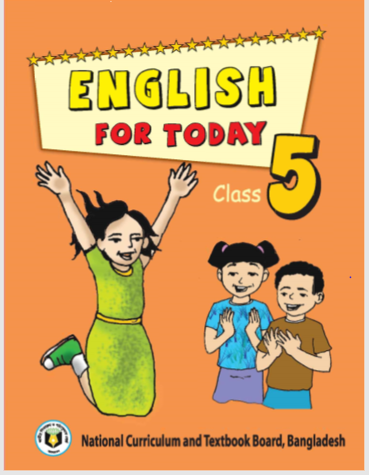
Teacher′s Identity
Md. Mostafizur Rahman
Assistant Teacher
Batisa Balika gov. primary school,
Lesson Identity
Class –Five
Sub- English
Unit- Four

Slide 3
What do you do in your free time ? Act.
(Free time means Leisure Time)
Reading, Drawing, Singing, Listening to music, Using the internet etc.

Slide 4
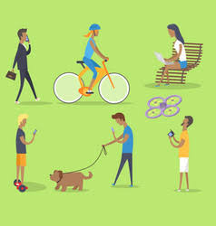
What are they doing?
They are spending their leisure time

Slide 5
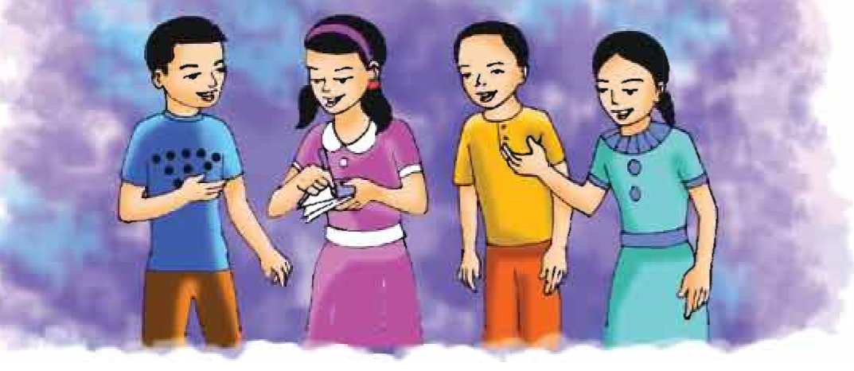
Lesson Declaration
Today we’ ll read
“Leisure Time”

Slide 6
LEARNING OUT COMES
Students will be able to
Listening
1.3.1-Recognize which words in a sentence are stressed.
Speaking
1.1.1 – Say words, phrases and sentences with proper
sounds and stress.
Reading
1.5.1- Read words, phrases and sentences in the text
with proper pronunciation, stress and intonation.

Slide 7
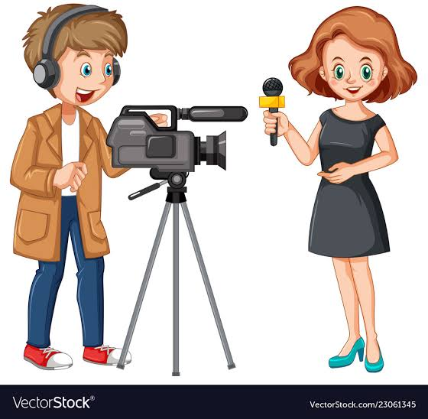
Look at the picture.

Slide 8
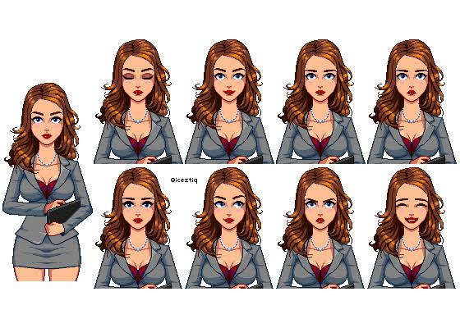
Who are they?
Reporters

Slide 9
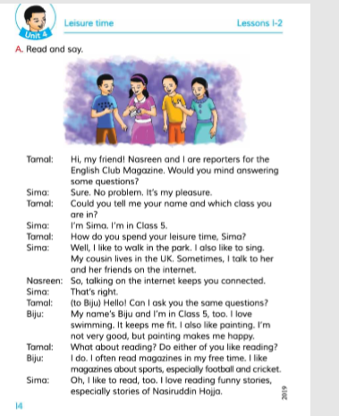
Teacher’s Reading
Open your book at page 14. A.(12 lines)
Now put your finger under the line
and read with me.

Slide 10
New Words
Word Meaning
Leisure time Free time
Reporter One who prepares reports
Mind Remembrance
Pleasure Delight
Cousin A relative
Problem Issues causing troubles

Slide 11
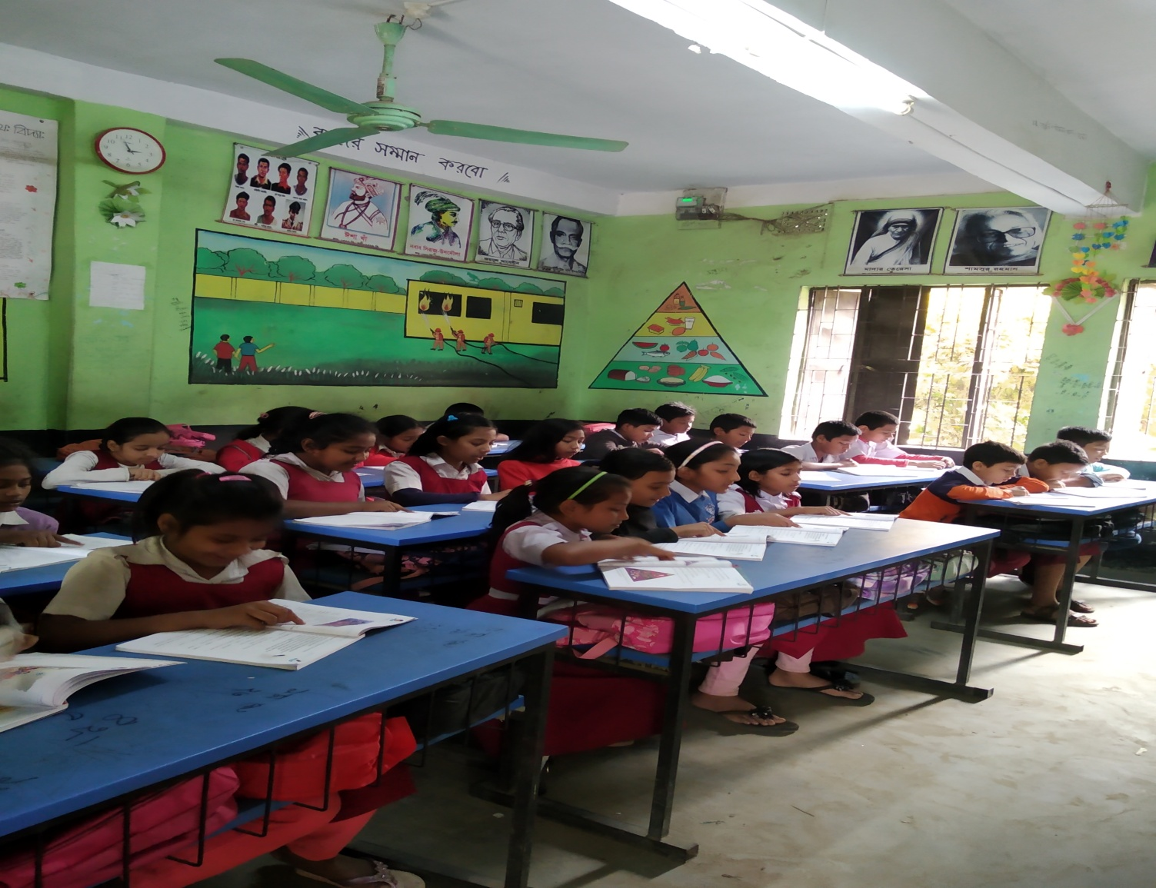
Student’s Silent Reading

Slide 12
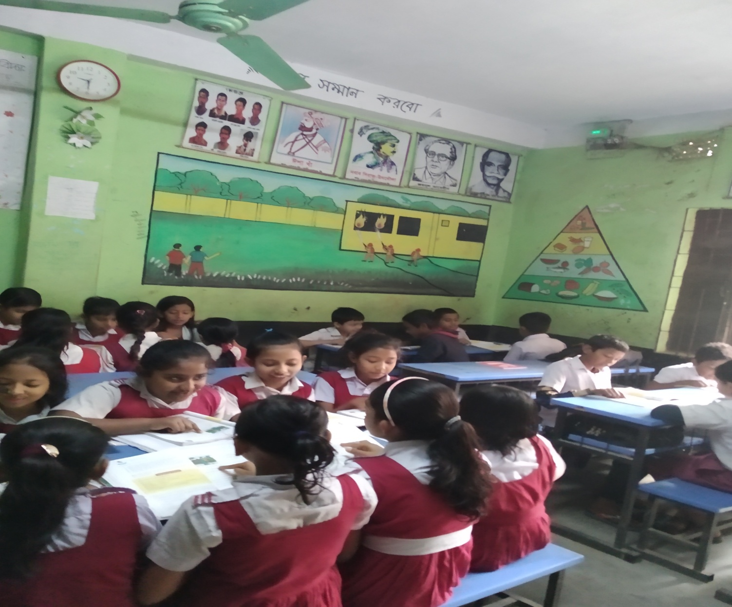
Group Work

Slide 13
A group: In which class do Sima
and Biju read?
B group: Where does Sima’s
cousin live?
C group: How does Sima spend
her leisure time?

Slide 14
Today “ We’ ve learnt how to
take permission to ask questions”.
What phrase the reporters used to
ask Sima and Biju their permission
to interview them?
Ans.“ Would” / “Could”.

Slide 15
Evaluation
How do you spend your
Leisure Time ?
Write in two sentences.

Slide 16
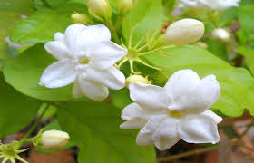
GOOD BYE

