Slide 1
WELCOME

Slide 2
TEACHER’S IDENTITY
Md. Mostafizur Rahman
Assistant teacher
Batisa Balika Govt. Primary School

Slide 3
Lesson Identity
Class: Five
Subject:English
Unit: 6(Eat Healthy)
Lesson: 4-5
Part of the lesson : F(What food.......our health)

Slide 4
LEARNING OUTCOMES
The students will be able to
Listening:3.3.1Understand questions about objects around them.
Speaking:1.1.1 Say words ,phrases and sentences with proper sounds and stress.
Reading:1.5.1Read words , phrases and sentences in the text with proper pronunciation , stress and intonation.
5.1.1Read silently with understanding paragraph

Slide 6
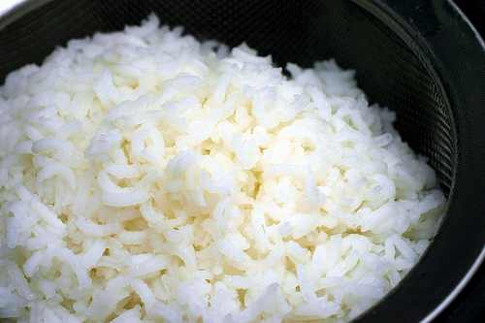
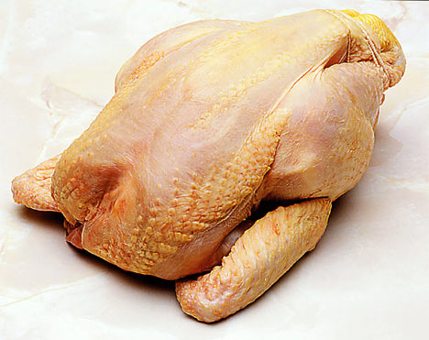
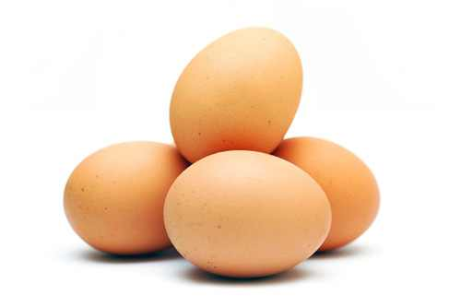
Healthy food
Rice
Chicken
Egg

Slide 7
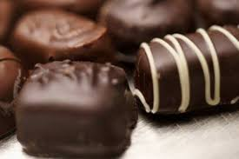
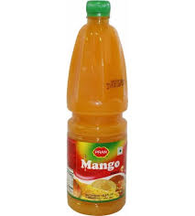
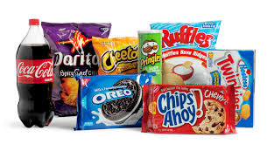
Unhealthy food
Chocolate
Juice
Soft drinks and chips

Slide 8
LESSON DECLARATION
EAT HEALTHY

Slide 9
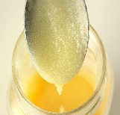
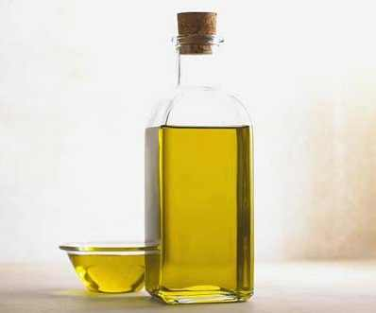
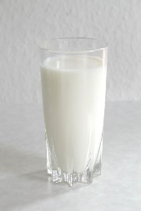
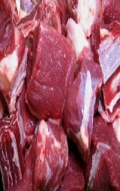
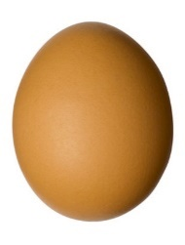
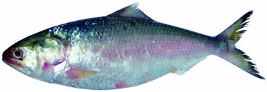
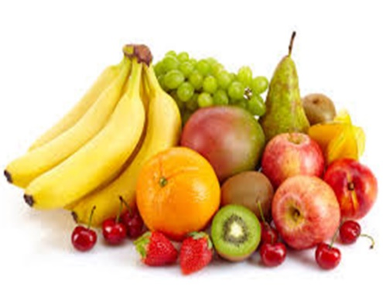
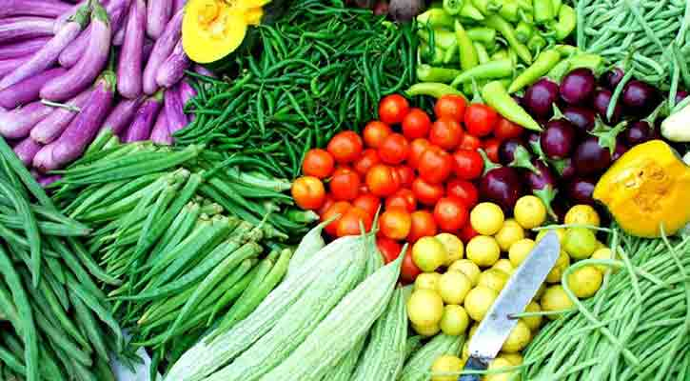
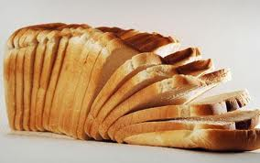
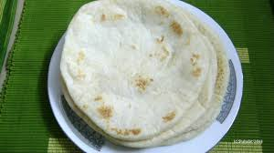
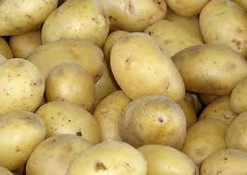
Top level
FOOD PYRAMID
Third level
Second level
Bottom

Slide 10
Foods made from grain
Rice
Roti
Bread

Slide 11
Potatoes
Potatoes are not grains, but they are similar. Grains give us energy.

Slide 12
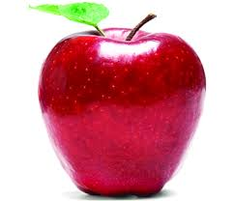
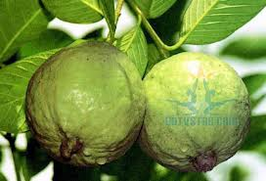
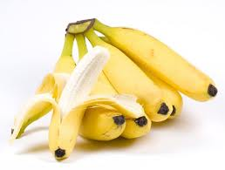
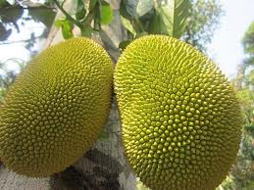
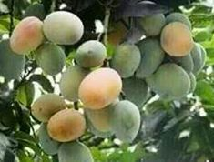
Fruits
Apple
Guava
Banana
Jackfruit
Mango

Slide 13
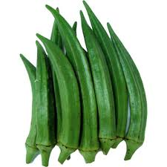
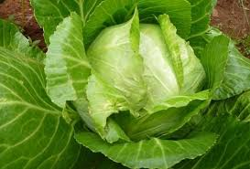
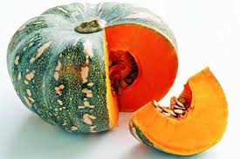
Vegetables
Ladies finger
Cabbage
Pumpkin

Slide 14
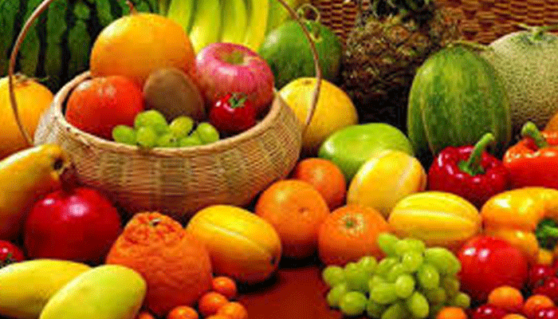
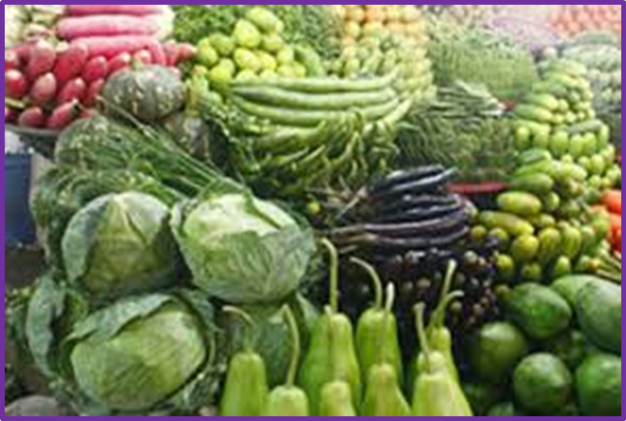
Fruits and vegetables have vitamins.
They help our eyes and our health.

Slide 15
Teachers Reading
Open your book page at 24

Slide 16
New words
Healthiest
Bottom
Grain
For example
Similar
Energy
Healthy, well
The lowest part
Crop
Such as
Same
Power

Slide 17
Pair reading
Chain drill

Slide 18
EVALUATION
Answer the following questions
Group 1:What does food pyramid tell us?
Group 2:Which foods are made from grain ? Write 3 items.
Group 3:How does fruits and vegetables help us?

Slide 19
Students reading alone in front of the class

Slide 20
HOMETASK
Write 5 sentences about
“ Food Pyramid”

Slide 21
THANK YOU ALL

