Slide 1
Welcome Everybody
To
Bhabanipur Sefatia Kamil Madrasah

Slide 2
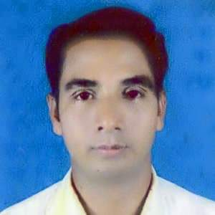
Introductions
Md. Moksed Ali
Assistant Teacher(English)
Bhabanipur Sefatia Kamil Madrasah,
Hatibandha, Lalmonirhat.
Mobile: 01717292475
Email:moksedali1980@gmail.com

Slide 3
More Introduction
Class
Subject
SixTo Ten
English 2nd Paper
Topic: ChangingSentence
( Affirm To Int )
Part : Two

Slide 4
Now Start Our
Today’sLesson

Slide 5
1.The man goes to a house.
2. The men live in the house.
3. Every teacher gives us knowledge.
4. They made the house.
Assertive Sentences

Slide 6
To days Topic
Changing Sentence (Affirmative to Interrogative)
Rules – 3 & 4

Slide 7
Learning Out comes:
The students will be able to..
1.Identify the sentences.
2.Say the sentences.
3.Change the sentences.

Slide 8
1.The man goes to a house.
=Doesn’t
the man go to a house?
2. The men live in the house.
Don’t
the man live in the house?

Slide 9
4. They made the house.
=Didn’t
they make a house?

Slide 10
Rule-3:
If there is Principal Verb
1. MV+s/es
Does not
Do not
2. MV+0
3. MV2
Did not
4.Other Parts
Are Same

Slide 11
Examples :
1. Mita goes home.
= Does n’t I go home?
2. We sing the national song.
= Do n’t we sing the national song?

Slide 12
3. Mita went home.
= Didn’t Mita go home?
4. Kamal played ball.
= Didn’t Kamal play ball?

Slide 13
1. Every teacher gives us knowledge.
=Who does n’t give us knowledge?
2. No teacher gives us knowledge.
=Who gives us knowledge?

Slide 14
Every student writes with a pen.
Who doesn’t write with a pen?
Rule -4:

Slide 15
If there is
Every+
Noun+
MV
1. Every + Noun
Who
2. doesn’t/
doesn’t/
didn’t
New
Are Same
3. Other Parts
3. Interrogative Sign
?

Slide 16
More Examples
Every one calls him.
=Who doesn’t call him?

Slide 17
Exercise:
1. I pray for him.
2. The farmer works in the field.
3. They write with pens.
4. We were only one day old.
5. She had to do the sum well.

Slide 18
GOOD BYE TO EVERYBODY

