Slide 1
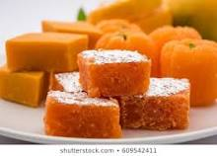
GOOD MORNING

Slide 2
Identity
English 1st paper
Class: Eight
Unit: one
Lesson : Five
1/1/2021
Md shafiqul islam
Assistant Teacher (English)
Sonatan darussannat dakhil Madrasha , kawnia, Rangpur.
Mail:shafiqulislam42347@gmail.com

Slide 3
Look at the picture

Slide 4
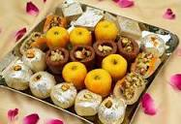
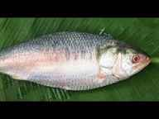
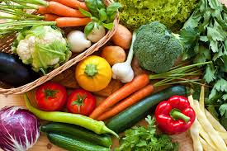
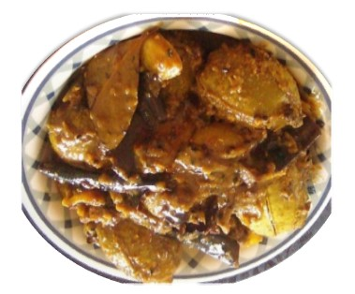
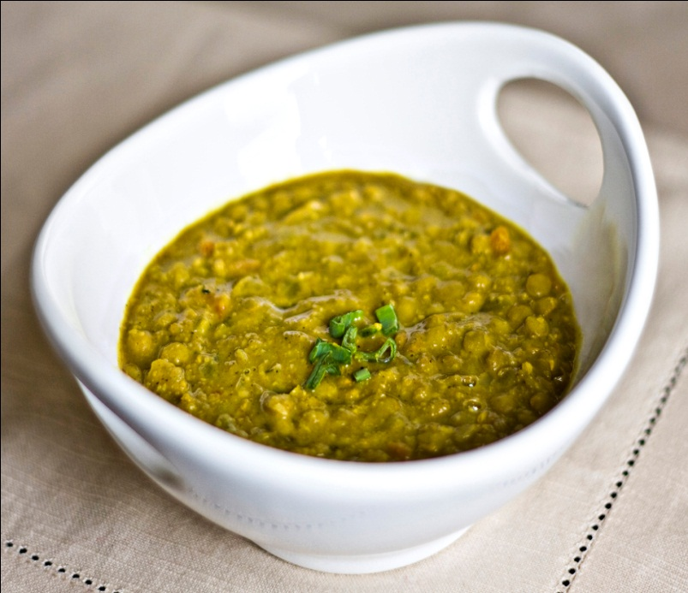
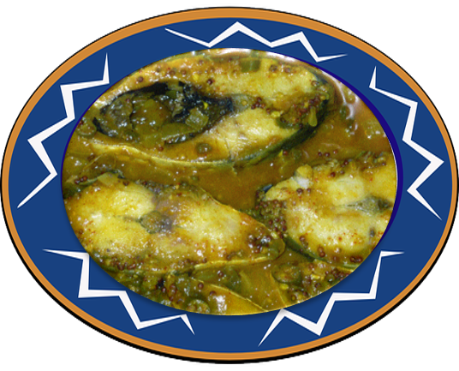
LOOK AT MORE PICTURE

Slide 5
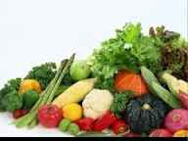
OUR TODAYS TOPIC-
Bangladeshi cuisine

Slide 6
LEARNING OUTCOME
After studied this lesson will be able to--------------
Read and understand text.
Word meaning.
Choose the best answer from the alternative.
Read the text and answer the question.
Fill in each gaps with suitable words from the text.

Slide 7
WORD MEANING
Cuisine -----------------রন্ধন-প্রণালী
Varied ------------------বিচিত্র
Delicious ---------------সুস্বাদু
Appetizing -------------মুখরোচক
Serve --------------------পরিবেশন করা
Source ------------------উৎস
Main ---------------------প্রধান
Entire --------------------সমগ্র
Festival ------------------উৎসব
Population --------------জনসংখ্যা
Organize -----------------সংগঠিত করা
Different -----------------বিভিন্ন
Variety -------------------বিভিন্ন
Wedding -----------------বিয়ে
Promotion ---------------পদোন্নতি

Slide 8
Describing text
Bangladeshi cuisine is rich and varied with the use of many spices. We have delicious and appetizing food, snacks and sweets.

Slide 9
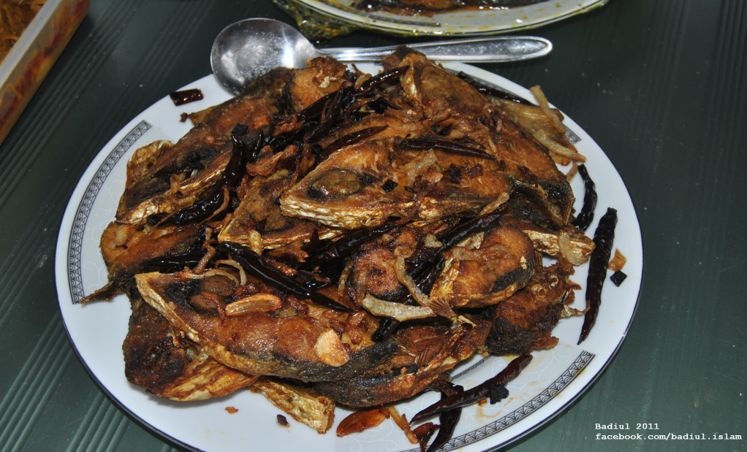
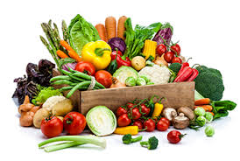
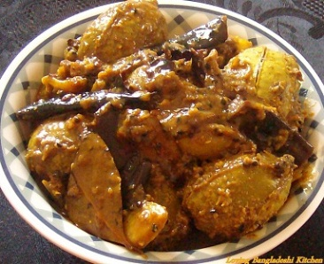
Boiled rice is our staple food. It is served with a variety of vegetables , curry, lentil soups, fish and meat.

Slide 10
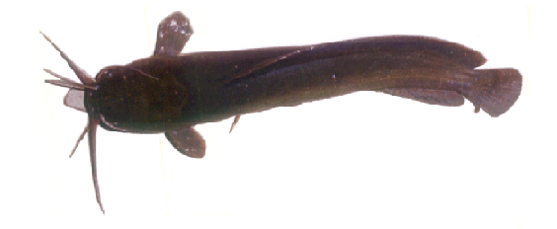
Fish is the main source of protein. Fishes are now cultivated in ponds. Also we have fresh-water fishes in the lakes and rivers. More than 40 types of fishes are common.

Slide 11
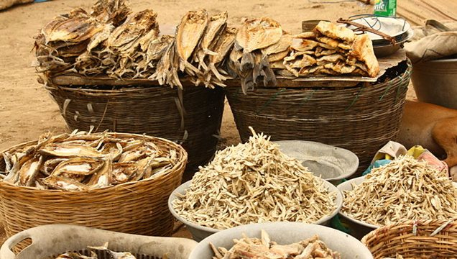
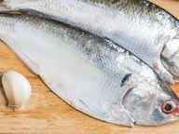
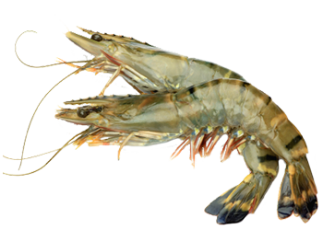
Shutki or dried fishes are popular. Hilsha is very popular among the people of Bangladesh.

Slide 12
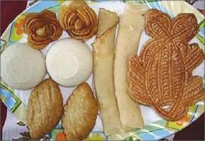
Pitha, a type of sweets made from rice flour, sugar, syrup, molasses and sometimes milk, is a traditional food loved by the entire population. During winter Pitha Utsab, meaning pitha festival , is organized by different groups of people.

Slide 13
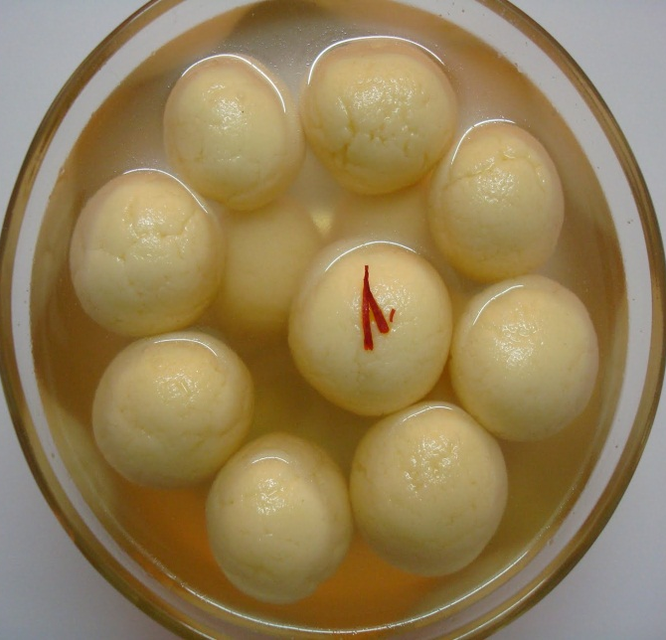
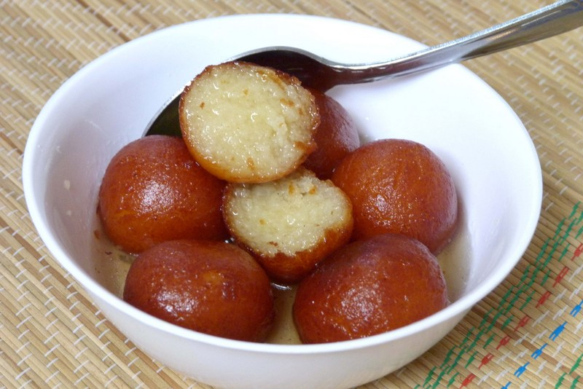
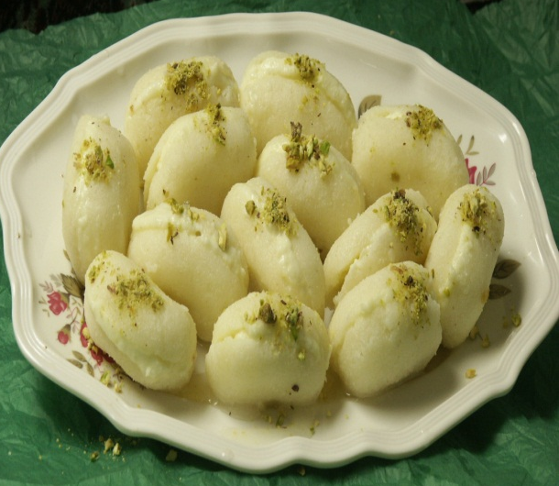
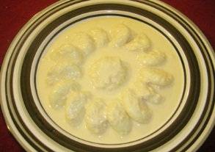
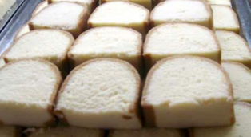
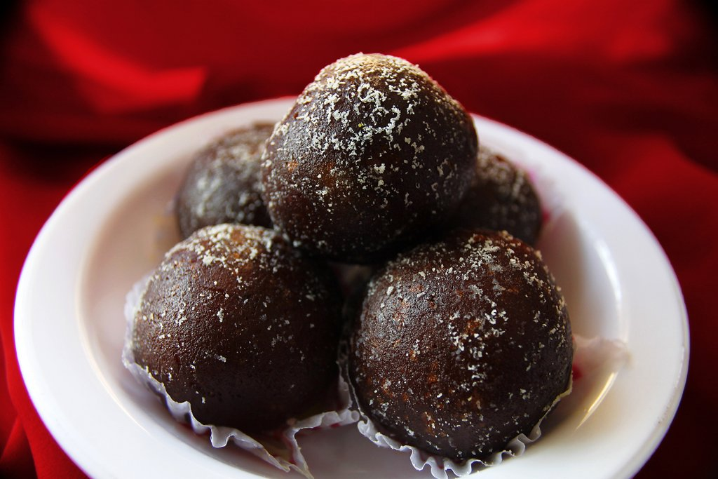
Sweets of Bangladesh are mostly milk-based. The common ones are roshgolla , Sandesh, rasamalai ,gulap jamun, kalo jamun and chom-chom. There are hundreds of different varieties of sweet preparations.

Slide 14
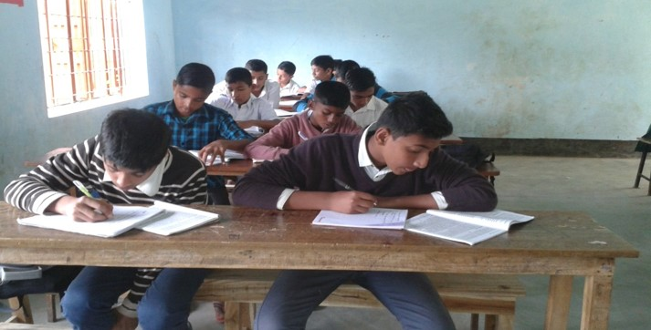
Silent Reading

Slide 15
Individual Work
What has made Bangladeshi food so special?
Make a list of the things you eat everyday?

Slide 16
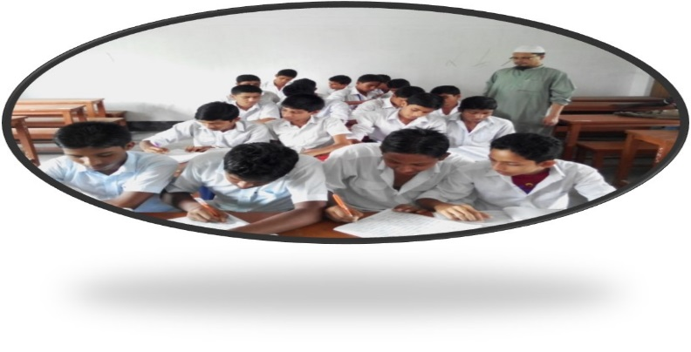
GROUP WORK
Choose the correct answer to each questions from the alternatives:
The word ‘ delicious’ in line 1 of the text means---------------
(a) highly pleasant to the taste (b) highly unpleasant to the taste (c ) highly boring to the taste (d )highly tasteless to the taste.
2. The use of many spices-----------made Bangladeshi cuisine rich.
(a) have (b) has (c ) is (d) are
Boiled rice is our -------------------food.
(a) main (b) popular (c ) unpopular (d) favourite
Panta ilish is a -----------------------platter of panta bhat.
(a) common (b) popular (c ) modern (d) typical
People of Bangladesh ---------------------sweets very much.
(a) like (b) likes (c ) dislike (e ) fond

Slide 17
Evaluation
Read the text answer the following question:
Where do we get the fishes from?
Why are sweets an important part of our life?
What is our staple food?
Which food is loved by the entire population?
How do we prepare panta illish?

Slide 18
Home Work
Read the following text and fill in the gaps with appropriate words:
River gypsies are an ethnic group of people in Bangladesh. They are known as beday to(a) -------------people. The (b )-------------have their own lifestyle and (c )----------------. They live in groups and do not (d )------------any land. Therefore, they live a nomadic life, (e )----------------from one place to another.

Slide 19
THANK YOU ALL STUDENT

