Slide 1
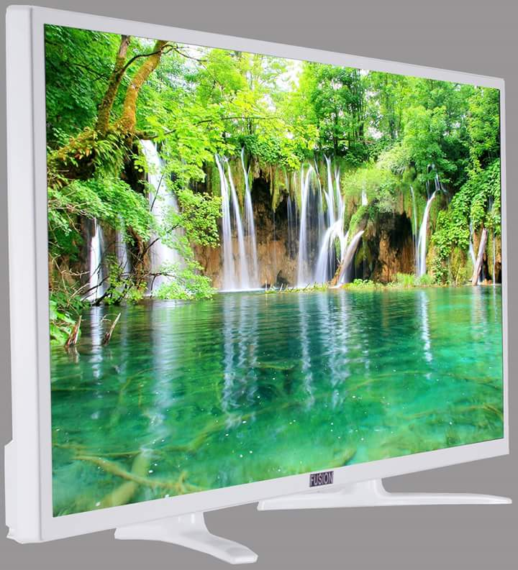
WELCOME TO ALL

Slide 2
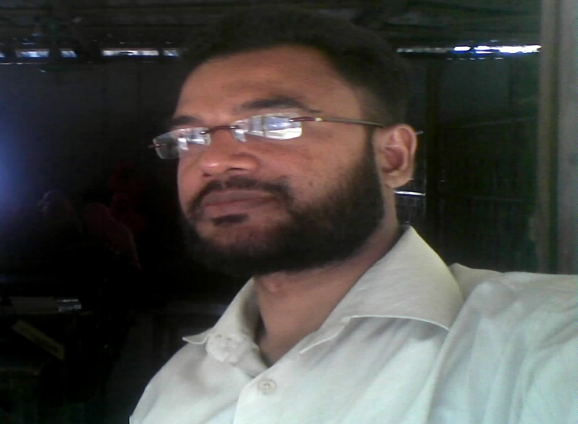
Teacher Information Md.Abu Noman Asst Teacher Batakhali Nuria Dakhil Madrasah Chakaria Purasava,Cox’sbazar. Mobail: 01818-541454 E-mail:-masternoman24434@gmail.com
Preposition
Sub-English 2nd paper

Slide 3
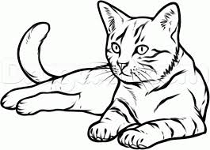
WHERE IS THE CAT?
ON the table

Slide 4
Where is the Cat ?
Under the table.

Slide 5
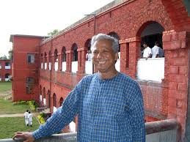
Where is the man ?
Beside the house.

Slide 6
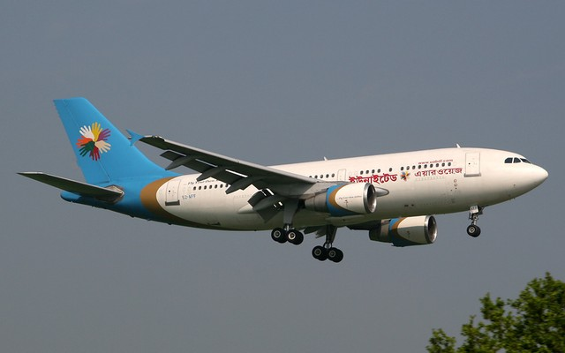
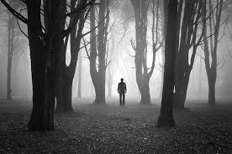
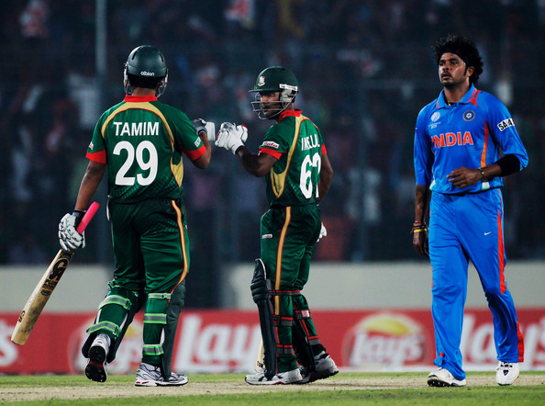
Where is the plane ?
Where is the man walking ?
Above their head.
Through the jungle

Slide 7
Where is the Earth running?
EARTH
SUN
Around the sun.
SUN

Slide 8
TODAY’S LESSION Preposition

Slide 9
Learning Outcomes :
After the end of the lesson ss will be able to:
define Preposition.
identify Preposition.
apply Preposition.

Slide 10
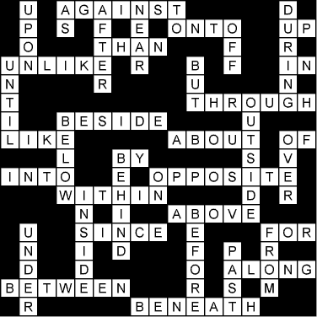
Individual work

Slide 12
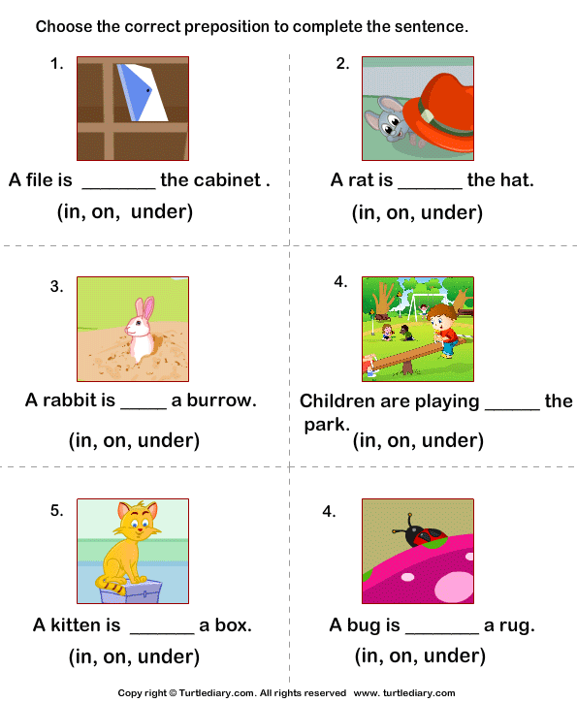
PAIR WORK

Slide 13
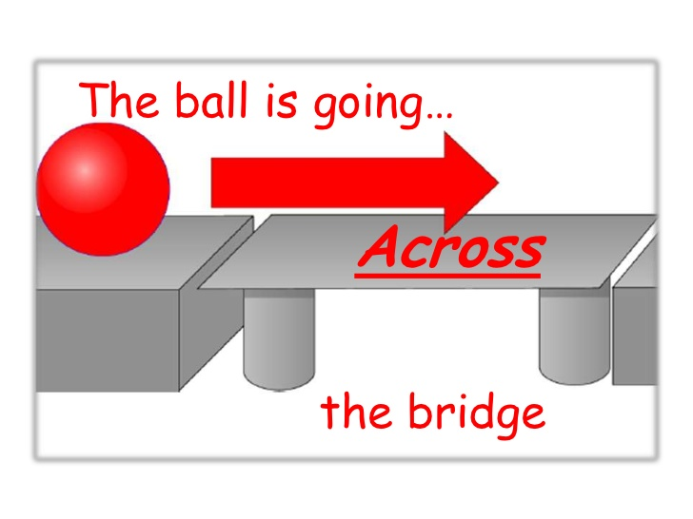
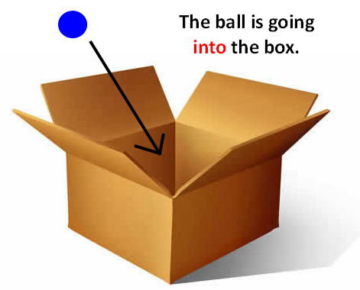
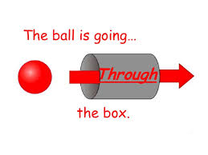

Slide 14
GROUP WORK
Fill in the gaps with the following prepositions. On, around, at, between, above, of, under, through, behind, among.
He kept the book ………… the table.
The man was sleeping ……….. the tree.
Two friends were walking ………the forest.
Jamal divided the mango ……… Rahim and Karim.
The sky is ……….our head.

Slide 15
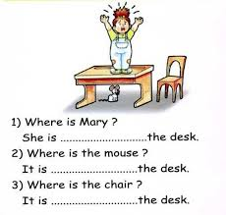
EVALUATION

Slide 16
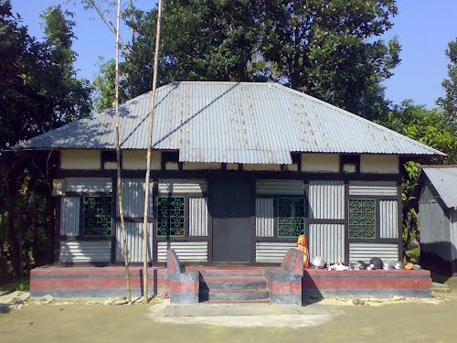
HOME WORK
Make two sentences with every Preposition
On, between, under, above, of, among, behind.

Slide 17
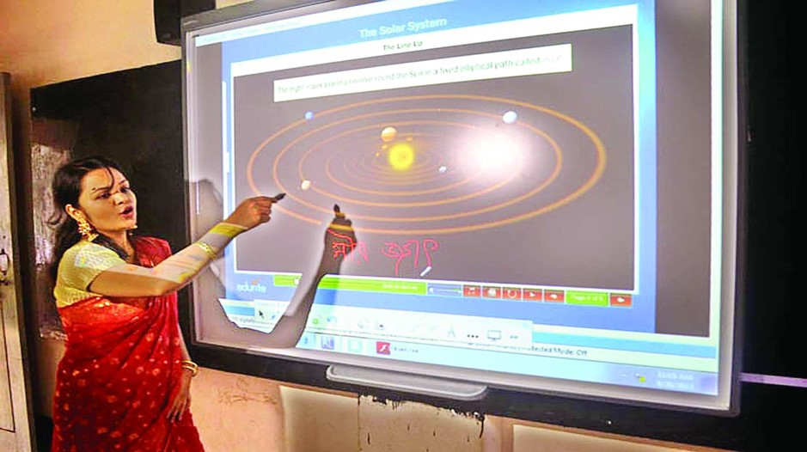
THANKS TO ALL

