Slide 1
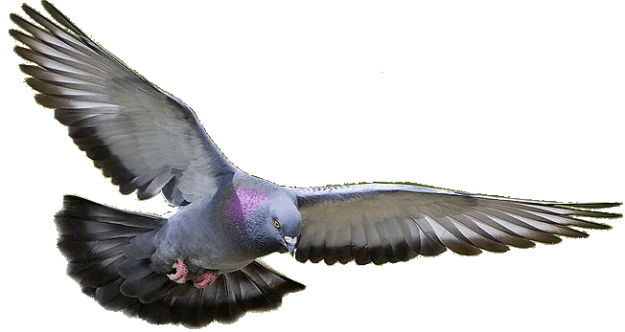
Welcome to my English class.

Slide 2
Identity
MD. Belal Hossain
Assistant teacher
Dhampti Habibur Rahman High School
Debidwar, Cumilla
English 2nd Paper
Grammar
Class-1X

Slide 3
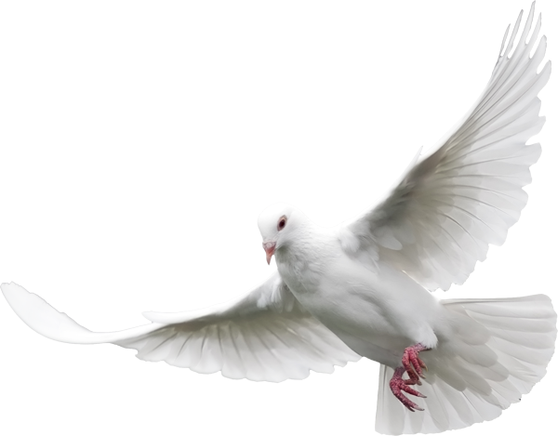
How amazing the pigeon is!
The pigeon is so amazing.

Slide 4
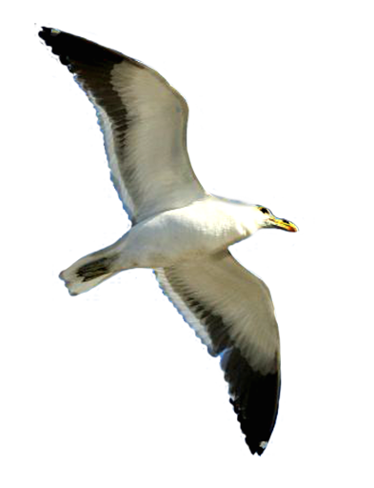
Our today’s topic is--
Changing sentence
(Exclamatory to Assertive)
Notes:
Lesson declaration

Slide 5
Learning outcomes
After completing this lesson, SS will be able to-
identify assertive sentence from different sentences.
identify exclamatory sentence and its classifications.
Change the sentence from exclamatory to assertive sentence
Notes:
Basic things with transformation of assertive and exclamatory are focused in this lesson.

Slide 6
What a strange animal the dinosaurs is!
The dinosaurs is a very strange animal.

Slide 7
What a beautiful bird it is!
It is a very beautiful bird.

Slide 8
Structure of Exclamatory Sentence
(a) What + a/an + adjective +subject + verb +!
(b) How+ adjective + Subject + verb +!
What a charming scenery it is!
How charming the scenery is!

Slide 9
Structure of Assertive Sentence
(a) Subject + verb +a + very/so/great+ adjective +noun
(b) Subject +verb + very/so/great +adjective
.
It is a very interesting game.
The game is very interesting.

Slide 10
Class Activities
Change the sentences into Assertive
What a powerful king of India Akbar was!
How charming a moonlight night is!
What a devastating phenomenon of the modern world terrorism is!
How attentive to her studies she was!
How handsome he was!
What an aristocratic throne there was for him!
How gorgeous it looked!
What a successful king he was indeed!

Slide 11
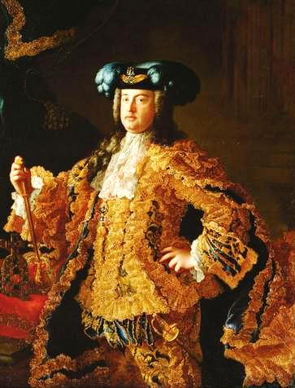
I wish I had the wings of a bird.
Had I the wings of a bird!
If I were a king.
I wish I were a king.
If/Had/Would that <subject + wish
+subject +were + extension +.

Slide 12
Home Works
What a big river the Padma is!
How deep it is!
What a vast water the river contains!
How useful the water of the river is for the people!
How beneficial it is for cultivation!
How cheerfully the fishermen enjoy fishing in the river !
How tasty the fish of this river is !
If I had a boat!
If I were a fisher man!
How dearly I like the river !

Slide 13
GOODBYE

