Slide 1
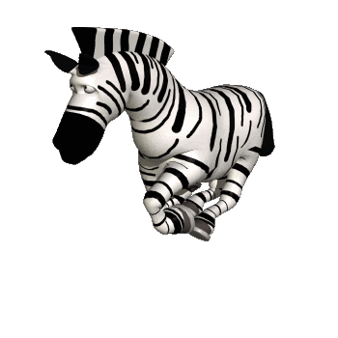
Good
morning

Slide 2
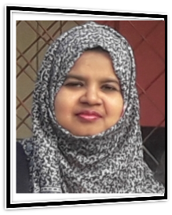
Introduction
Farjana Amin
Assistant teacher
Dhadash Govt. pri. School
Puthia, Rajshahi.
Class : One
Subject : English
Alphabet. Lesson: 4-6,
Unit : 29. Page : 58
Farjana Amin

Slide 3
Lets see a video

Slide 4
Lesson Declaration
Z
z
Alphabet(Zz)
Farjana Amin

Slide 5
Learning outcomes
Students will be able to-
1.1.1 to become familiar with English sounds by listen to
common English word.
1.1.2 to say simple words.
1.2.1 to recognize and read the alphabet both small and
capital (non-cursive) letters.
3.1.2 write words using non-cursive small letters.
Farjana Amin

Slide 6
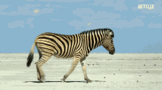
Look, listen and say
Z
z
zebra
Farjana Amin

Slide 7
Look, listen and say. Trace in the air.
Farjana Amin

Slide 8
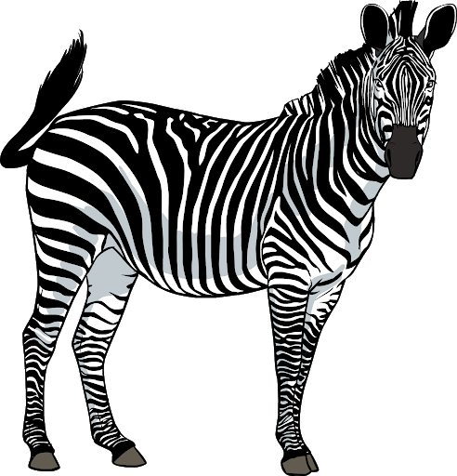
Look, listen and say
Z
Zebra
Capital letter
Farjana Amin

Slide 9
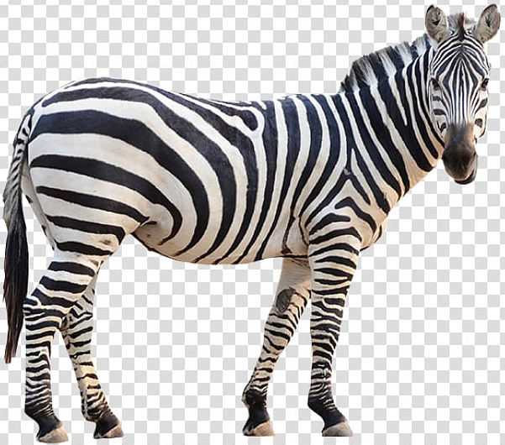
Look, listen and say
z
zebra
Small letter
Farjana Amin

Slide 10
Look, listen and say. Trace in the air.
Farjana Amin

Slide 11
Say and read. Trace and write.
WCW
Z
Z
Z
Z
z
z
z
z

Slide 12
Look, listen and say. Trace in the air.
Z
Z
Farjana Amin

Slide 13
z
z
Look, listen and say. Trace in the air.
Farjana Amin

Slide 14
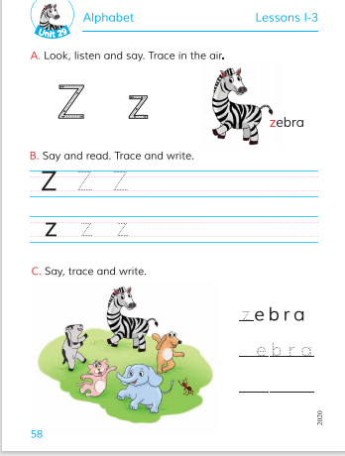
Open at page 58
Farjana Amin

Slide 15
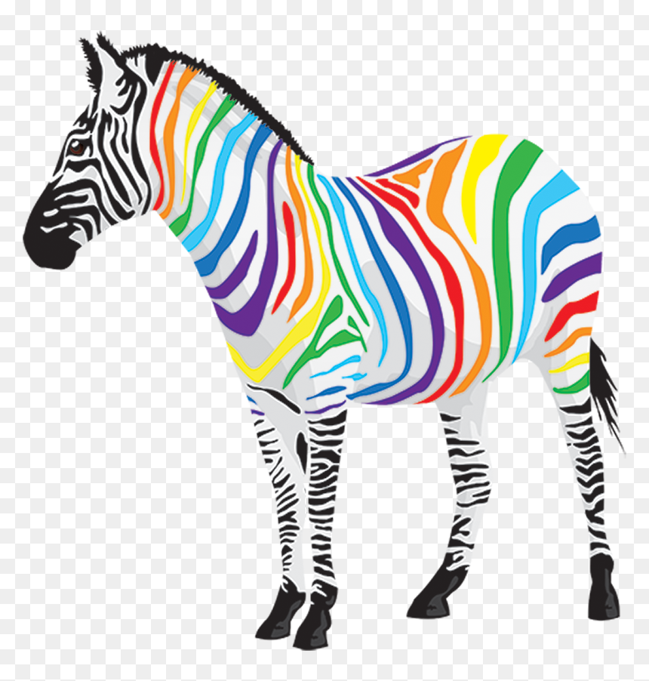
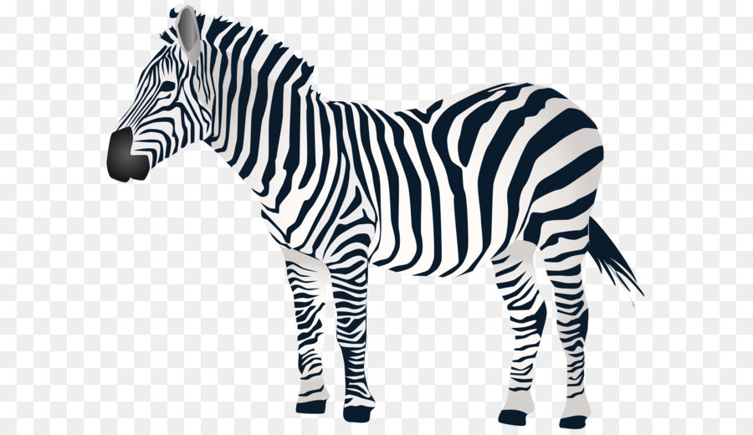
Loud reading by the teacher
WCW
Z
Zebra
z
zebra
Farjana Amin

Slide 16
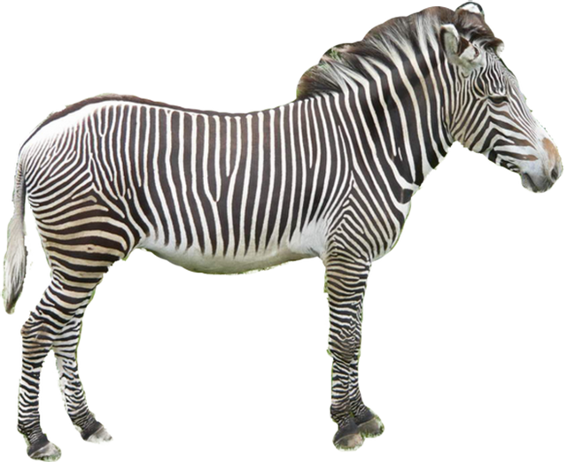
Match the pictures with the letters:
Group work
zebra
Z
z
Zebra
Farjana Amin

Slide 17
WCW
Say and read. Trace and write.
Z
Z
Z
z
z
z
Farjana Amin

Slide 18
Evaluation
Look and say. Write.
Look at the picture and fill in the gaps:
zebra
Farjana Amin

Slide 19
Evaluation
Write noncursive small letter “ z ”.
Farjana Amin

Slide 20
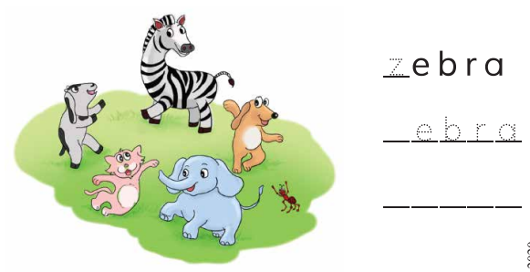
Evaluation
Fill in the gaps with correct letters.
_ebra
z
_
_
_
b
r
e
a
_
_
_

Slide 21
Good bye
Farjana Amin

