Slide 1
Welcome Everybody

Slide 2
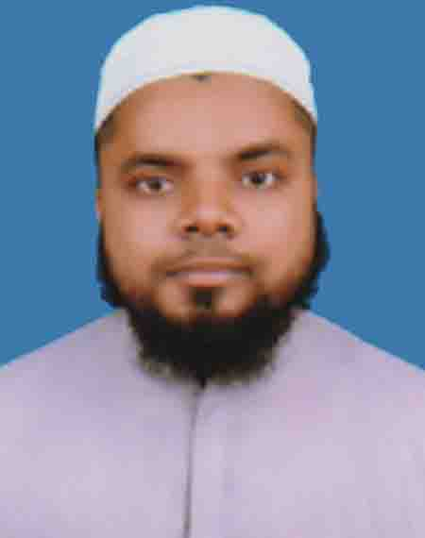
Introduction of the teacher
Md. Hasnain
Ibtedayi headteacher
Dakkhin Koralmara Hossainia Shatantra Ibtedayee Madrasa.
Tajumuddin, Bhola

Slide 3
Introduction of the lesson
Class:2
Unit: 24
Lesson: 1-3
Lesson title: Animals and where they live.

Slide 4
Learning Outcomes
Students will be able to-
Listening
1.1.1 repeat after the teacher simple words and phrases with proper sounds and stress.
Speaking
1.1.1 repeat after the teacher simple words and phrases with proper sounds and stress.
1.1.2 say simple words and phrases with proper sounds and stress.
Reading
1.4.1 read words and phrases with the help of visual clues(about 3o new words) and simple sentences.

Slide 5
Let’s listen a audio
Today we will read – Animals and where they live .

Slide 6
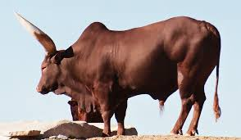
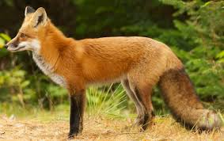
What’s this picture?
Ox
Fox

Slide 7
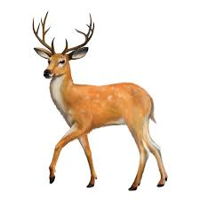
What’s this picture?
Deer

Slide 8
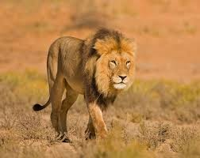
What’s this picture?
Lion

Slide 9
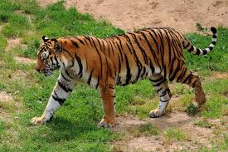
What’s this picture?
Tiger

Slide 10
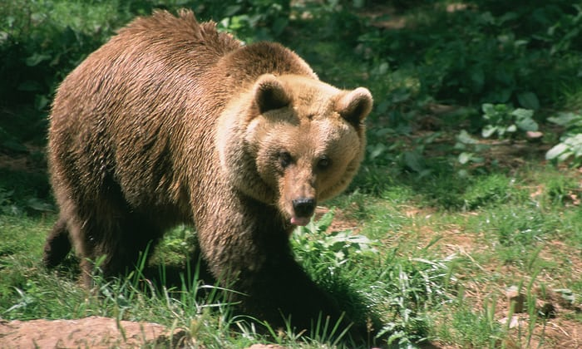
What’s this picture?
Bear

Slide 11
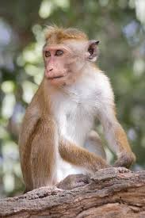
What’s this picture?
Monkey

Slide 12
What’s this picture?
Fox

Slide 13
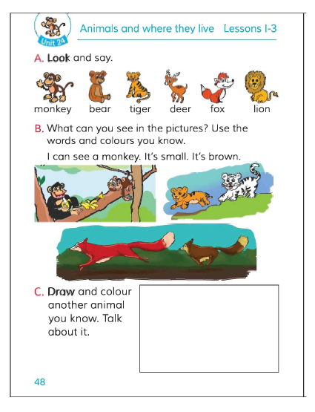
Now open your EFT book Page:48

Slide 14
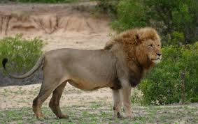
What can you see in this picture?
Monkey
Deer
Fox
Lion
Tiger
Bear

Slide 15
Which picture is missing?
Monkey
Deer
Fox
Bear
Lion
Tiger

Slide 16
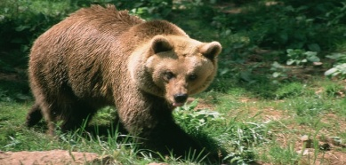
Match the picture with the word
Fox
Monkey
Bear
Tiger
Deer
Lion

Slide 17
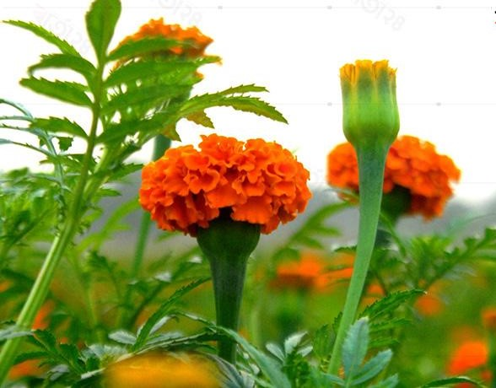
Thank You
See you again

