Slide 1
Welcome

Slide 2
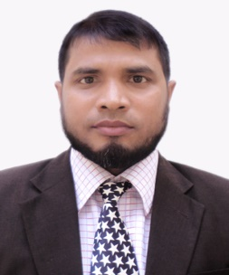
Teacher’s Identity
Md. Mahbub Alam
Asst: Teacher
Munsefpur Govt: Primary School
Rupdia, Sadar, Jashore.
mahbub_35@yahoo.com

Slide 3
Lesson Identity
Class: 2
Subject: English
Caption of the lesson : Alphabet
Unit: 2
Today’s Lesson : Look, listen and say

Slide 4
Learning Outcome
Student will be able to:
1.2.1 Recognize and read the alphabet both small and capital ( non-cursive)
1.3.1 Recognize and read the name of objects having the same initial and final sounds

Slide 5
Creat Safe Environment
https://www.youtube.com/watch?v=hq3yfQnllfQ

Slide 6
F
f
G
g
H
h
I
i
J
j

Slide 7
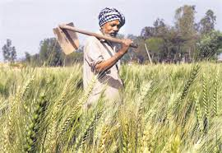
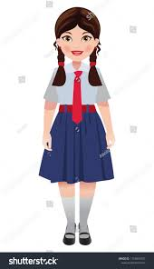
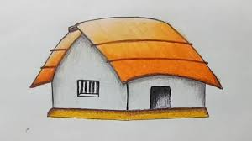
Farmer
Girl
Hut

Slide 8
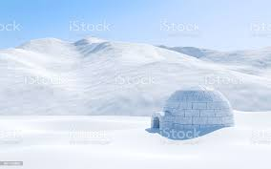
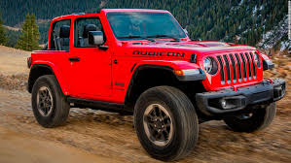
Igloo
Jeep

Slide 9
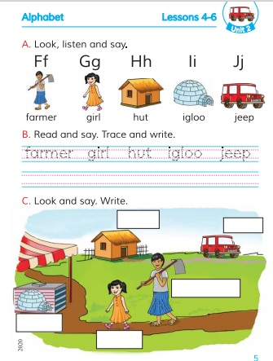
Open at page 5

Slide 10
Group Work
Group A: Matching the pictures with the word
Group B: Trace and write the words

Slide 11
hut
farmer
igloo
jeep
girl

Slide 13
Evaluation
hut
jeep
girl

Slide 14
Thank you All

