Slide 1
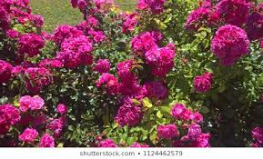
Welcome to Multimedia Class

Slide 2
Teachers information
Mazada Akter
Lecturer (English)
Barabor alim Madrasha
Class : X1
Subject : English Second paper

Slide 3
Let’s watch some images attentively

Slide 4
Can you guess what’s the today’s topic by watching this video and images?
Hakaluki Haor
Unit-12: Environment and Nature
Lesson-2 :The Hakaluki Haor
Part-2
Exactly, today’s topic is

Slide 5
Learning outcome
At the end of the lesson, students will be able to-
Increase vocabulary
Achieve the reading skill.
Answer the questions easily.

Slide 6
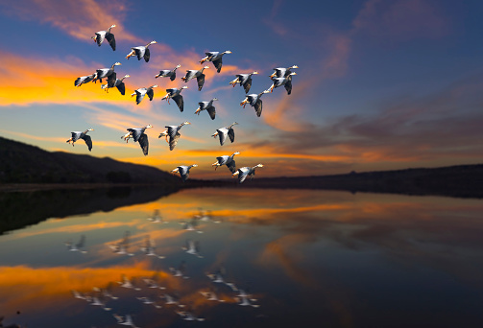
Migratory
Vocabulary
Mean: Denoting an animal that migrates.
Ex: Hakaluki Haor is a very important resting place of migratory birds.
Ant: Resident, Inhabitant

Slide 7
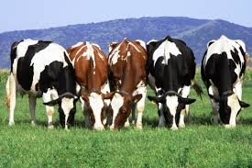
Grazing
Syn: Pasturage
Mean: Grassland suitable for pasturage.
Ex: Hakluki haor is a good grazing land in winter.

Slide 8
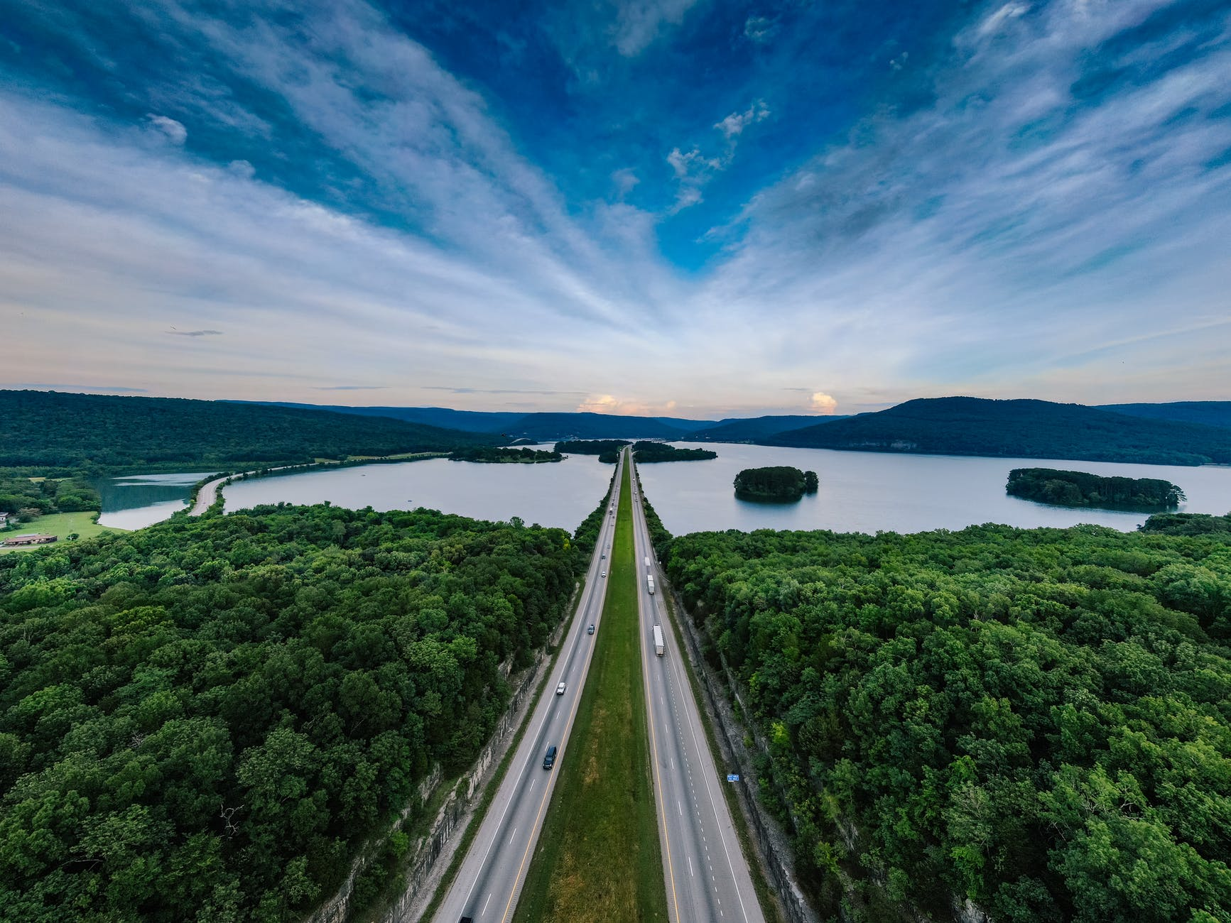
Landscape
Mean: All the visible features of an aea land.
Ex:There are many unique landscapes in our country .

Slide 9
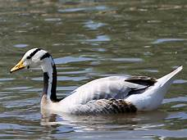
Now read the text
The haor is a very important resting place for migratory waterfowls flying in from the north. The most interesting species is the Barheaded Goose, which is now hardly seen in the fresh water wetlands. Many other important species of waterfowls make the Haor their temporary home.
waterfowls
Barheaded goose
Wetlands

Slide 10
Individual work
Fill in the blanks
Habitat
Hakaluki haor is a critical (a) and breeding ground for fish and other (b) spices. It is considered one of the (c) major mother fisheries of Bangladesh.More than100fish spices are(d) in the haor. Some of the major(e) important fishes are Rui, Kalibush, Mrigal, Boal. Katla Koi etc. The haor is also the (f) for globally significant(g) .Different types of(h) birds come to visit in (i) Migratory birds add
(j) to the haor.
aquatic
four
available
economically
home
waterfowls
migrating
Winter.
beauty

Slide 11
Pair work
Discuss ‘Hakaluki Haor’.

Slide 12
Evaluation
Answer the questions
Why do the people of distant areas make shelters there?
What bird species are seen in Hakaluki Haor in Winter?
How have the dense swamp forests been destroyed?
What economic benefits does the Haor provide to locals?
5.Describe the natural beauty ofHakaluki Haor?

Slide 13
Home work
Write a short paragraph on ‘Economic Evaluation Of Hakaluki Haor’.

Slide 14
Thank you so much
For watching

