Slide 1
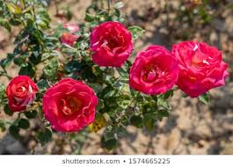
Welcome to Multimedia Class

Slide 2
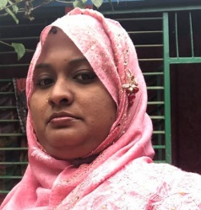
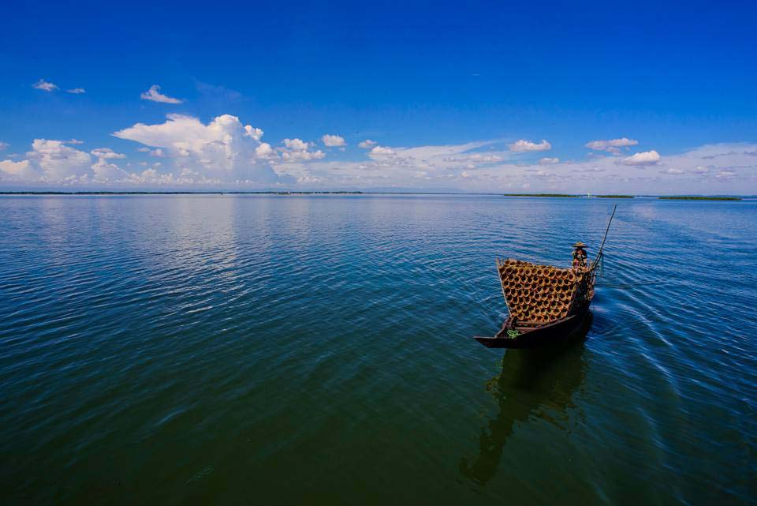
Teachers information
Mazada Akter
Lecturer (English)
Barabor alim Madrasha
Class : X
Subject : English First paper

Slide 3
Lesson Introduce
Class : X.
Subject : English first paper .
Unit : 7.
Lesson : 6. Love for humanity.(Mother Teresa)

Slide 4
Aims and objects:
At the end of the lesson the students will be able to.
Say about a famous woman of the world.
Know about her mission.
Write a paragraph on her.
Lesson declaration with previous test:
Look at the picture and answer the questions.

Slide 5
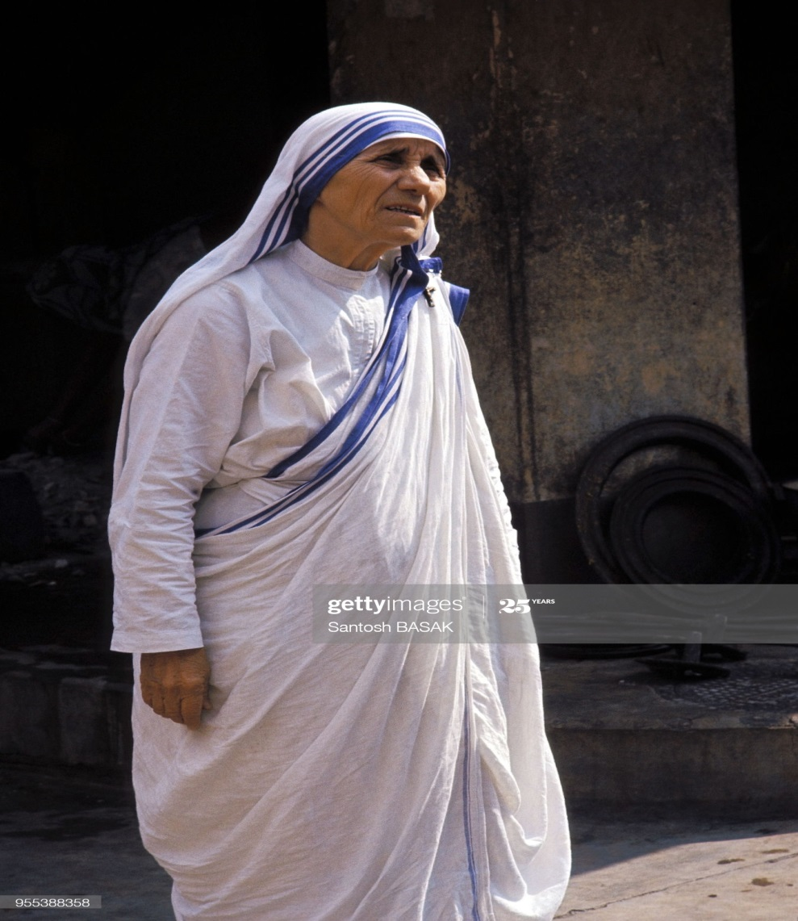
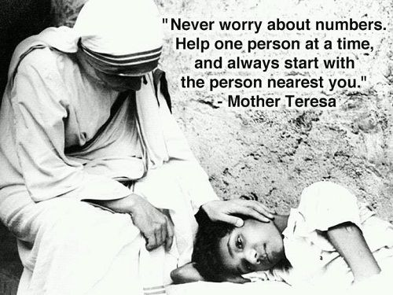
What have you seen in the pictures?
Ans: In the picture we have seen ----------------------
OK, fine.
Todays lesson is Love for humanity. (Mother Teresa).

Slide 6
Word meaning
Sick = Osusto
Dying = Mritu poth jatri
Fellow = Sati
Care = Jotno neya
Carry on = Chaliye jawa
Opportunity = Sujug
Kindness = Doya
Charity = Bodannota
Survive = Beche thaka
Recognize = sikriti deya
Extend = Prosharito kora
Salute = Obibadon

Slide 7
Open at page no 103 and read text B silently
Mother Teresa was moved by the sight of the sick and dying on the streets of Kolkata. She founded a home for the dying destitute and named it “Nirmal Hriday”, meaning pure heart. She and her fellow nuns brought the dying people off the streets of Kolkata to this home. They were lovingly looked after and cared for. Since then many men, women and children have been taken from the streets and carried to Nirmal Hriday. This unloved and uncared people get an opportunity to die in an environment of kindness and love. In their last hours they get human and divine love, and can feel they are also children of God. The missionaries of charity try to find jobs for those who survive, or send them to homes where they can live happily for some more years in a caring environment. Regarding commitment to family, Mother Teresa said, “May be in our own family, we have somebody, who is feeling to lonely, who is feeling sick, who is feeling worried. Are we there? Are we willing to give until it hurts in order to be with our families, or do we put our interest first? We must remember that love beings at home and we must also remember that future of humanity passes through the family”.
Mother Teresa’s work has been recognized throughout the world and she received a number of awards. These include the Pope xxiii peace prize(1971), the Nehru prize for promotion of international peace & understanding(1972), the Balzan prize(1978), the Nobel prize (1979), and the Bharat Ratna (1980).
Mother Teresa died at the age of 87, on 5 September 1997. The world salutes her for her love and compassion for humanity. She has taught us how to extend our hand towards those who need our love and support irrespective of creed, caste and religion. The picture of mother Teresa, draped in a white and blue bordered sari, with a wrinkled face, ever soft eyes and soft eyes and a saintly smile, lives on in our mind.

Slide 8
Use appropriate information from the text to complete The grid.
Mother Teresa
Event | Date
(a). Received the Nehru Prize
(b). Received the Nobel Prize
(c). Received the Bharat Ratna
(d). Died
(e). Born
Ans: a + 1972, b + 1979, c + 1980, d + 1997, e + 1910

Slide 9
Fill in the gaps with suitable words from the text.
Regarding commitment to (a) -------, Mother Teresa said, “May be in our (b) ----- family, we have somebody, who is (c) ------ to lonely, who is feeling sick, who is feeling worried. Are we there? Are we (d) ------ to give until it hurts in order to be with our families, or do we put our interest first? We must (e) ------ that love beings at home and we must also remember that future of humanity passes through the family”.
Ans: a = family, b = own, c = feeling, d = willing, f = remember,

Slide 10
Answer the following questions.
1 . What was founded by Mother Teresa?
2 . What was the mission of her life?
3 . What does “Nirmol Hridoy” stands for?
4 . Why do you think the home is named “Nirmol Hridoy”?
5 . What have we learnt from Mother Teresa?
Answer :
1 . A home named Nirmol Hridoy.
2 . Her mission was to love the people who are unloved and uncared.
3 . “Nirmol Hridoy” stands for pure heart.
4 . Because the unloved and uncared people were brought to the home and
after taking care of a long time they become complete healthy and happy. So the home is called Nirmol Hridoy.
5 . We have learnt from Mother Teresa that we all should love the creation of Allah. It is the best prayer to serve the human being and all other creation of the world.

Slide 11
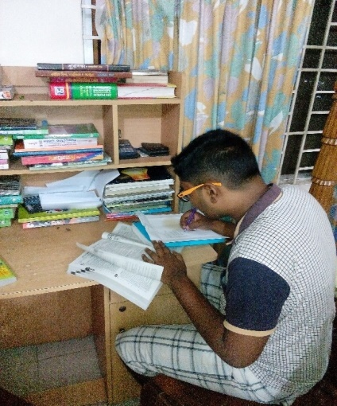
HOME WORK
Write the summary of the passage in not more than 100 words .

